Slide 1
Design and Analysis of Large Scale Log Studies
A CHI 2011 course v11
Susan Dumais, Robin Jeffries, Daniel M. Russell, Diane Tang, Jaime Teevan
CHI Tutorial, May, 2011

Slide 2
Introduction
Daniel M. Russell
Google

Slide 3
What Can We (HCI) Learn from Log Analysis?
Logs are the traces of human behavior
  … seen through the lenses of whatever sensors we have
Actual behaviors
  As opposed to recalled behavior
  As opposed to subjective impressions of behavior

Slide 4
Benefits
Portrait of real behavior… warts & all
  … and therefore, a more complete, accurate picture of ALL behaviors, including the ones people don’t want to talk about
Large sample size / liberation from the tyranny of small N
  Coverage (long tail) & Diversity
Simple framework for comparative experiments
Can see behaviors at a resolution / precision that was previously impossible
➔ Can inform more focused experiment design

Slide 5
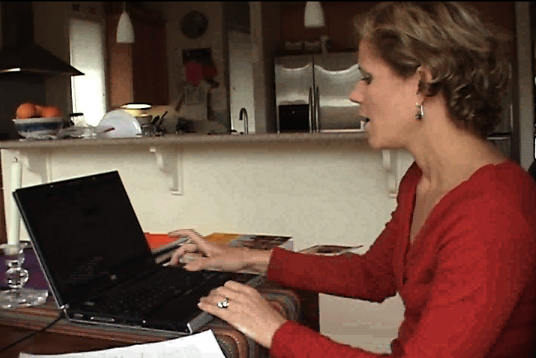
Drawbacks
Not annotated
Not controlled
No demographics
Doesn’t tell us the why
Privacy concerns
    AOL / Netflix / Enron / Facebook public
    Medical data / other kinds of personally identifiable data
00:32 …now I know…
00:35 … you get a lot of weird things..hold on…
00:38 “Are Filipinos ready for gay flicks?”
00:40 How does that have to do with what
I just….did...?
00:43 Ummm…
00:44 So that’s where you can get surprised…
you’re like, where is this… how does
this relate…umm…

Slide 6
What Are Logs for This Discussion?
User behavior events over time
  User activity primarily on web
    Edit history
    Clickstream
    Queries
    Annotation / Tagging
    PageViews
    … all other instrumentable events (mousetracks, menu events….)
  Web crawls (e.g., content changes)
    E.g., programmatic changes of content

Slide 7
How to Generate Logs
Use existing logged data
  Explore sources in your community (e.g., proxy logs)
  Work with a company (e.g., intern, visiting researcher)
  Construct targeted questions
Generate your own logs
  Focuses on questions of unique interest to you
Construct community resources
  Shared software and tools
    Client side logger (e.g., VIBE logger)
  Shared data sets
  Shared experimental platform to deploy experiments (and to attract visitors)
  Other ideas?

Slide 8
Interesting Sources of Log Data
Anyone who runs a Web services
Proxy (or library) logs at your institution
Publically available social resources
  Wikipedia (content, edit history)
  Twitter
  Delicious, Flickr
  Facebook public data?
Others?
  GPS
  Virtual worlds
  Cell call logs

Slide 9
Other Kinds of Large Data Sets
Mechanical Turk (may / may not be truly log-like)
  Other rater panels, particularly ones that generate behavioral logs
Medical data sets
Temporal records of many kinds…
  Example: logs from web servers for your web site
  Example: an app that generates logs
    a la the “instrumented Sketchup” application
    Akers, et al., 2009

Slide 10
Audience Discussion
What kind of logs do you need to analyze?
What kinds of logs does your work generate?
Open Discussion

Slide 11
Overview
Perspectives on log analysis
  Understanding User Behavior (Teevan)
  Design and Analysis of Experiments (Tang & Jeffries)
  Discussion on appropriate log study design (all)
Practical Considerations for log analysis
  Collection & storage (Dumais)
  Data Cleaning (Russell)
  Discussion of log analysis & HCI community (all)

Slide 12
Section 1:
Understanding User Behavior
Jaime Teevan & Susan Dumais
Microsoft Research

Slide 13
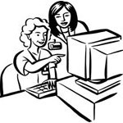

Kinds of User Data
User Studies Controlled interpretation of behavior with detailed instrumentation
User Panels In the wild, real-world tasks, probe for detail
Log Analysis No explicit feedback but lots of implicit feedback

Slide 14
Kinds of User Data
 | Observational
User Studies Controlled interpretation of behavior with detailed instrumentation | In-lab behavior observations
User Panels In the wild, real-world tasks, probe for detail | Ethnography, field studies, case reports
Log Analysis No explicit feedback but lots of implicit feedback | Behavioral log analysis
Goal: Build an abstract picture of behavior

Slide 15
Kinds of User Data
 | Observational | Experimental
User Studies Controlled interpretation of behavior with detailed instrumentation | In-lab behavior observations | Controlled tasks, controlled systems, laboratory studies
User Panels In the wild, real-world tasks, probe for detail | Ethnography, field studies, case reports | Diary studies, critical incident surveys
Log Analysis No explicit feedback but lots of implicit feedback | Behavioral log analysis | A/B testing, interleaved results
Goal: Build an abstract picture of behavior
Goal: Decide if one approach is better than another

Slide 16
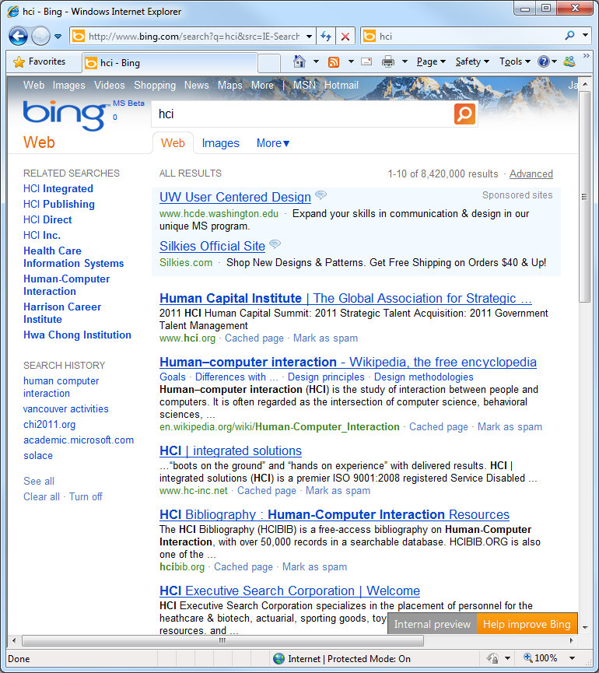
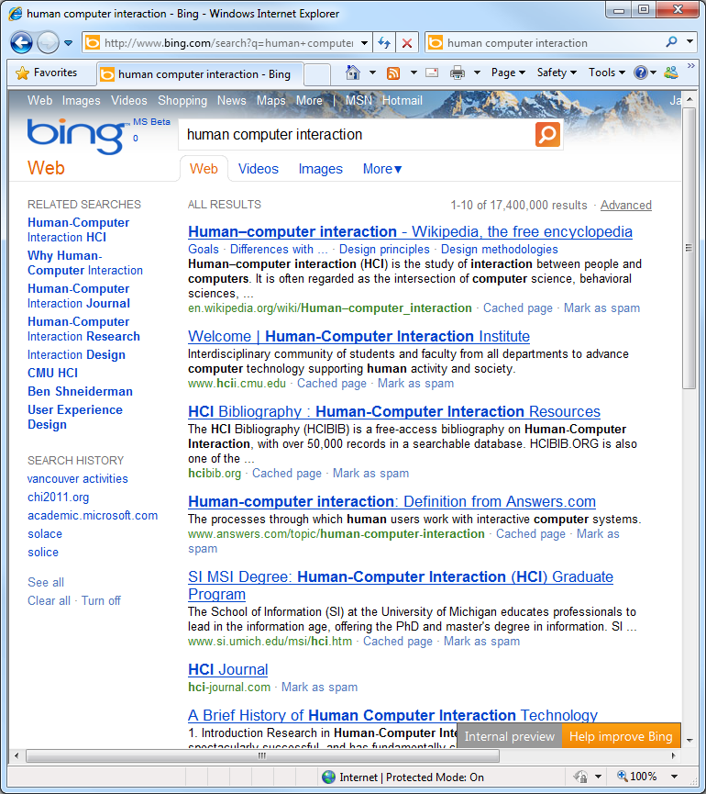
Web Service Logs
Example sources
  Search engine
  Commercial site
Types of information
  Queries, clicks, edits
  Results, ads, products
Example analysis
  Click entropy
  Teevan, Dumais and Liebling. To Personalize or Not to Personalize: Modeling Queries with Variation in User Intent. SIGIR 2008
Recruiting
Academic field
Government
contractor

Slide 17
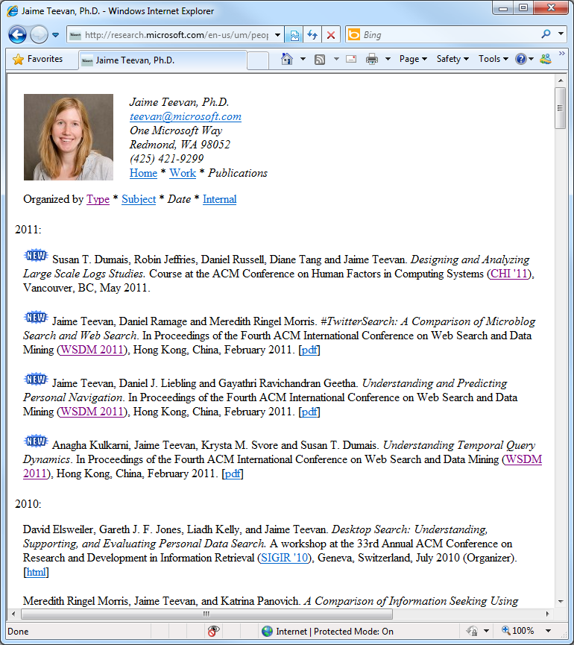
Web Browser Logs
Example sources
  Proxy
  Logging tool
Types of information
  URL visits, paths followed
  Content shown, settings
Example analysis
  Revisitation
  Adar, Teevan and Dumais. Large Scale Analysis of Web Revisitation Patterns. CHI 2008

Slide 18
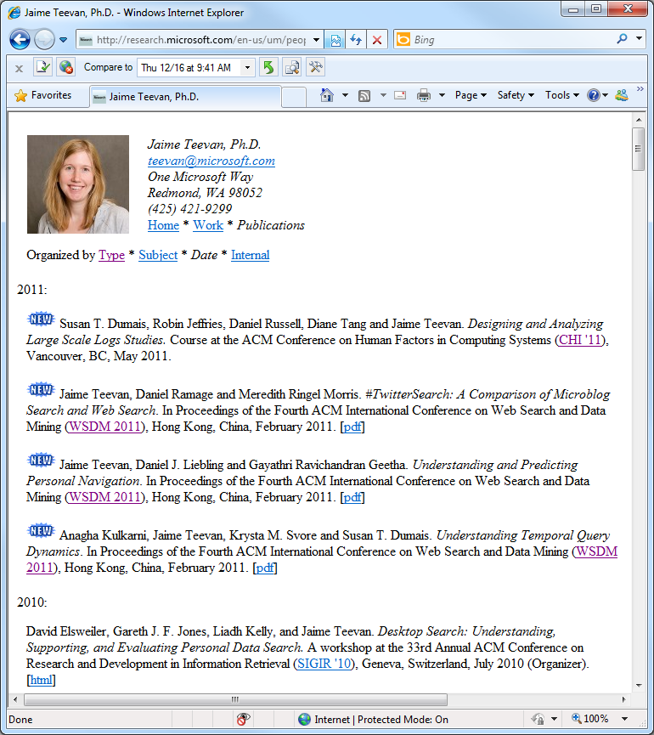
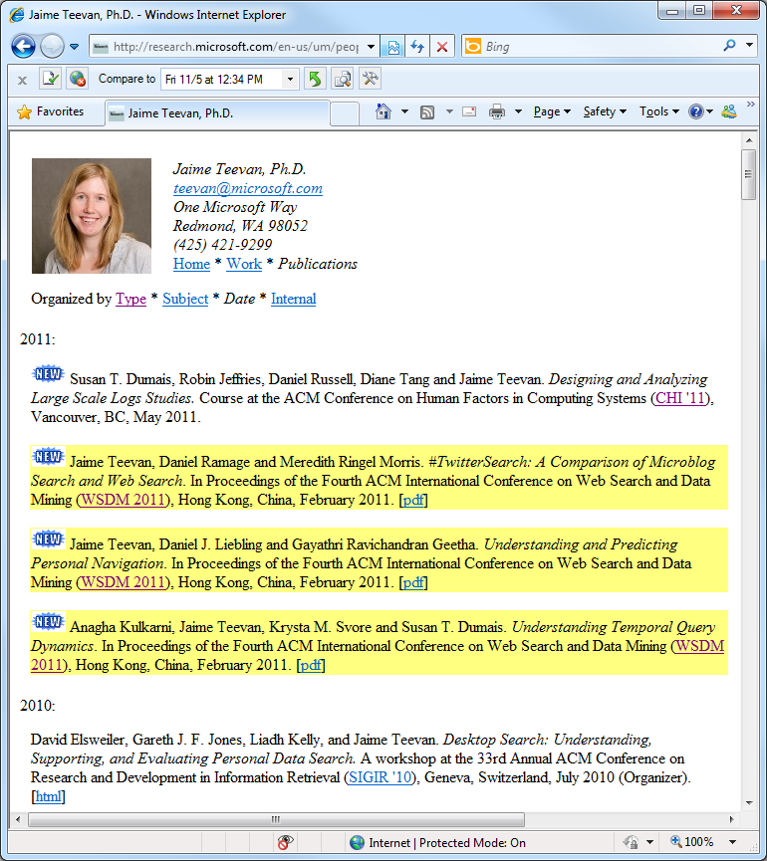
Web Browser Logs
Example sources
  Proxy
  Logging tool
Types of information
  URL visits, paths followed
  Content shown, settings
Example analysis
  DiffIE
  Teevan, Dumais and Liebling. A Longitudinal Study of How Highlighting Web Content Change Affects .. Interactions. CHI 2010

Slide 19
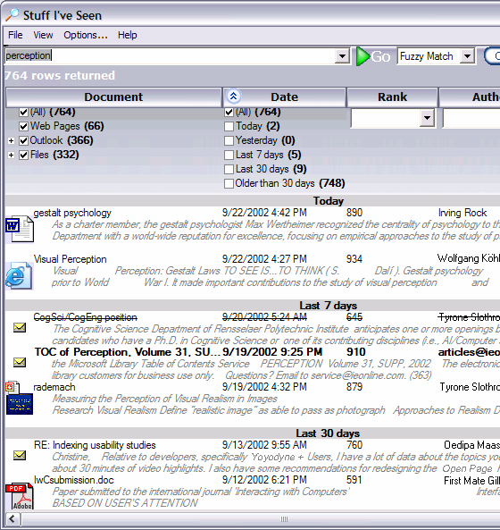
Rich Client-Side Logs
Example sources
  Client application
  Operating system
Types of information
  Web client interactions
  Other client interactions
Example analysis
  Stuff I’ve Seen
  Dumais et al. Stuff I've Seen: A system for personal information retrieval and re-use. SIGIR 2003

Slide 20
Logs Can Be Rich and Varied
Sources of log data
Types of information logged
Web service
  Search engine
  Commerce site
Web Browser
  Proxy
  Toolbar
  Browser plug-in
Client application
Interactions
  Queries, clicks
  URL visits
  System interactions
Context
  Results
  Ads
  Web pages shown

Slide 21
Using Log Data
What can we learn from log analysis?
What can’t we learn from log analysis?
How can we supplement the logs?

Slide 22
Using Log Data
What can we learn from log analysis?
  Now: About people’s behavior
  Later: Experiments
What can’t we learn from log analysis?
How can we supplement the logs?

Slide 23


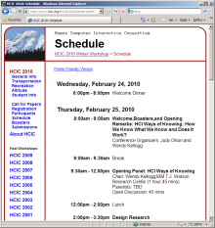
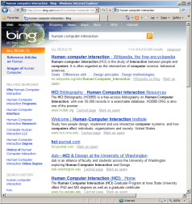

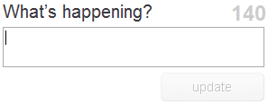

Generalizing About Behavior
Buttons clicks
Structured answers
Information use
Information needs
What people think
Feature
use
chi 2011
Human behavior

Slide 24
Generalizing Across Systems
Bing version 2.0
Bing use
Web search engine use
Search engine use
Information seeking
Build new features
Logs from a particular run
Logs from a Web search engine
From many Web search engines
From many search verticals
From browsers, search, email…
Build better systems
Build new tools

Slide 25
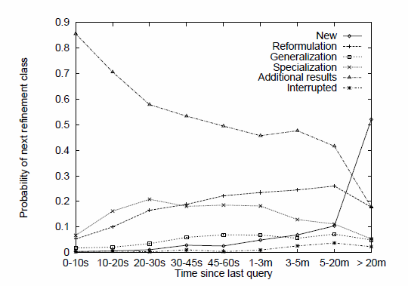

What We Can Learn from Query Logs
Summary measures
  Query frequency
  Query length
Analysis of query intent
  Query types and topics
Temporal features
  Session length
  Common re-formulations
Click behavior
  Relevant results for query
  Queries that lead to clicks
Queries appear 3.97 times
[Silverstein et al. 1999]
2.35 terms
[Jansen et al. 1998]
Navigational, Informational, Transactional
[Broder 2002]
Sessions 2.20 queries long
[Silverstein et al. 1999]
[Lau and Horvitz, 1999]
[Joachims 2002]

Slide 26
Query | Time | User
chi 2011 | 10:41am 2/18/10 | 142039
pan pacific hotel | 10:44am 2/18/10 | 142039
fairmont waterfront hotel | 10:56am 2/18/10 | 142039
chi 2011 | 11:21am 2/18/10 | 659327
restaurants vancouver | 11:59am 2/18/10 | 318222
vancouver bc restaurants | 12:01pm 2/18/10 | 318222
uist conference | 12:17pm 2/18/10 | 318222
chi 2011 | 12:18pm 2/18/10 | 142039
daytrips in bc, canada | 1:30pm 2/18/10 | 554320
uist 2011 | 1:30pm 2/18/10 | 659327
chi program | 1:48pm 2/18/10 | 142039
chi2011.org | 2:32pm 2/18/10 | 435451
mark ackerman | 2:42pm 2/18/10 | 435451
fairmont waterfront hotel | 4:56pm 2/18/10 | 142039
chi 2011 | 5:02pm 2/18/10 | 142039

Slide 27
Query | Time | User
chi 2011 | 10:41am 2/18/10 | 142039
pan pacific hotel | 10:44am 2/18/10 | 142039
fairmont waterfront hotel | 10:56am 2/18/10 | 142039
chi 2011 | 11:21am 2/18/10 | 659327
restaurants vancouver | 11:59am 2/18/10 | 318222
vancouver bc restaurants | 12:01pm 2/18/10 | 318222
uist conference | 12:17pm 2/18/10 | 318222
chi 2011 | 12:18pm 2/18/10 | 142039
daytrips in bc, canada | 1:30pm 2/18/10 | 554320
uist 2011 | 1:30pm 2/18/10 | 659327
chi program | 1:48pm 2/18/10 | 142039
chi2011.org | 2:32pm 2/18/10 | 435451
mark ackerman | 2:42pm 2/18/10 | 435451
fairmont waterfront hotel | 4:56pm 2/18/10 | 142039
chi 2011 | 5:02pm 2/18/10 | 142039
Query typology

Slide 28
Query | Time | User
chi 2011 | 10:41am 2/18/10 | 142039
pan pacific hotel | 10:44am 2/18/10 | 142039
fairmont waterfront hotel | 10:56am 2/18/10 | 142039
chi 2011 | 11:21am 2/18/10 | 659327
restaurants vancouver | 11:59am 2/18/10 | 318222
vancouver bc restaurants | 12:01pm 2/18/10 | 318222
uist conference | 12:17pm 2/18/10 | 318222
chi 2011 | 12:18pm 2/18/10 | 142039
daytrips in bc, canada | 1:30pm 2/18/10 | 554320
uist 2011 | 1:30pm 2/18/10 | 659327
chi program | 1:48pm 2/18/10 | 142039
chi2011.org | 2:32pm 2/18/10 | 435451
mark ackerman | 2:42pm 2/18/10 | 435451
fairmont waterfront hotel | 4:56pm 2/18/10 | 142039
chi 2011 | 5:02pm 2/18/10 | 142039
Query typology
Query behavior

Slide 29
Query | Time | User
chi 2011 | 10:41am 2/18/10 | 142039
pan pacific hotel | 10:44am 2/18/10 | 142039
fairmont waterfront hotel | 10:56am 2/18/10 | 142039
chi 2011 | 11:21am 2/18/10 | 659327
restaurants vancouver | 11:59am 2/18/10 | 318222
vancouver bc restaurants | 12:01pm 2/18/10 | 318222
uist conference | 12:17pm 2/18/10 | 318222
chi 2011 | 12:18pm 2/18/10 | 142039
daytrips in bc, canada | 1:30pm 2/18/10 | 554320
uist 2011 | 1:30pm 2/18/10 | 659327
chi program | 1:48pm 2/18/10 | 142039
chi2011.org | 2:32pm 2/18/10 | 435451
mark ackerman | 2:42pm 2/18/10 | 435451
fairmont waterfront hotel | 4:56pm 2/18/10 | 142039
chi 2011 | 5:02pm 2/18/10 | 142039
Uses of Analysis
Ranking
  E.g., precision
System design
  E.g., caching
User interface
  E.g., history
Test set development
Complementary research
Query typology
Query behavior
Long term trends

Slide 30
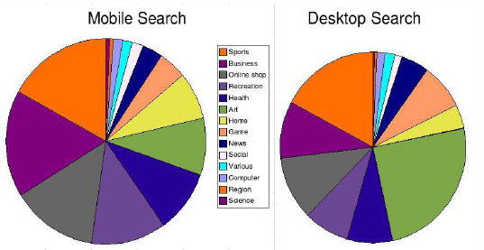
Partitioning the Data
Language
Location
Time
User activity
Individual
Entry point
Device
System variant
[Baeza Yates et al. 2007]

Slide 31
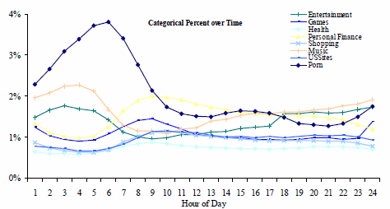
Partition by Time
Periodicities
Spikes
Real-time data
  New behavior
  Immediate feedback
Individual
  Within session
  Across sessions
[Beitzel et al. 2004]

Slide 32
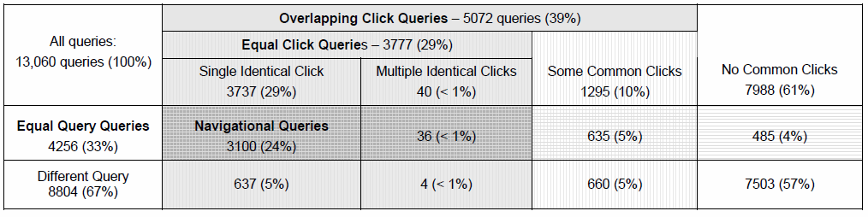
Partition by User
Temporary ID (e.g., cookie, IP address)
  High coverage but high churn
  Does not necessarily map directly to users
User account
  Only a subset of users
[Teevan et al. 2007]

Slide 33
What Logs Cannot Tell Us
People’s intent
People’s success
People’s experience
People’s attention
People’s beliefs of what’s happening
Limited to existing interactions
Behavior can mean many things

Slide 34
Example: Click Entropy
Question: How ambiguous is a query?
Approach: Look at variation in clicks.
[Teevan et al. 2008]
Click entropy
  Low if no variation
    human computer interaction
  High if lots of variation
    hci
Recruiting
Academic field
Government
contractor

Slide 35
Which Has Lower Variation in Clicks?
www.usajobs.gov v. federal government jobs
find phone number v. msn live search
singapore pools v. singaporepools.com
Results change
Click entropy = 1.5
Click entropy = 2.0
Result entropy = 5.7
Result entropy = 10.7

Slide 36
Which Has Lower Variation in Clicks?
www.usajobs.gov v. federal government jobs
find phone number v. msn live search
singapore pools v. singaporepools.com
tiffany v. tiffany’s
nytimes v. connecticut newspapers
Results change
Result quality varies
Click entropy = 2.5
Click entropy = 1.0
Click position = 2.6
Click position = 1.6

Slide 37
Which Has Lower Variation in Clicks?
www.usajobs.gov v. federal government jobs
find phone number v. msn live search
singapore pools v. singaporepools.com
tiffany v. tiffany’s
nytimes v. connecticut newspapers
campbells soup recipes v. vegetable soup recipe
soccer rules v. hockey equipment
Results change
Result quality varies
Task affects # of clicks
Click entropy = 1.7
Click entropy = 2.2
Clicks/user = 1.1
Clicks/user = 2.1

Slide 38
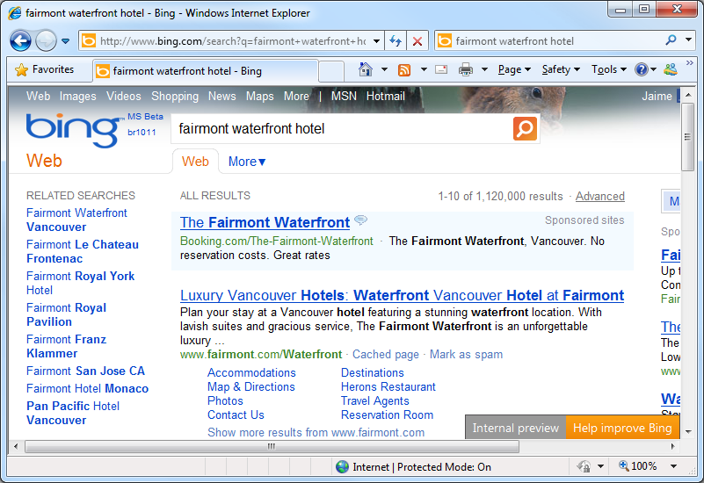
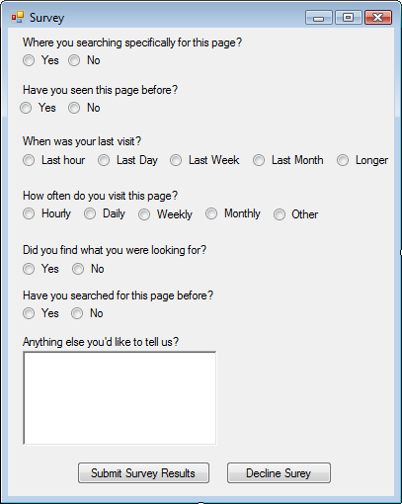
Dealing with Log Limitations
Look at data
Clean data
Supplement the data
  Enhance log data
    Collect associated information (e.g., what’s shown)
    Instrumented panels (critical incident, by individual)
  Converging methods
    Usability studies, eye tracking, surveys,
    field studies, diary studies
Query | Time | User
chi 2011 | 10:41am 2/18/10 | 142039
pan pacific hotel | 10:44am 2/18/10 | 142039
fairmont waterfront hotel | 10:56am 2/18/10 | 142039
chi 2011 | 11:21am 2/18/10 | 659327
restaurants vancouver | 11:59am 2/18/10 | 318222
vancouver bc restaurants | 12:01pm 2/18/10 | 318222
uist conference | 12:17pm 2/18/10 | 318222
Query | Time | User
chi 2011 | 10:41am 2/18/10 | 142039
pan pacific hotel | 10:44am 2/18/10 | 142039
fair | 10:55am 2/18/10 | 142039
fairmont | 10:55am 2/18/10 | 142039
fairmont water | 10:56am 2/18/10 | 142039
fairmont waterfront | 10:56am 2/18/10 | 142039
fairmont waterfront hotel | 10:56am 2/18/10 | 142039

Slide 39
Example: Re-Finding Intent
Large-scale log analysis of re-finding
[Tyler and Teevan 2010]
  Do people know they are re-finding?
  Do they mean to re-find the result they do?
  Why are they returning to the result?
Small-scale critical incident user study
  Browser plug-in that logs queries and clicks
  Pop up survey on repeat clicks and 1/8 new clicks
Insight into intent + Rich, real-world picture
  Re-finding often targeted towards a particular URL
  Not targeted when query changes or in same session

Slide 40
Summary: Understanding User Behavior
Log data gives a rich picture of real world behavior
There are many potential sources of log data
Partition the data to view interesting slices
Recognize what the data can and cannot tell you
Supplement logs with complementary data

Slide 41
Section 2: Design and Analysis of Experiments
Robin Jeffries & Diane Tang

Slide 42
What Do We Mean by an Experiment?
A change to the user experience, directly or indirectly
  Have a hypothesis
  Collect metrics to verify / nullify hypothesis
    Measurability is key!
Running on a live (web) app; data coming in from real users, doing their own tasks
Multiple arms, each providing different experiences
  At minimum, the new experience and the original control
  Can be an entire space of parameters with multiple values for each parameter
R

Slide 43
Example Changes and Hypotheses
Visible changes:
  Underlines: if I remove underlines, the page will be cleaner and easier to parse and users will find what they need faster
  Left Nav: by adding links to subpages, users will be able to better navigate the site
  Adding a new feature: the usage of this feature is better than what was previously shown in its place
Less visible changes:
  Ranking: if I change the order of the (search) results, users will find what they are looking for faster (higher up on the page)
R

Slide 44
Why Do Experiments?
To test your hypothesis
  In reality (or ultimately): gather data to make an informed, data-driven decision
Little changes can have big impacts. You won't know until you measure it.
With big changes, who knows what will happen. Your intuition is not always correct
Law of unintended side effects: what you wanted to impact gets better, but something else gets worse. You want to know that.
R

Slide 45
What Can We Learn from Experiments?
How (standard) metrics change
Whether/How often users interact with a new feature
How users interact with a new feature
Whether behavior changes over time. (learning/ habituation)
  But, remember, you are following a cookie, not a person
R

Slide 46
What Can’t We Learn from Experiments?
WHY: figuring out why people do things
  Need more direct user input
Tracking a user over time
  Without special tracking software: only have a cookie
  Cookie != user
Measuring satisfaction / feelings directly
  Only indirect measures (e.g., how often users return)
Did users even notice the change?
Did users tell their friends about feature x?
Did users get a bad impression of the product?
Did the users find the product enjoyable to use?
Is the product lacking an important feature?
Would something we didn't test have done better than what we did test?
Is the user confused and why?
R

Slide 47
Section Outline
Background
Experiment design:
  What am I testing & what am I measuring?
Experiment sizing:
  How many observations do I need?
Running experiments:
  What do I need to do?
Analyzing experiments:
  I’ve got numbers, what do they mean?
D

Slide 48
Basic Experiment Definitions
Incoming request R has:
  Cookie C
  Attributes A:
    Language, country, browser, etc.
Experiment:
  Diversion: is a request in the experiment?
    Unit of diversion: cookie vs. request
    May also depend on attributes
  Triggering: which subset of diverted requests does an experiment actually change (impact)?
    E.g., weather onebox vs. page chrome
    Page chrome: triggering == diversion
    Weather onebox: triggering << diversion
  On triggered requests, experiment changes what is served to the user
D

Slide 49
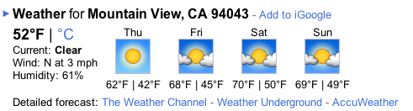

Examples: Weather Onebox vs. Page Chrome
D

Slide 50
Experiment Design
What decision do you want to make?
3 interlinked questions:
  What do you want to test?
    What is the space you will explore/what factors will you vary?
  What hypotheses do you have about those changes?
  What metrics will you use to test these hypotheses?
How will you make your decision?
  Every outcome should lead to a decision
R

Slide 51
Decisions, Goals, Underlying Assumptions
Ultimately: have a goal, make a decision
  Goal: improve the user experience
    Assumption: if users find what they are looking for faster, then the user experience is improved
    Decision: Will making the page less cluttered change how quickly users find what they want?
  Goal: increase feature usage
    Decision: Will changing the appearance of links on the page increase the click through to this feature?
  Goal: increase time on site
    Decision: Will adding dancing hamsters to the page lead visitors to spend more time on the site?
R

Slide 52
Changes: Design Space
Which factors do you want to vary?
  E.g., layout, positioning, features, colors, size, etc.
Practical:
  Are there options that are unacceptable?
    E.g., Blue text on blue background
  Full-factorial (all possible combinations) or not?
    Analysis isn’t easy for non-full factorial design
    More arms in full factorial → increase in total work
    Experiment size & number of arms can be an issue for full factorial
  Confounds/nuisance factors
    Not always possible to isolate: have a plan
    Example: images coming from a separate server, which sometimes goes down, so image is not shown. Want to treat those requests differently than the requests that produce the intended results
R

Slide 53
Example: Video Inclusions
  Show a playable thumbnail of a video in web results for highly ranked video results
  Explore different visual treatments for thumbnails and different levels of triggering the thumbnail
  Treatments:
    Thumbnail on right and conservative triggering
    Thumbnail on right and aggressive triggering
    Thumbnail on left and conservative triggering
    Thumbnail on left and aggressive triggering
    Control (never show thumbnail; never trigger)
→ Note: this is not a complete factorial experiment
(should have 9 conditions)
R

Slide 54
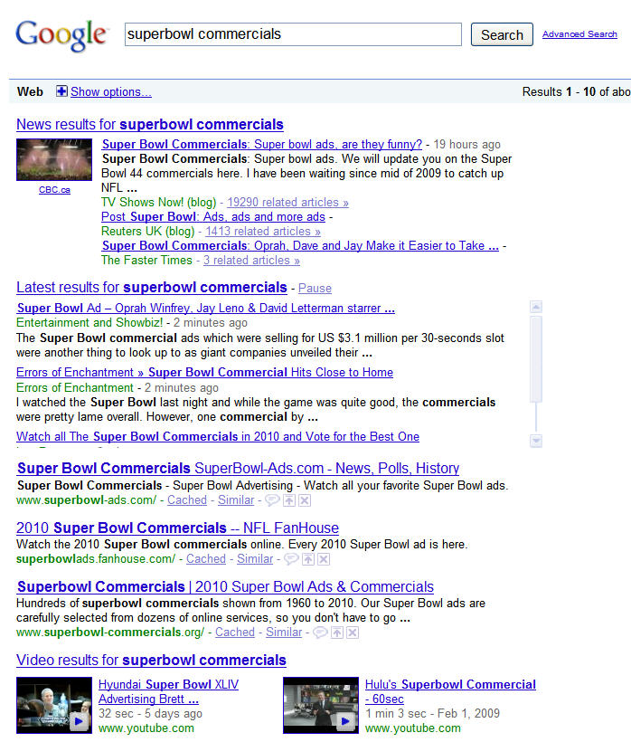
Video
Inclusions
R

Slide 55
Hypotheses
Given the proposed changes, what effects do you expect to see?
  More concrete than “it will be cool”
  Will it impact what users do, how often they do it, how long it will take, their satisfaction?
How will you measure these changes?
  What vs. why
  Hypotheses ➔ metrics
R

Slide 56
Metrics
Which metrics?
  Often lots of metrics
    What vs. why; need a suite of metrics to answer multiple questions
    Some matter all the time: overall usage, whole page parsing, etc.
    Some matter to your hypothesis:
      “Increased feature usage”: click through rate, bounce rate, etc.
      “Easier to parse”: time to first action
  Metrics may “disagree”
    Is TTR (time to result) faster, but success lower?
    Is TTR faster, but users never come back?
    Is TTR faster, but only for a subset of users (who overwhelm the metric)?
How big of a change in the metrics matter?
  Statistical vs. practical significance
R

Slide 57
Putting It Together: Experiments
Given the decisions and space of possible changes:
  Get set of possible arms
For each arm, what are the hypotheses & metrics?
  How different are the hypotheses?
  Which hypotheses are measurable?
  Do we need to run all possible arms to make the decision?
Given this smaller set of arms, now come the practical issues:
  How big do the arms need to be to get reasonable metrics? Given that, how many arms can I actually run?
  What else do I need to think about in order to actually run an experiment?
R

Slide 58
Experiment Sizing: Overview
Metrics
  Power: How big a change do you want to detect? How many observations will you need in order to detect that change?
Triggering
  How much of the incoming traffic is actually affected?
Power + Triggering ➔ How big your experiment is
  How many arms you can run concurrently?
  How big is each arm?
  What is the exposure risk (if this is a product)?
D

Slide 59
Power
Power is the probability that when there really is a difference, you will statistically detect it
Power depends on:
  What you want to measure
  Size of difference you want to be able to detect
  Standard error of the measurement
  Number of observations
Power can (and should be) calculated before you run the experiment
  Too many studies where it was discovered after the fact that there wasn't enough power to detect the effect of interest
  There are standard formulas, e.g., en.wikipedia.org/wiki/Statistical_power
D

Slide 60
Power Example: Variability Matters
 | Effect Size (% change you care about) | Standard Error | Observations Required
Metric A | 1% | 4.4 | 4,100,000
Metric B | 1% | 7.0 | 10,300,000
D

Slide 61
Power: Variance of Logs Data
Logs data has high variance
  Users vary widely: sophistication, language, strategy, etc.
  Tasks vary widely
Independence assumptions may not hold
  Cookies vs. requests
    Sequence of events from a cookie are correlated
      If I clicked on a “show more” link before, I’m more likely to do it again
      If I queried for a topic before, I’m more likely to query for that topic again
      If I search a lot today, I’m more likely to search a lot tomorrow
    Interacts with metrics (request-based metric vs. cookie-based metric)
    Changes variance
How to measure variance
  Globally: A1 vs. A2 vs. … experiments
  Per-experiment: pre-periods and post-periods
D

Slide 62
Sizing and Triggering
Triggering: what fraction of traffic actually shows the change?
Power calculation: need X requests to detect change of C%
Triggering fraction: expt. affects Y (fraction) of requests
Actual experiment size: X / Y
Approach valid only if counterfactuals are logged in the control
  Experiment: when does weather onebox show?
  Control: when would weather onebox have shown? (counterfactual)
  In some cases, you can’t identify the counterfactual cases, and you have to calculate metrics on the full set of (diluted) data
If no counterfactual, need to measure (C * Y)% change in metric on all traffic
  The smaller Y is, the more dilution you have
D

Slide 63
Experiment Sizing: Example
Metric Standard Error | Trigger Rate | Effect Size on Affected Traffic | Needed Queries (Affected) | Queries Needed in Expt. (Counterfactuals Logged) | Effect Size if No Counterfactuals (Measured on All Traffic) | Queries Needed in Expt. (No Counterfactuals Logged)
5 | 1% | 10% | 52,500 | 5,250,000 | 0.1% (10% * 1%) | 525,000,000
5 | 5% | 10% | 52,500 | 1,050,000 | 0.5% (10% * 5%) | 21,000,000
5 | 20% | 10% | 52,500 | 262,500 | 2% (10% * 20%) | 1,312,500
5 | 50% | 10% | 52,500 | 105,000 | 5% (10% * 50%) | 210,000
D

Slide 64
Sizing: Other Design Choices
How long will you need to run your experiment, given your sizing calculations?
  How many arms do you have?
  How much traffic can you devote to your experiment arms?
Power vs. risk trade-offs
  How many users are you willing to impact? (suppose it’s a terrible user experience – how many users do you want to annoy?)
  Risk of exposure (for potential new products)
  Sequential vs. simultaneous arms
    Sequential reduces risk, but introduces analysis issues such as seasonality and other timing issues (holidays, major weather event)
How many days?
  Shorter means faster, but units of weeks smooth out day of week effects
D

Slide 65
Within-subject vs. Between-subject
Within-subject:
  Has lower variance: need less traffic to get significant metrics
  Two options:
    Within-results: interleaved results (e.g., search results)
      Within-results is inherently within subject
    Within-subject: time slicing – show expt. and control at different times
  Interleaved: very useful, but primarily for ranking changes
    Same number of results, no UI changes
  Time-slicing: within-user variance lower, but users may have different tasks, be on different OS/browsers, in different locations, etc.
Between-subject: More broadly useful, but higher variance, will need more traffic
D

Slide 66
Running Experiments
Selecting a population (diversion)
Controls
R

Slide 67
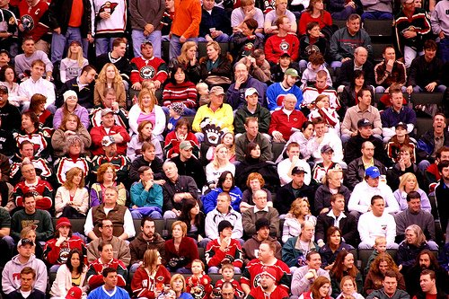
Selecting a Population
A population is a set of people
  In particular location(s)
  Using particular language(s)
  During a particular time period
  Doing specific activities of interest
Important to consider how those choices might impact your results
  Chinese users vs. US users during Golden Week
  Sports related change during Super Bowl week in US vs. UK
  Users in English speaking countries vs. users of English UI vs. users in US
R

Slide 68
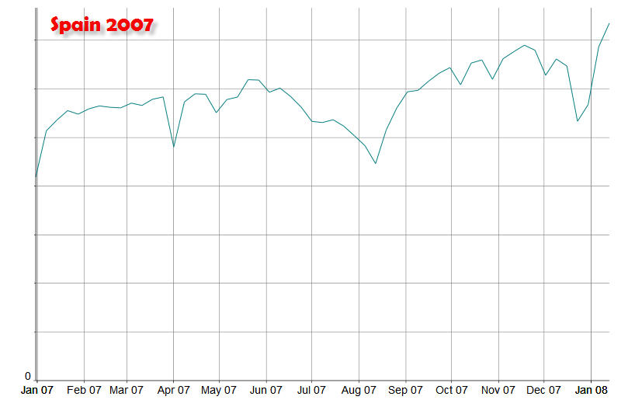
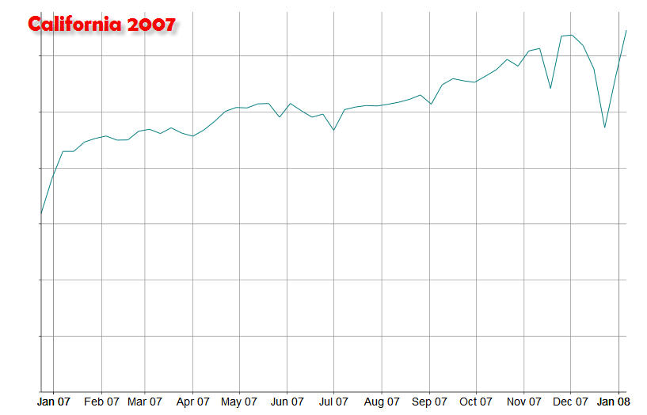
R

Slide 69
Controls
A control is the standard user experience that you are comparing a change to
What is the right control?
  Gold standard:
    Equivalent sample from same population
    Doing similar tasks
    Using either:
      The existing user experience
      A baseline “minimal” “boring” user experience
R

Slide 70
How Controls Go Wrong
Treatment is opt-in
Treatment or control limited to subset (e.g., treatment only for English, control world-wide)
Treatment and control at different times
Control is all the data, treatment is
limited to events that showed something novel (no counterfactual)
Not logging counterfactuals at experiment time.
  Often very hard to reverse-engineer later
  Gives a true apples-to-apples comparison
  But, not always possible (e.g., if what-to-display decisions are being made "on the fly")
R

Slide 71
Analyzing Experiments
Sanity checking
Metrics, confidence intervals, slicing
Mix vs. metric shifts
D

Slide 72
Sanity Checking
Before looking at the metrics to draw conclusions, make sure that you believe the numbers!
E.g., overall traffic
  Very few changes impact overall traffic
  Number of cookies, % of traffic
Break data down along different dimensions / slicings
  E.g., do you see different effects with different browsers? In different countries?
Things that can screw things up
  Bots visiting your site (did you mess with them?)
  If you got mentioned in a blog, did that cause a traffic spike
Don't bother looking at other metrics unless sanity checks pass!
D

Slide 73
Managing Real World Challenges
Data from all around the world
  E.g., collecting data for a given day (start/end times differ), collecting "daytime" data
One-of-a-kind events
  Death of Michael Jackson/Anna Nicole Smith
  Problems with data collection server
  Data schema changes
Multiple languages
  Practical issues in processing many orthographies
  E.g., dividing into words to compare query overlap
  Restricting language:
    Language ≠ country
    Query language ≠ UI language
D

Slide 74
When is a Metric Change Significant?
Confidence interval (C.I.): interval around the treatment mean that contains the true value of the mean x% (typically 95%) of the time
C.I.s that do not contain the control mean are statistically significant (statistically different from the control)
This is an independent test for each metric
  Thus, you will get 1 in 20 results (for 95% C.I.s) that are spurious -- you just don't know which ones
C.I.s are not necessarily straightforward to compute.
D

Slide 75
How to Interpret Significant Metrics
If you look at enough metrics, something will be significant by chance.
  Confidence interval only tells you there is a 95% chance that this difference is real; not 100%
  If only a few things significant, is chance the likely explanation?
  Look for converging evidence (many metrics are correlated; do all the metrics correlated with this one move in the same direction?)
If your parameters are continuous, you may be able to interpolate or extrapolate to other values (e.g., 1” submit button vs. 2”; how would 1.5” do?)
You can miss significance because the true difference is tiny/zero or because you don’t have enough power
  If you did your sizing right, you have enough power to see all the differences of practical significance
D

Slide 76
More on Metrics
Your experiment may have diverted on 10% of events, but only triggered on 20% of those events.
  Which denominator are you using?
It’s obvious to look at the metrics that apply to your specific change, but what about the overall impact?
  E.g., if your change slows things down, those who stay may have a great experience, but what about those who left?
Slicing up the data
  Country, language, browser, etc.
  Great way to understand the effects better
    Is most of the change coming from users of browser X; in country Y?
Need to be careful re: mix vs. metric shifts (Simpson’s paradox)
D

Slide 77
Simpson’s Paradox:
Simultaneous Mix and Metric Changes
Batting averages
    Changes in mix (denominators) make combined metrics (ratios) inconsistent with yearly metrics
 | 1995 | 1996 | Combined
Derek Jeter | 12/48 .250 | 183/582 .314 | 195/630 .310
David Justice | 104/411 .253 | 45/140 .321 | 149/551 .270
D

Slide 78
More on Simpson’s Paradox
Neither the individual data (the yearly metrics) or the combined data is inherently more correct
  It depends, of course, on what your hypothesis is
Once you have mix changes (changes to the denominators across subgroups), all metrics (changes to the ratios) are suspect
  Always compare your denominators across samples
  Maybe the point of the experiment was to produce a mix change
  Can you restrict analysis to the data not impacted by the mix change (the subset that didn't change)?
  Minimally, be up front about this in any writeup
D

Slide 79
Detailed Analysis ➔ Big Picture
Not all effects will point the same direction
  Take a closer look at the items going in the "wrong" direction
    Can you interpret them?
      E.g., people are doing fewer next-pages because they are finding their answer on the first page
    Could they be artifactual?
    What if they are real?
      What should be the impact on your conclusions? on your decision?
Significance and impact are not the same thing
  Couching things in terms of % change vs. absolute change helps
  A substantial effect size depends on what you want to do with the data
D

Slide 80
Summary:
Critical Steps When Designing Experiments
Determine your hypotheses
Decide on which metrics
Size your experiment
  Take the triggering fraction into account
    If at all possible, identify the counterfactual events in the control
Sanity check your data
Make sure you have enough power to not miss effects of interest; look for converging evidence to keep from acting on spuriously significant results
Don’t get bit by Simpson’s Paradox
R

Slide 81
Discussion
All

Slide 82
Our story to this point…
Perspectives on log analysis
  Understanding user behavior Jaime
    What you can / cannot learn from logs
    Observations vs. experiments
    Different kinds of logs
  How to design / analyze large logs Robin & Diane
    Selecting populations
    Statistical Power
    Treatments
    Controls
    Experimental error

Slide 83
Discussion
How might you use logs analysis in your research?
What other things might you use large data set analysis to learn?
  Time-based data vs. non-time data
Large vs. small data sets?

Slide 84
Section 3: Practical Considerations for Log Analysis

Slide 85
Overview
Data collection and storage [Susan Dumais]
  Logging the data
  Storing the data
  Using the data responsibly
Data analysis [Daniel M. Russell]
  How to clean the data
Discussion: Log analysis and the HCI community

Slide 86
Section 3A:
Data Collection, Storage and Use
Susan Dumais and Jaime Teevan
Microsoft Research

Slide 87
Overview
Logging the data
Storing the data
Using the data responsibly
Building large-scale systems out-of-scope

Slide 88
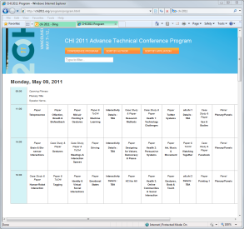
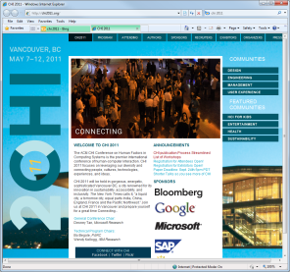
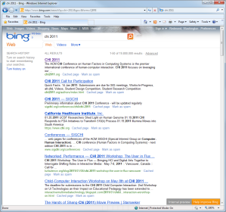
A Simple Example
Logging search Queries and Clicked Results
dumais
beijing
sigir 2011
Web Service
vancouver
“SERP”
chi 2011
Web Service
Web Service

Slide 89
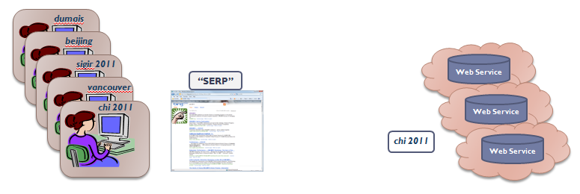
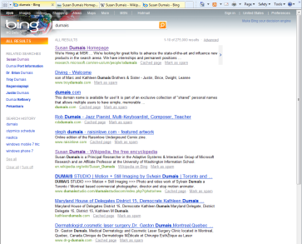
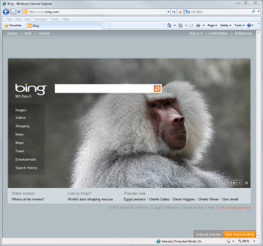
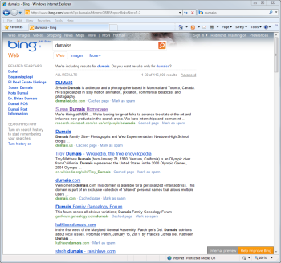


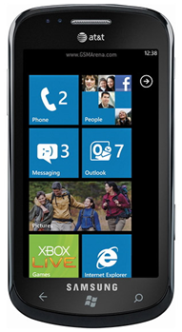

A Simple Example (cont’d)
Logging Queries
  Basic data: <query, userID, time>
    Which time? time_{Client.send}, time_{Server.receive}, time_{Server.send}, time_{Client.receive}
  Additional contextual data:
    Where did the query come from?
    What results were returned?
    What algorithm or presentation was used?
    Other metadata about the state of the system

Slide 90
A Simple Example (cont’d)
Logging Clicked Results (on the SERP)
  How can a Web service know which SERP links are clicked?
    Proxy re-direct
    Script (e.g., JavaScript)
      Dom and cross-browser challenges, but can instrument more than link clicks
    No download required; but adds complexity and latency, and may influence user interaction
  What happened after the result was clicked?
    What happens beyond the SERP is difficult to capture
    Browser actions (back, open in new tab, etc.) are difficult to capture
    To better interpret user behavior, need richer client instrumentation
http://www.chi2011.org vs. http://redir.service.com/?q=chi2011&url=http://www.chi2011.org/&pos=3&log=DiFVYj1tRQZtv6e1FF7kltj02Z30eatB2jr8tJUFR
<img border="0" id="imgC" src=“image.gif" width="198" height="202" onmouseover="changeImage()" onmouseout="backImage()">
<script lang="text/javascript">
function changeImage(){ document.imgC.src="thank_you..gif “; }
function backImage(){ document.imgC.src=“image.gif"; }
</script>

Slide 91
Browsers, Tabs and Time
Interpreting what happens on the SERP
Scenario 1:
  7:12 SERP shown
  7:13 click R1
  <“back” to SERP>
  7:14 click R5
  <“back” to SERP>
  7:15 click RS1
  <“back” to SERP>
  7:16 go to new search engine
Scenario 2
  7:12 SERP shown
  7:13 click R1
    <“open in new tab”>
  7:14 click R5
    <“open in new tab”>
  7:15 click RS1
    <“open in new tab”>
  7:16 read R1
  10:21 read R5
  13:26 copies links to doc
Both look the same, if all you capture is clicks on result links
Important to distinguish to interpret user behavior
  Tabbed browsing accounted for 10.5% of clicks [Weinreich et al. 2006]
  81% of observed search sequences are ambiguous [Viermetz et al. 2006]

Slide 92
Richer Client Instrumentation
Toolbar (or other client code)
  Richer logging (e.g., browser events, mouse/keyboard events, screen capture, eye-tracking, etc.)
  Several HCI studies of this type [e.g., Kellar et al., Cutrell et al.]
  Importance of robust software, and data agreements
Instrumented panel
  A group of people who use client code regularly; may also involve subsequent follow-up interviews
  Nice mix of in situ use (the what) and support for further probing (the why)
  E.g., Curious Browser [Fox et al., next slide]
Data typically recorded on the client
  Still needs to get logged centrally on a server

Slide 93
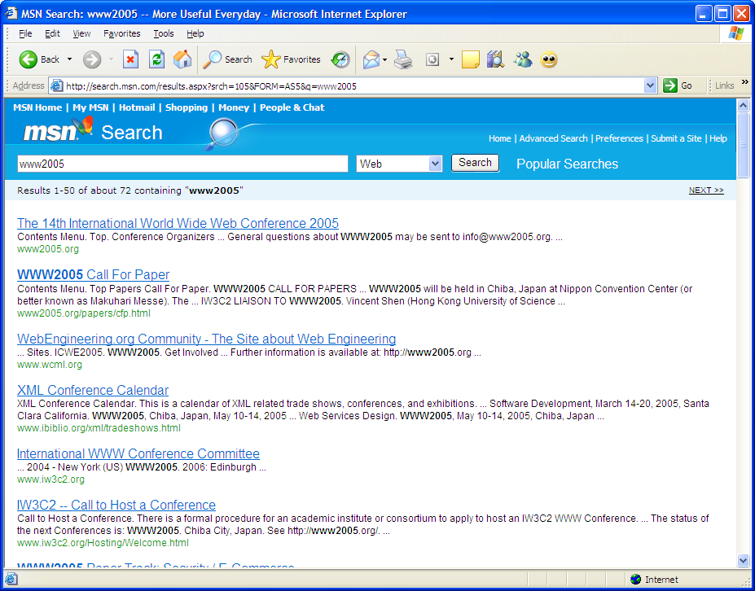
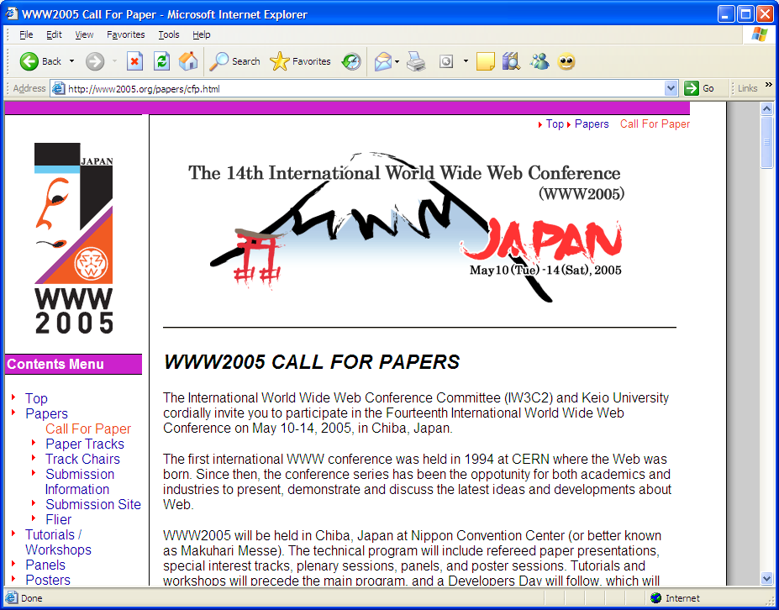
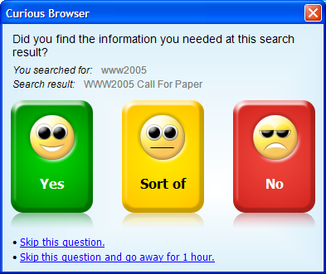
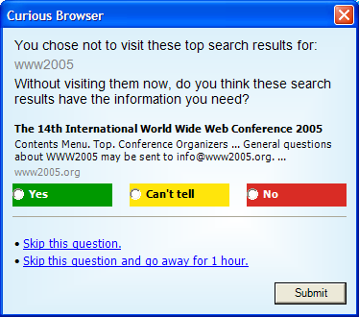
Example: Curious Browser [Fox et al. 2005]
Browser plug-in to examine relationship between implicit and explicit behavior
  Capture many implicit actions (e.g., click, click position, dwell time, scroll)
  Probe for explicit user judgments of relevance of a page to the query
Deployed to ~4k people in US and Japan
Learned models to predict explicit judgments from implicit indicators
  45% accuracy w/ just click; 75% accuracy w/ click + dwell + session
Used to identify important features; then apply model in open loop setting

Slide 94
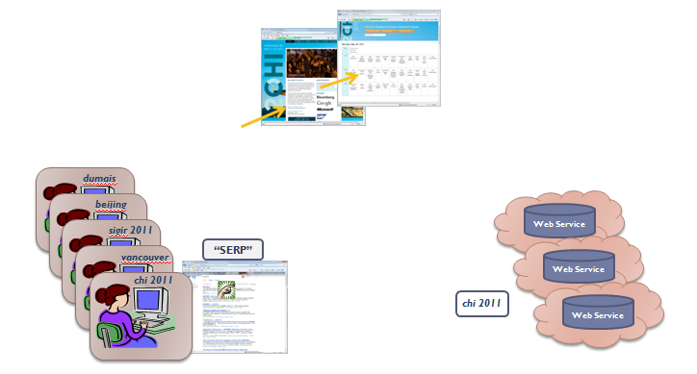
A (Not-So-) Simple Example
Logging: Queries, Clicked Results, and Beyond

Slide 95
Setting Up Server-side Logging
What to log?
  Log as much as possible
  But … make reasonable choices
    Richly instrumented client experiments can provide some guidance
    Pragmatics about amount of data, storage required will also guide
What to do with the data?
  The data is a large collection of events, often keyed w/ time
    E.g., <time, userID, action, value, context>
  Keep as much raw data as possible (and allowable)
  Post-process data to put into a more usable form
    Integrating across servers to organize the data by time, userID, etc.
    Normalizing time, URLs, etc.
    Richer data cleaning [see next section]

Slide 96
A Few More Important Practical Issues
Time
Scale
Identifying “Users”
Data Privacy and Security

Slide 97
Time (and Time Again)
Time
  Client time is closer to the user, but can be wrong or reset
  Server time includes network latencies, but controllable
  In both cases, need to synchronize time across multiple machines
  Data integration
    Ensure that joins of data are all using the same basis (e.g., UTC vs. local time)
  Accurate timing data is critical for understanding the sequence of user activities, daily temporal patterns, etc.

Slide 98
Issues of Scale
Data Collection
  Storage requirements
    E.g., 1k bytes/record x 10 records/query x 100 mil queries/day = 1000 Gb/day
  Network bandwidth
    Client to server; Data center to data center
Data Analysis
  What are MapReduce, Hadoop, Pig all about?
    MapReduce – framework for processing huge datasets on compute clusters
      Key idea: partition problem into pieces which can be done in parallel
      Map: take input, and divide it into sub-problems which can be distributed
      Reduce: collect results, and combine them to get final answer
    Hadoop - open-source implementation of MapReduce
    Pig - execution engine on top of Hadoop
  Why would you want to use them?
  How can you use them?

Slide 99
How is a User Identified?
Http cookies, IP address, temporary ID
  Provides broad coverage and easy to use, but …
  Multiple people use same machine
  Same person uses multiple machines (and browsers)
    How many cookies did you use today?
  Lots of churn in these IDs
    Jupiter Res (39% delete cookies monthly); Comscore (2.5x inflation)
Login, or Download of client code (e.g., browser plug-in)
  Better correspondence to people, but …
  Requires sign-in or download
  Results in a smaller and biased sample of people or data (who remember to login, decided to download, etc.)
Either way, loss of data

Slide 100
Using the Data Responsibly
What data is collected and how it can be used?
  User agreements (terms of service)
  Emerging industry standards and best practices
Trade-offs
  More data:
    More intrusive and potential privacy concerns, but also more useful for understanding interaction and improving systems
  Less data:
    Less intrusive, but less useful
Risk, benefit, and trust

Slide 101
Using the Data Responsibly (cont’d)
Control access to the data
  Internally: Access control; data retention policy
  Externally: Risky (e.g., AOL, Netflix, Enron, Facebook public)
Protect user privacy
  Directly identifiable information
    Social security, credit card, driver’s license numbers
  Indirectly identifiable information
    Names, locations, phone numbers … you’re so vain (e.g., AOL)
    Putting together multiple sources indirectly (e.g., Netflix, hospital records)
      Linking public and private data
      k-anonymity; Differential privacy; etc.

Slide 102
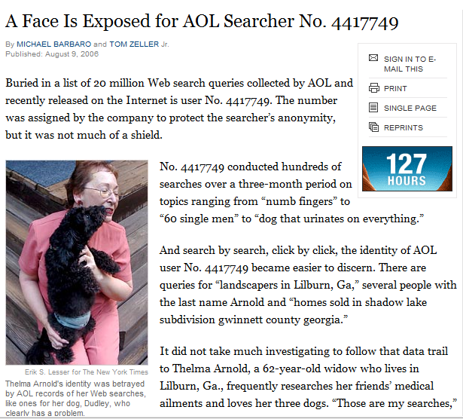
Example: AOL Search Dataset
Indirectly identifiable information
  Names, locations, phone numbers … you’re so vain
AOL released data to academic community Aug 4, 2006
  Anonymized query-click logs - 3 months; 650k users; 20mil searches
  <AnonID, Query, QueryTime, ItemRank, ClickURL>
A few days later … a New York Times story
  A Face Is Exposed for AOL Searcher No. 4417749 (Aug 9, 2006)
    Aug 21, 2006: Two employees fired; CTO resigns
  The road from ID 4417749 to Thelma Arnold, a 62 year old woman living in GA
    Multiple queries for businesses and services in Lilburn, GA. (n ~ 11k people)
    Multiple queries for Jarrett Arnold (and other members of the Arnold clan)
    NYT contacted all people in Lilburn with the last name Arnold (n=14)
    When contacted, Thelma Arnold acknowledged that these were her queries
  AnonID Query QueryTime ItemRank ClickURL
  ---------- --------- --------------- ------------- ------------
  1234567 uist 2006 2006-04-04 18:18:18 1 http://www.acm.org/uist/uist2006/
  1234567 uist 2006 deadline 2006-04-04 18:18:18 3 http://www.acm.org/uist/uist2006/
  1234567 chi 2006-04-24 09:19:32
  1234567 chi 2006 2006-04-24 09:20:04 2 http://chi2006.org
  1234567 chi program 2006-04-24 09:25:50 2 http://www.chi2006.org/docs/finalprogram2006.pdf
  1234567 perlman montreal 2006-04-24 10:15:14 4 http://oldwww.acm.org/perlman/guide.html
  1234567 uist 2006 notif ication 2006-05-20 13:13:13
  …

Slide 103
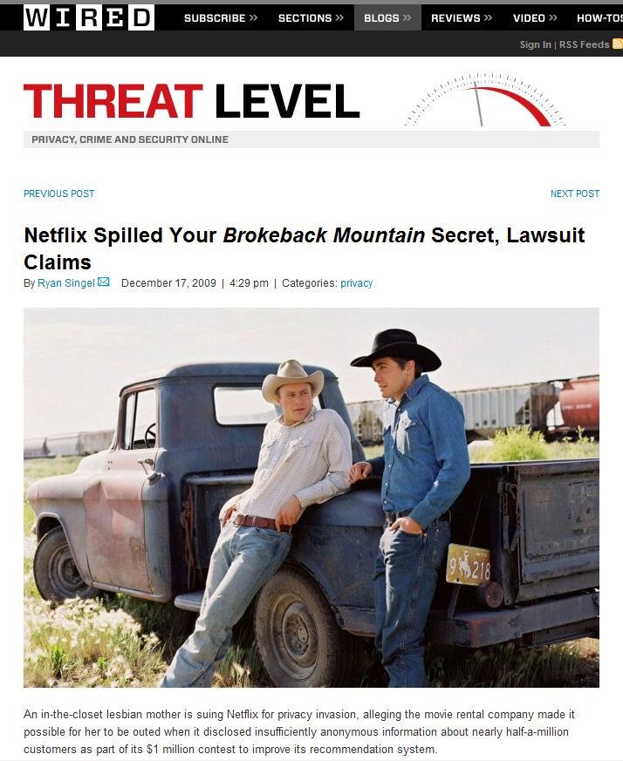
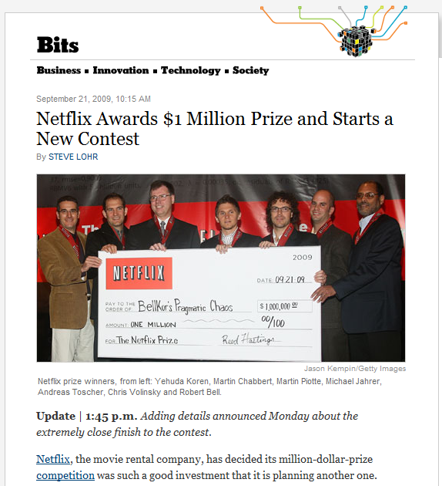
Example: Netflix Challenge
Indirectly identifiable information
  Putting together multiple sources indirectly
    Linking public and private data; and k-anonymity
Netflix Challenge announced Oct 2, 2006, $1million prize
  100 million ratings, from 480k people, for 17k movies
  <UserID, Rating, DateOfRating, Movie, MovieYear, MovieName>
  Sept 21, 2009 – Grand Prize award to BellKor’s Pragmatic Chaos
  A few years … later
    A. Narayanan, V. Shmatikov. (2008) Robust De-anonymization of Large Sparse Datasets. IEEE Symposium on Security and Privacy 2008, 111–125.
      Data de-anonymized using background knowledge from IMDB
      Robust to perturbations in data
    Dec 17, 2009 – Doe v. Netflix
    Mar 12, 2010 – Second Netflix competition cancelled
  Ratings
  ----------
  1: [Movie 1 of 17770]
  12, 3, 2006-04-18 [CustomerID, Rating, Date]
  1234, 5 , 2003-07-08 [CustomerID, Rating, Date]
  2468, 1, 2005-11-12 [CustomerID, Rating, Date]
  …
  Movie_Titles
  -----------------
  ...
  10120, 1982, “Bladerunner”
  …
  17690, 2007, “The Queen”
    From Netflix FAQ
“No, all customer identifying information has been removed; all that remains are ratings and dates. This follows our privacy policy [. . . ] Even if, for example, you knew all your own ratings and their dates you probably couldn’t identify them reliably in the data because only a small sample was included (less than one tenth of our complete dataset) and that data was subject to perturbation. Of course, since you know all your own ratings that really isn’t a privacy problem is it?”

Slide 104
Using the Data Responsibly (cont’d)
Control access to the data
  Internally: Access control; data retention policy
  Externally: Risky (e.g., AOL, Netflix, Enron, Facebook public)
Protect user privacy
  Directly identifiable information
    Social security, credit card, driver’s license numbers
  Indirectly identifiable information
    Names, locations, phone numbers … you’re so vain (e.g., AOL)
    Putting together multiple sources indirectly (e.g., Netflix, hospital records)
      Linking public and private data
      k-anonymity; Differential privacy; etc.
Transparency and user control
  Publicly available privacy policy
  Give users control to delete, opt-out, etc.

Slide 105
Summary
Data collection and storage
  Logging the data
    At the server
    On the results page
    Richer client-side logging
  Storing the data
    Challenges of: time, scale, users
  Using the data responsibly
    Controlling access to data
    Protecting privacy
    Providing transparency and user control
Data analysis [Daniel Russell]
  Cleaning the data

Slide 106
Section 3B:
Data cleaning for large logs
Daniel M. Russell

Slide 107
Why Clean Log Data?
The big false assumption: Isn’t log data intrinsically clean?
  A: Nope.

Slide 108
Typical Log Format
210.116.18.93 - - [23/Jan/2005:13:37:12 -0800]
“GET /modules.php?name=News&file=friend&op=FriendSend&sid=8225 HTTP/1.1" 200 2705
"http://www.olloo.mn/modules.php?name=News&file=article&catid=25&sid=8225" "Mozilla/4.0
(compatible; MSIE 6.0; Windows NT 5.1; SV1)“ …
– Client IP - 210.126.19.93
– Date - 23/Jan/2005
– Accessed time - 13:37:12
– Method - GET (to request page ), POST, HEAD (send to server)
– Protocol - HTTP/1.1
– Status code - 200 (Success), 401,301,500 (error)
– Size of file - 2705
– Agent type - Mozilla/4.0
– Operating system - Windows NT
http://www.olloo.mn/modules.php?name=News&file=article&catid=25&sid=8225 →
→ http://www.olloo.mn/modules.php?name=News&file=friend&op=FriendSend&sid=8225
What this really means… A visitor (210.126.19.93) viewing the news who sent it to friend.

Slide 109
Sources of Noise
Non-completion due to caching (back button)
Also… tabs… invisible…
  Also – new browser instances.
C.html
D.html
E.html
B.html
F.html
Topological Structure
Path completion
Clicks
Reality
H.html
J.html
A.html
G.html
I.html
K.html
A,B,C,D,F
A,B,C,D,C,B,F
L.html
M.html
O.html
Q.html
N.html
P.html

Slide 110
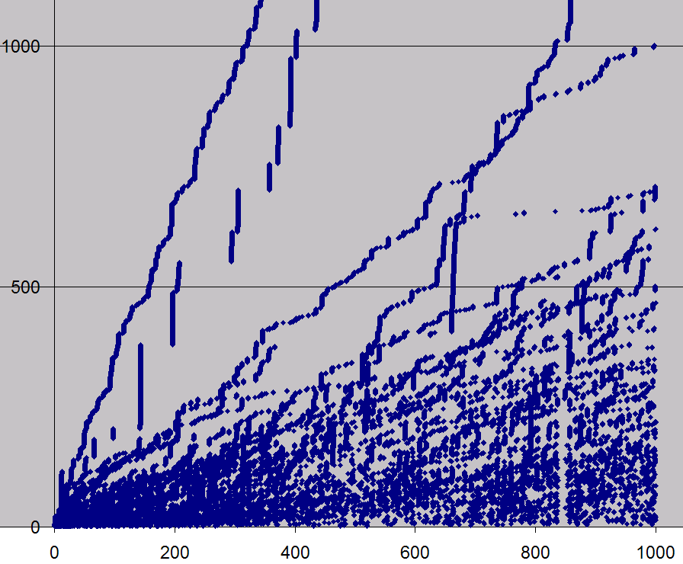
A Real Example
A previously unknown gap in the data
Sum number of
clicks against
time
Time (hours)

Slide 111
What We’ll Skip…
Often data cleaning includes
(a) Input / value validation
(b) Duplicate detection / removal
    We’ll assume you know how to do that
  (c) Multiple clocks – syncing time across servers / clients
  But… note that valid data definitions often shift out from under you. (See schema change later)

Slide 112
When Might You NOT Need to Clean Data?
Examples:
  When the data is going to be presented in ranks.
    Example: counting most popular queries. Then outliers
    are either really obvious, or don’t matter
  When you need to understand overall behavior for system purposes
    Example: traffic modeling for queries—probably don’t want to remove outliers because the system needs to accommodate them as well!

Slide 113
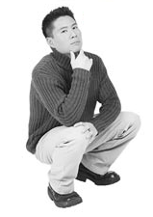
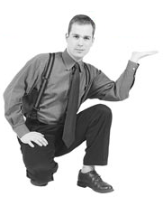
Before Cleaning Data
Consider the point of cleaning the data
  What analyses are you going to run over the data?
  Will the data you’re cleaning damage or improve the analysis?
How about we remove all the short click queries?
So…what DO I want to learn from this data?

Slide 114
Importance of Data Expertise
Data expertise is important for understanding the data, the problem and interpreting the results
  Often.. .background knowledge particular to the data or system:
    “That counter resets to 0 if the number of calls exceeds N”.
    “The missing values are represented by 0, but the default amount is 0 too.”
Insufficient DE is a common cause of poor data interpretation
DE should be documented with the data metadata

Slide 115
Outliers
Often indicative either of
  Measurement error, or that the population has a heavy-tailed distribution.
  Beware of distributions with highly non-normal distributions
    Be cautious when using tool or intuitions that assume a normal distribution (or, when sub-tools or models make that assumption)
    A frequent cause of outliers is a mixture of two distributions, which may be two distinct sub-populations

Slide 116
Outliers: Common Types from Search
Quantity:
  10K searches from the same cookie in one day
  Suspicious whole numbers: exactly 10,000 searches from single cookie

Slide 117
Outliers: Common Types from Search
Quantity:
  10K searches from the same cookie
  in one day
  Suspicious whole numbers:
  exactly 10,000 searches from single
  cookie
Repeated:
  The same search repeated over-frequently
  The same search repeated at the same time (10:01AM)
  The same search repeated at a repeating interval (every 1000 seconds)
Time of day | Query
12:02:01 | [ google ]
13:02:01 | [ google ]
14:02:01 | [ google ]
15:02:01 | [ google ]
16:02:01 | [ google ]
17:02:01 | [ google ]

Slide 118
Treatment of Outliers: Many Methods
Remove outliers when you’re looking for average user behaviors
  Methods:
    Error bounds, tolerance limits – control charts
    Model based – regression depth, analysis of residuals
    Kernel estimation
    Distributional
    Time Series outliers
    Median and quantiles to measure / identify outliers
Sample reference:
Exploratory Data Mining and Data Quality, Dasu & Johnson (2004)

Slide 119

Identifying Bots & Spam
Adversarial environment
How to ID bots:
  Queries too fast to be humanoid-plausible
  High query volume for a single query
  Queries too specialized (and repeated) to be real
  Too many ad clicks by cookie

Slide 120
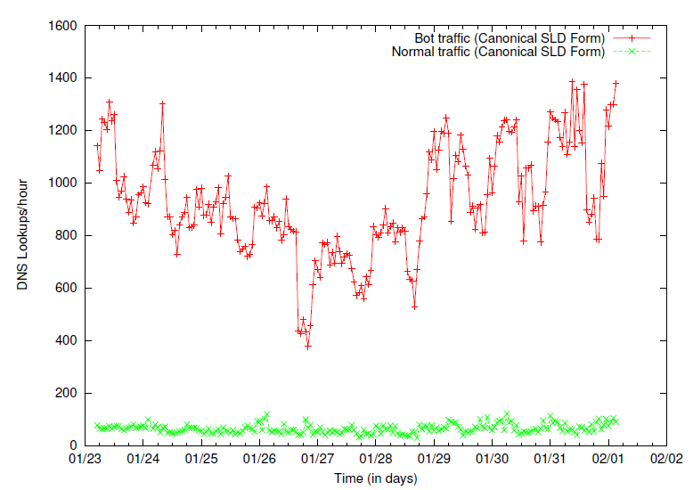
Bot Traffic Tends to Have
Pathological Behaviors
Botnet Detection and Response
The Network is the Infection
David Dagon, OARC Workshop 2005,
Such as abnormally high page-request or DNS lookup rates

Slide 121
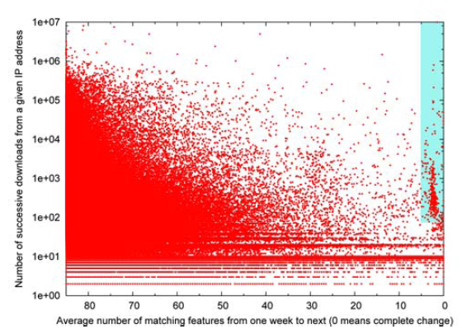
How to ID Spam
Spam, Damn Spam, and Statistics: Using statistical analysis to locate spam web pages. D. Fetterly, M. Manasse and M. Najork. 7th Int’l Workshop on the Web and Databases, June 2004.
  Look for outliers along different kinds of features
    Example: click rapidity, interclick time variability,
Spammy sites often change many of their features
(page titles, link anchor text, etc.) rapidly week to week

Slide 122
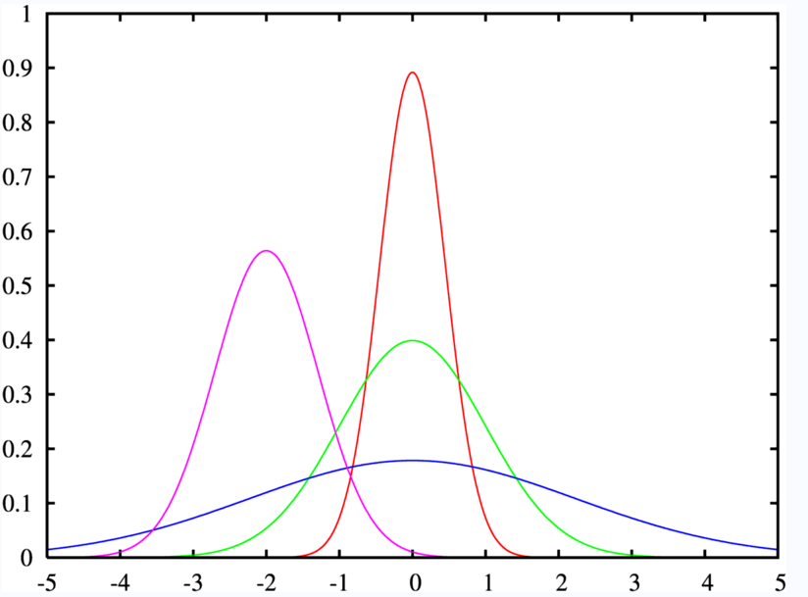
Bots / Spam Clicks Look Like Mixtures
Although bots tend to be tightly packed and far from the large mass of data

Slide 123
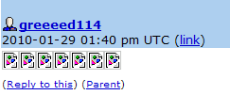
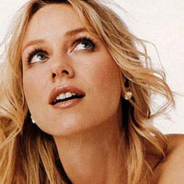
Story About Spam…
98.3% of queries for [naomi watts] had no click
Checking the referers of these queries led us to a cluster of LiveJournal users
img src="http://www.google.ru/search?q=naomi+watts...
What??
Comment spam by greeed114. No friends, no entries. Apparently trying to boost Naomi Watts on IMDB, Google, and MySpace.

Slide 124
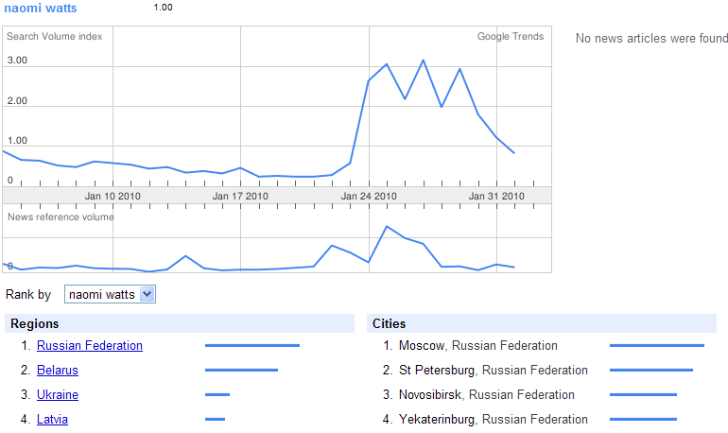
Did it Work?

Slide 125
Cleaning Heuristics:
Be Sure to Account for Known Errors
Examples:
  Known data drops
    e.g., when a server went down during data collection period – need to account for missing data
  Known edge cases
    e.g., when errors occur at boundaries, such as timing cutoffs for behaviors (when do you define a behavior such as a search session as “over”)

Slide 126
Simple Ways to Look for Outliers
Simple queries are effective:
Select Field, count(*) as Cnt
from Table
Group by Field
Order by Cnt Desc
  Hidden NULL values at the head of the list, typos at the end of the list
Visualize your data
  Often can see data discrepancies that are difficult to note in statistics
  LOOK at a subsample… by hand. (Be willing to spend the time)

Slide 127
But Ultimately…
Nearly all data cleaning operations are special purpose, one-off kinds of operations

Slide 128
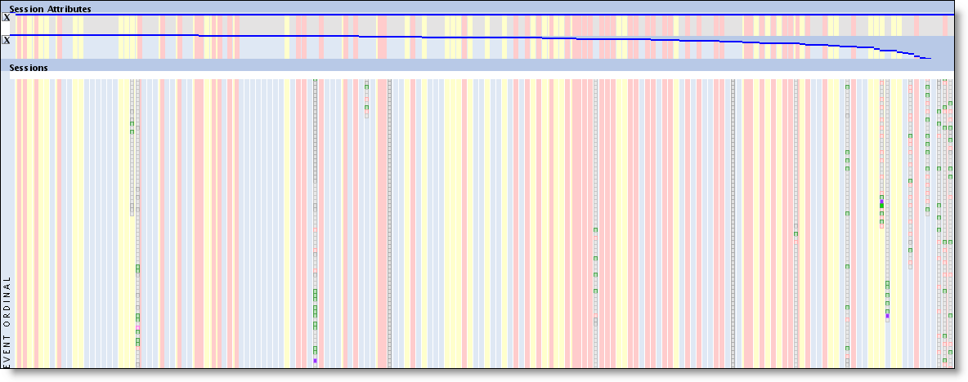
But Ultimately…
Big hint: Visual representations of the data ROCK!
Why? Easy to spot all kinds of variations on the data quality that you might not anticipate a priori.

Slide 129
Careful About Skew, not Just Outliers
For example, if an NBA-related query is coming from Wisconsin, search queries are biased by local preferences. Google Trends and Google Insights data shows pretty strong indications of this (look at the Cities entries in either product):
http://www.google.com/trends?q=Milwaukee+bucks&ctab=0&geo=all&date=all&sort=0
http://www.google.com/trends?q=lakers&ctab=0&geo=all&date=all&sort=0
http://www.google.com/trends?q=celtics&ctab=0&geo=all&date=all&sort=0
http://www.google.com/trends?q=manchester+united&ctab=0&geo=all&date=all
http://www.google.com/trends?q=chelsea&ctab=0&geo=all&date=all&sort=0
http://www.google.com/insights/search/#q=lakers%2C%20celtics%2Cmilwaukee%20bucks&cmpt=q
http://www.google.com/insights/search/#q=arsenal%2Cmanchester%20united%2Cchelsea&cmpt=q
Using this data will generate some interesting correlations. For example, Ghana has a higher interest in Chelsea (because one of the Chelsea players is Ghanaian).
Similarly for temporal variations (see Robin’s query volume variation over the year)

Slide 130
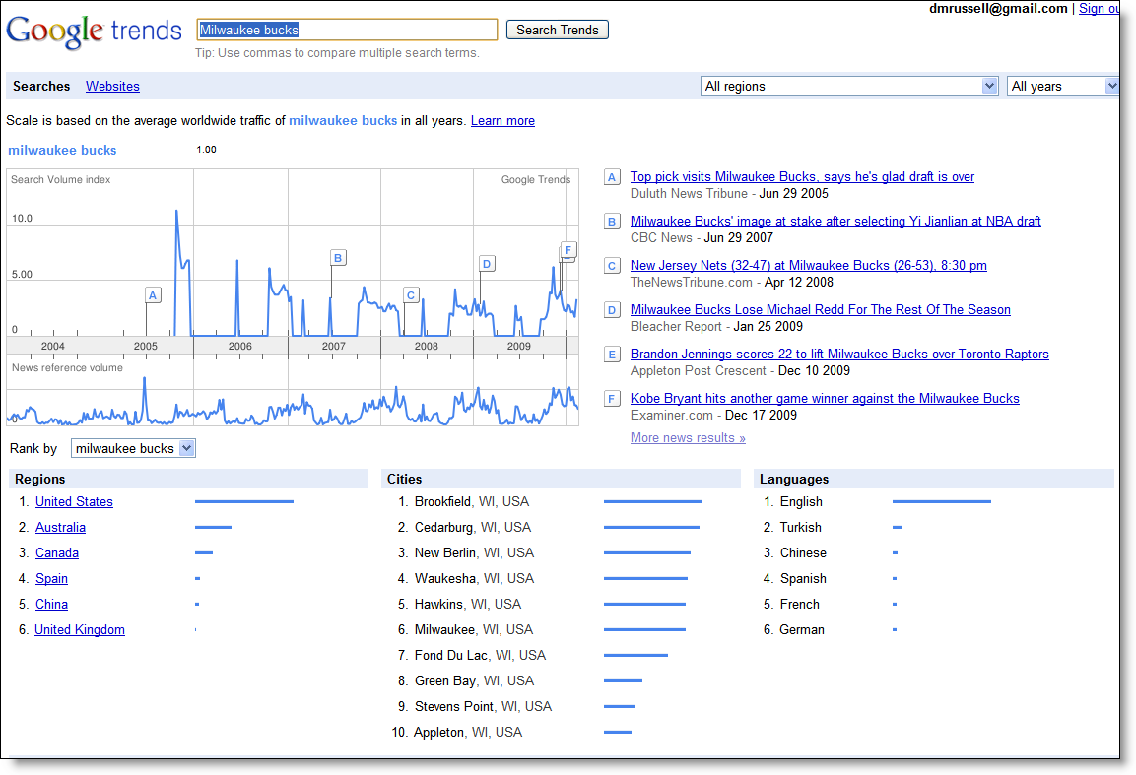

Slide 131
Pragmatics
Keep track of what data cleaning you do!
  Add lots of metadata to describe what operations you’ve run
  (It’s too easy to do the work, then forget which cleaning operations you’ve already run.)
    Example: data cleaning story from ClimateGate –only the cleaned data was available…
  Add even more metadata so you can interpret this (clean) data in the future.
    Sad story: I’ve lost lots of work because I couldn’t remember what this dataset was, how it was extracted, or what it meant… as little as 2 weeks in the past!!

Slide 132
Pragmatics
BEWARE of truncated data sets!
  All too common: you think you’re pulling data from Jan 1, 20?? – Dec 31, 20??, but you only get Jan 1 – Nov 17
BEWARE of censored / preprocessed data!
  Example: Has this data stream been cleaned-for-safe-search before you get it?
    Story: Looking at queries that have a particular UI treatment. (Image univeral triggering) We noticed the porn rate was phenomenally low. Why? Turns out that this UI treatment has a porn-filter BEFORE the UI treatment is applied, therefore, the data from the logs behavior was already implicitly run through a porn filter.

Slide 133
Pragmatics
BEWARE of capped values
  Does your measuring instrument go all the way to 11?
  Real problem: time on task (for certain experiments) is measured only out to X seconds. All instances that are > X seconds are either recorded as X, or dropped. (Both are bad, but you need to know which data treatment your system follows.)
    This seems especially true for very long user session behaviors, time-on-task measurements, click duration, etc.
  Metadata should capture this
  Note: big spikes in the data often indicate this kind of problem

Slide 134
Pragmatics
Do sanity checks constantly
  Don’t underestimate their value.
  Right number of files? Roughly the right size? Expected number of records?
  Does this data trend look roughly like previous trends?
  Check sampling frequency (Are you using downsampled logs, or do you have the complete set?)

Slide 135
Pragmatics
Metadata – describes your data, and what you’ve done to it over the course of time
  Too many examples of data being extracted, and then becoming useless over time because you can’t figure out where it was extracted from, or what manipulations where done with it.
    Example: dataset 1 (full logs from March 1, 2010 – April 1, 2010)
      → Despammed with Datacleaner.NoClickfarms and Datacleaner.NoBots
      → All long sessions removed
      → All non-EN interactions removed
      → All sessions of length 1 removed
      And NOW, three months later, you find the file. It’s labeled “Data.txt”
      Good luck.

Slide 136
Data Integration
Be sure that joins of data are all using the same basis
  E.g., time values that are measured consistently – UTC vs. local timezone
Time | Event
18:01:19 | Query A
18:01:20 | Query A
18:05:30 | Query B
18:25:30 | Query B
19:53:01 | Query B
19:53:02 | Query C
PST
Time | Event
18:01:29 | Query A
18:05:30 | Query B
19:53:02 | Query C
Zulu
Time | Event
18:01:19 | Query A
18:25:30 | Query B
19:53:01 | Query B

Slide 137
Often Can’t Re-run Experiments
Too many basis factors have changed over time…
  The underlying web contents (and therefore index and all associated behaviors) have turned over
  The cookies you based the first study on are all gone (or enough of them have changed/aged-out that within-cookies is no longer possible
  Logging system changes the kinds of behaviors that are logged
  Underlying interpretations of key metrics might have changed (e.g., re-scaling the values—what once was a 5.0 is now a 3.5)
  Policy changes may prevent certain kinds of data collection, retention or interpretation

Slide 138
Data Cleaning Summary
CAUTION: Many, many potholes to fall into
Know what the purpose of your data cleaning is for
Maintain metadata
Beware of domain expertise failure
Ensure that the underlying data schema is what you think it is
Transition: This sets us up to consider how we can use logs analysis more generally in the HCI community…

Slide 139
Section 3C: Log Analysis and the HCI Community
All

Slide 140
Kinds of User Data
 | Observational | Experimental
User Studies Controlled interpretation of behavior with detailed instrumentation | In-lab behavior observations | Controlled tasks, controlled systems, laboratory studies
User Groups In the wild, real-world tasks, probe for detail | Ethnography, field studies, case reports | Diary studies, critical incident surveys
Log Analysis No explicit feedback but lots of implicit feedback | Behavioral log analysis | A/B testing, interleaved results
Goal: Build an abstract picture of behavior
Goal: Decide if one approach is better than another

Slide 141
Discussion: Log Analysis and HCI
Is log analysis relevant to HCI?
How to present/review log analysis research
  Observational
  Experimental
How to generate logs
Sources of log data

Slide 142
Is Log Analysis Relevant to HCI?
“Know thy user”
  In situ large-scale log provide unique insights
  Real behavior
What kinds of things can we learn?
  Patterns of behavior (e.g., info seeking goals)
  Use of systems (e.g., how successful are people in using the currrent vs. new system)
  Experimental comparison of alternatives

Slide 143
How to Present/Review Log Analysis
Examples of successful log analysis papers
  Several published logs analysis of observational type
  But fewer published reports of the experimental type
Determining if conclusions are valid
  Significance unlikely to be a problem
  Data cleanliness important
  Only draw supported claims (careful with intent)

Slide 144
References
Adar, E. , Teevan, J. and Dumais, S. T. (2008). Large scale analysis of Web revisitation patterns. In Proceedings CHI '08, 1197-1206.
Akers, D., Simpson, M., Wingorad, T. and Jeffries, R. (2009) Undo and erase events as indicators of usability problems. In Proceedings of CHI ’09, 659-668.
Beitzel, S. M., Jensen, E. C., Chowdhury, A., Grossman, D. and Frieder, O. (2004). Hourly analysis of a very large topically categorized Web query log. In Proceeding of SIGIR ’04, 321-328.
Broder, A. (2002). A Taxonomy of Web Search. SIGIR Forum, 36(2), Fall 2002.
Cutrell, E., Robbins, D.C., Dumais, S.T. and Sarin, R. (2006). Fast, Flexible Filtering with Phlat: Personal search and organization made easy. In Proceedings of CHI ’06, 261-270.
Dagon, D. (2005). Botnet detection and response: The network is the infection. In OARC Workshop 2005.
Dasu, T. and Johnson, T. (2004), Exploratory Data Mining and Data Cleaning, 2004.
Dumais, S. T., Cutrell, E., Cadiz, J. J., Jancke, G., Sarin, R. and D. C. Robbins (2003). Stuff I've Seen: A system for personal information retrieval and re-use. In Proceedings of SIGIR ’03, 72-79.
Fetterly, D., Manasse, M. and Najork, M. (2004). Spam, damn spam, and statistics: Using statistical analysis to locate spam web pages. 7th Int’l Workshop on the Web and Databases, June 2004.

Slide 145
References
Fox, S. , Karnawat, K. Mydland, M., Dumais, S. T. and White,T. (2005). Evaluating implicit measures to improve Web search. ACM:TOIS, 23(2), 147-168.
Jansen, B. J., Spink, A., Bateman, J. and Saracevic, T. (1998). Real life information retrieval: A study of user queries on the web. SIGIR Forum, 32(1), 5 -17.
Joachims, T. (2002). Optimizing search engines using clickthrough data. In Proceedings of KDD ’02. 133-142.
Kohavi, R., Longbotham, R., Sommerfield, D. and Henne, R. M., (2009). Controlled experiments on the Web: Survey and practical guide. Data Mining and Knowledge Discovery, 18(1), 140-181.
Kohavi, R., Longbotham, R. and Walker, T. (2010). Online experiments: Practical lessons. IEEE Computer, 43 (9), 82-85.
Kellar, M., Watters, C. and Shepherd, M. (2006). The impact of task on the usage of Web browser navigation mechanisms. In Proceedings of GI’06, 235-242.
Lau, T. and E. Horvitz, Patterns of search: Analyzing and modeling Web query refinement. In Proceedings of User Modeling ‘99, 119-128.
Narayanan, A. and Shmatikov, V. (2008). Robust de-anonymization of large sparse datasets. In Proceedings of IEEE Symposium on Security and Privacy, 111–125.

Slide 146
References
Silverstein, C., Henzinger, M., Marais, H. and Moricz, M. (1999). Analysis of a very large Web search engine query log. SIGIR Forum, 33 (1), 6-12.
Tang, D., Agarwal, A. and O’Brien, D. (2010). Overlapping experiment Infrastructure: More, better, faster experimentation. In Proceedings of KDD ’10, 17-26.
Teevan, J., Adar, E., Jones, R. and Potts, M. (2007). Information re-retrieval: Repeat queries in Yahoo's logs. In Proceedings of SIGIR '07, 151-158.
Teevan, J., Dumais, S. T. and Liebling, D. J. (2008). To personalize or not to personalize: Modeling queries with variation in user intent. In Proceedings SIGIR '08, 163-170.
Teevan, J., Dumais, S. T. and Liebling, D. J. (2010). A longitudinal study of how highlighting Web content change affects people's Web interactions. In Proceedings CHI '10, 1353-1356.
Tyler, S. K. and Teevan, J. (2010). Large scale query log analysis of re-finding. In Proceedings WSDM '10, 191-200.
Viermetz, M., Stolz, C., Gedov, V. and Skubacz, M. (2006). Relevance and impact of tabbed browsing behavior on web usage mining. In Proceedings of Web Intelligence, 262-269.
Weinreich, H., Obendorf, H., Herder, E. and Mayer, M. (2006). Off the beaten tracks: Exploring three aspects of web navigation. In Proceedings of WWW ’06, 133-142.
Yates, B., Dupret, G. and Velasco, J. (2007). A study of mobile search queries in Japan. In Query Log Analysis: Social And Technological Challenges. A workshop at WWW ‘07.

