Slide 1
Section 2: Finding and Refinding
Jaime Teevan
Microsoft Research

Slide 2
Introduction: Jaime Teevan
Affiliations
Researcher at Microsoft
Affiliate professor at the University of Washington
Ph.D. from MIT
Research interests
Personalized search
Past search behavior
Social and temporal context
Personal info management
Selfsourcing
Notes:
Became interested in search back in the late 90s when I worked for Infoseek.
Models for web search different.
Yahoo was the main way for people to find things, format was a directory, static pages with a bunch of links.
Pre-link analysis, Boolean search, charging for search.
In my research, I look for patterns in how people search
Temporal context interesting, web content changes, whereas before we thought of information as static.
Think about web search, but also other kinds of search, and, more broadly, PIM.
Currently doing a lot related to selfsourcing

Slide 3
Finding Is a Complex, Multi-Stepped Process
Typical query involves more than one click
59% of people return to the search page after their first click
Clicked result often not the endpoint
People orienteer from results using context as a guide
Not all information needs can be expressed with current tools
Recognition is easier than recall
Typical search session involves more than one query
40% of sessions contain multiple queries
~50% of time spent in sessions of 30+ minutes
Search tasks often involve more than one session
25% of queries are from multi-session tasks
Notes:
Long sessions, even if there are fewer of them, are most of the time that we spend searching
Ironic that even though people spend a lot of time searching, 100ms delay makes us abandon more.
Challenge: Try to figure out how to create more time for search engines. (Slow Search)
So all of this multi-click, multi-query, multi-session behavior is complex.
Exploratory, topics evolve, we learn as we search,
But despite how complex search can be, a good chunk of it we can understand fairly clearly: It involves re-finding

Slide 4
Finding Often Involves Refinding
Repeat query (33%)
microsoft research
Repeat click (39%)
research.microsoft.com
Query → msr
Lots of repeats (43%)
People also regularly return to previously viewed domains
Repeat Query | 33%
New Query | 67%
 |  | Repeat Click | New Click
Repeat Query | 33% | 29% | 4%
New Query | 67% | 10% | 57%
 |  | 39% | 61%
Notes:
Fascinating that it is so common given when you think of using a search engine, you mostly think about getting to new content.
Presents a really simple opportunity for personalization.
Let’s look more at what people are trying to do when they are re-finding.

Slide 5
Refinding to Return to a Previous Result
39% of queries involve a repeat click
Over half appear navigational: Same query, same single click
Searcher knows a lot of meta-information about target
Refinding queries are better than the initial query
Longer, more common, rank the URL higher, converge
“free music → “pandora” → “pandora”
“jobs” → “monster jobs” → “monster jobs”
People learn how to describe their target page
Important aspects: People, path, time
Within a search session, refinding often unintentional
New query finds same page for re-evaluation
Notes:
Session matters
Intra-session refinding is reevaluating, often found via a query that ranks the page higher
Inter-session refinding is picking up the task

Slide 6
Reasons to Return to a Previous Result
Refinding previous content
Lots of revisitation on the web in general
Via back button, tab completion, link following
Search engines are used to revisit infrequently visited pages
Refound webpages are more likely to be static
Refinding a starting point
The more similar the query, the more similar the trail
Monitoring a site for new content
May also monitor the search results of a query
Example: Twitter queries
Notes:
Even more repeat queries on something like Twitter – queries change less and are repeated a lot as people monitor content

Slide 7
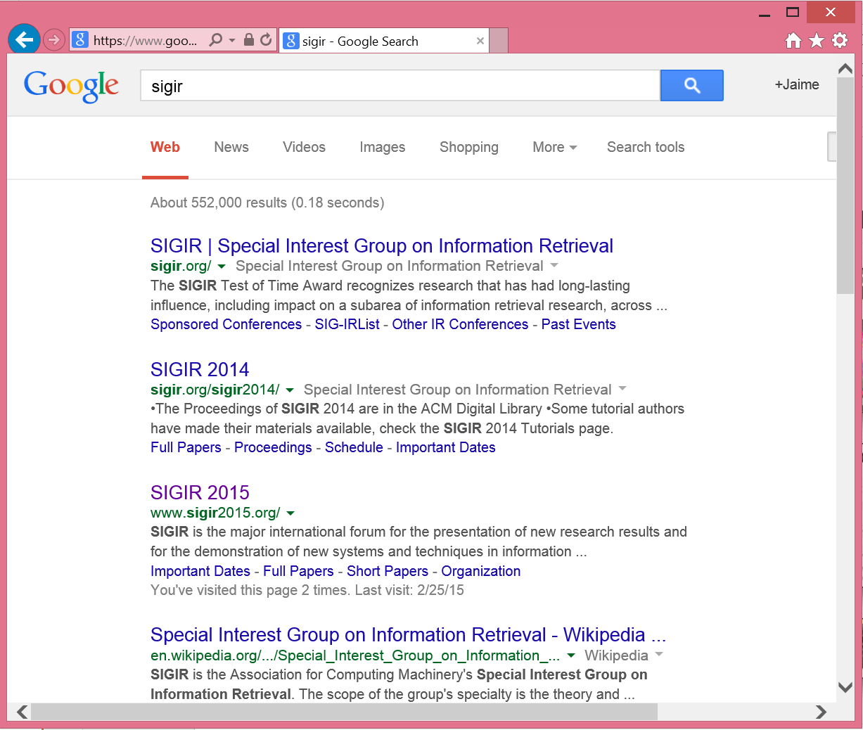
Design Implications: Help People Return
At query time: Show past queries and clicks
At result time
Highlight past results
Personalize ranking
Visual representations
Notes:
15% of all queries we have enough history to almost perfectly predict the click based on repeat behavior
(“almost perfectly” = 95% accuracy, or better than we can predict you’ll click on http://facebook.com if you search for “facebook.”)

Slide 8
Refinding to Pick Up a Task
Tasks extend over time
Results found at the end of a session are likely to be refound
Refinding clicks are likely to occur at the start of a session
10% of queries involve a repeat click and new click

Slide 9
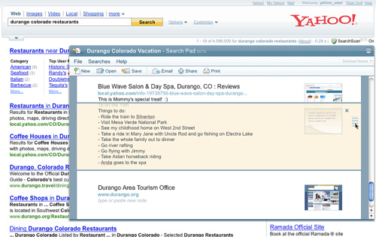
Design Implications: Help People Pick Up Tasks
Identify tasks when they are started
Enable people to save what they found
Support slow search
Identify tasks when they are resumed
Reinstantiate context

Slide 10
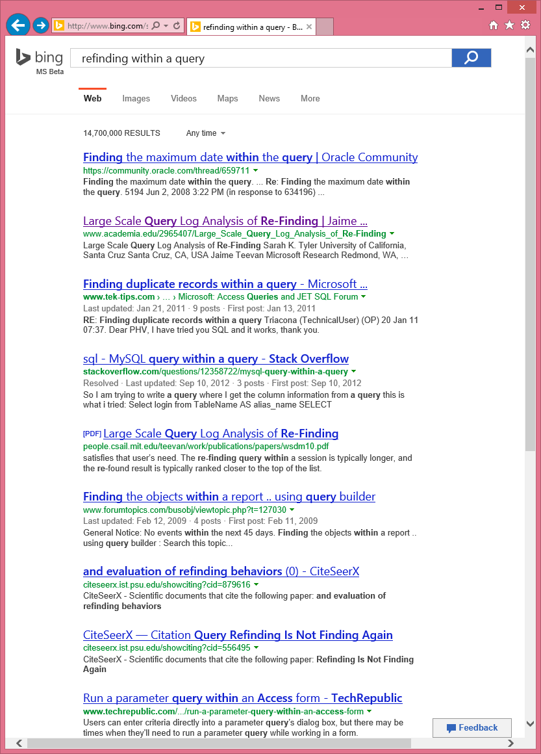
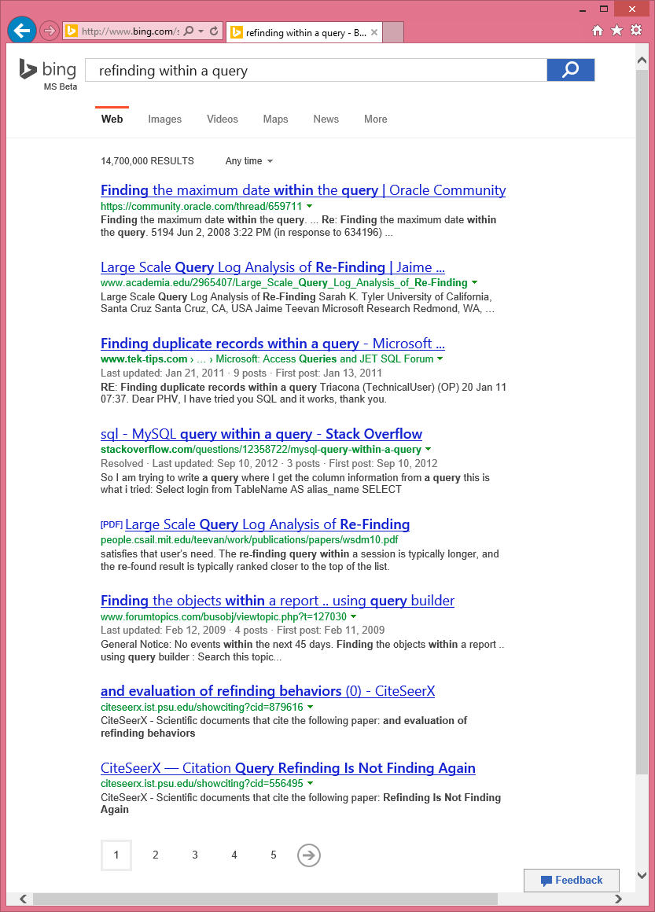
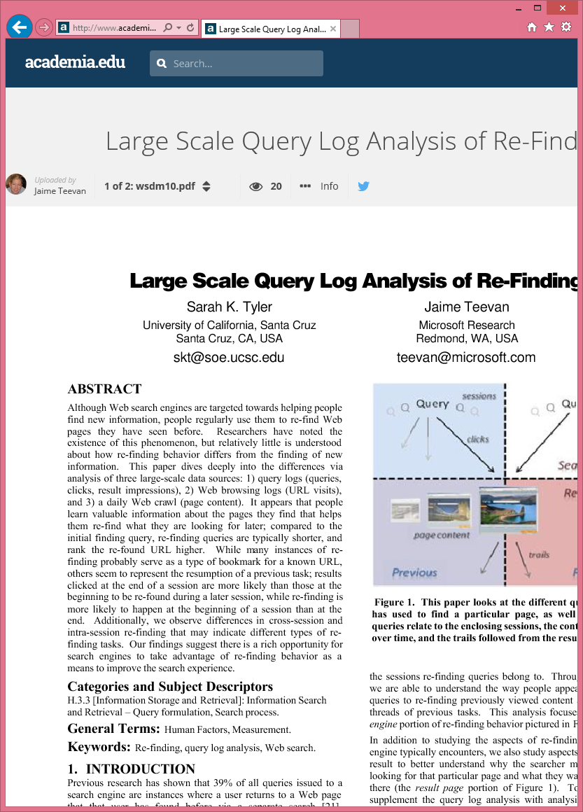
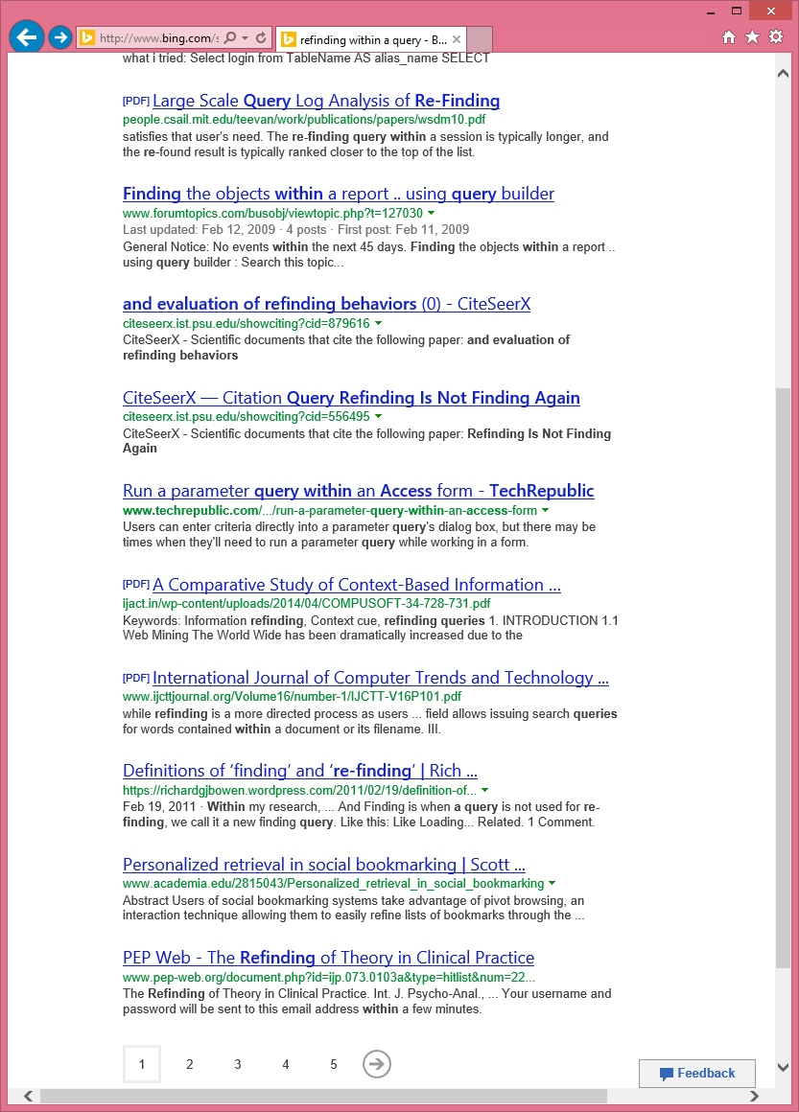
Refinding in the Face of Change
Search result ordering changes
Across search sessions
Even within an individual query!
Notes:
Give specific numbers for how often changes across sessions
Why? Improved ranking, general instability
This can be good – better, more relevant information, etc.

Slide 11
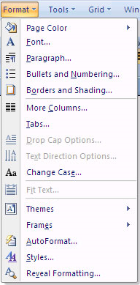
Change Can Cause Problems
Example: Dynamic menus
Put commonly used items at top
Slows menu item access
Does search result change likewise interfere with refinding?
Notes:
Fewer repeat clicks (53% v. 88%)
Slower time to click (26 seconds v. 6 seconds)

Slide 12
Change Interferes with Refinding
When search result ordering changes people are
Less likely to click on a repeat result
Slower to click on a repeat result when they do
More likely to abandon their search
Happens within a query and across sessions
Even happens when the repeat result moves up!

Slide 13
But Change Helps with Finding!
Change to click
Unsatisfied initially
Gone > Down > Stay > Up
Satisfied initially
Stay > Down > Up > Gone
Changes around click
Always benefit NSAT users
Best below the click for satisfied users
 | NSAT | SAT
Up | 2.00 | 4.65
Stay | 2.08 | 4.78
Down | 2.20 | 4.75
Gone | 2.31 | 4.61
NSAT | Changes | Static
Above | 2.30 | 2.21
Below | 2.09 | 1.99
SAT | Changes | Static
Above | 4.93 | 4.93
Below | 4.79 | 4.61
Notes:
[Higher number = better]

Slide 14
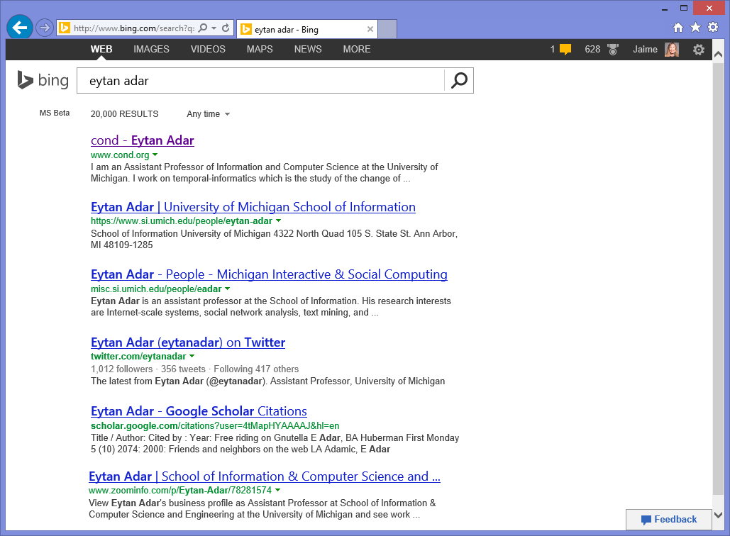
Design Implications: Bias Display by Experience

Slide 15
Create a Change Blind Refinding Experience

Slide 16
Summary of Design Implications
Finding often involves refinding
Help people return to a previous result
Support the issuing of refinding queries
Make it easy to identify previous results in a result list
Help people pick up tasks
Identify tasks when they are started
Identify tasks when they are resumed
Change interferes with refinding – but helps with finding!
Bias display of new content by searcher’s experience

Slide 17
References
General overview of finding and re-finding: Teevan, Capra, Perez-Quiñones. How people find personal information. In Personal Information Management, UW Press 2007.
Cross-session search behavior
Kotov, Bennett, White, Dumais, Teevan. Modeling and analysis of cross-session search tasks. SIGIR 2011.
Dumais. Task-based search: A search engine perspective. http://bit.ly/15rK5tD
Understanding refinding
Teevan, Adar, Jones, Potts. Information re-retrieval: Repeat queries in Yahoo’s logs. SIGIR 2007.
Tyler, Teevan. Large scale query log analysis of re-finding. WSDM 2010.
Adar, Teevan, Dumais. Large scale analysis of web revisitation patterns. CHI 2008.
Supporting refinding
Teevan, Cutrell, Fisher, Drucker, Ramos, Andre, Hu. Visual Snippets: Summarizing web pages for search and revisitation. CHI 2009.
Teevan, Liebling, Geetha. Understanding personal navigation. WSDM 2011.
The impact of change on refinding
Teevan. How people recall, recognize and reuse search results. TOIS 2008.
Teevan. The Re:Search Engine: Simultaneous support for finding and re-finding. UIST 2007.
Lee, Teevan, de la Chica. Characterizing multi-click behavior and the risks and opportunities of changing results during use. SIGIR 2014.

