Slide 1
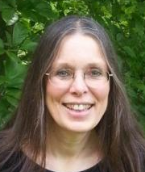
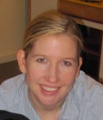
Publishing Your Research
Holly Rushmeier
Jaime Teevan

Slide 2
Publishing Your Research
The Publishing Process
Holly Rushmeier

Slide 3
Goal of Publishing
Benefits
Advance the state of the art
Public evidence of your abilities
Quality v. quantity
Quality! Quantity varies by area
Citations matter as career progresses
How to generate citations
High quality work
Highly visible outlets
Notes:
In determining whether something is publishable, the audience that needs or wants the information is considered, not the authors need to publish. Quality is always the paramount concern, typical numbers of publications and numbers of authors/paper varies with sub-area.

Slide 4
Avenues for Publication
Primary outlets
Conference Papers
Journal Papers
Additional
Workshop Abstracts
Doctoral consortium Abstracts/Posters
Conference/Workshop Posters
Other outlets
Software, patents, books, data repositories
Social media: blogs, Twitter, YouTube

Slide 5
Focus: Conferences
Conference status is different in CS
Primary outlet for CS (selective)
Place to meet for other disciplines (not selective)
Identifying top-tier conferences
Process
Acceptance rate/citations
Sponsoring organizations

Slide 6
Conference Process
Uniform submission date
May have separate abstract deadline
Program committee
May be hierarchical, may have non-committee reviewers
Decisions
May be two-pass
Details vary by area and year
Read the CFP carefully!!!

Slide 7
SIGGRAPH2013 Example Timeline
Pre-deadline: fill out forms Jan 17
Deadline: MD5 for all content Jan 18
Upload deadline: Jan 19
Committee assignments: ~ Jan 23
Tertiary assignments: ~Jan 30
Reviews available: Mar 11
Rebuttals due: Mar 14
Committee meeting: Mar 20-23
Preliminary decisions: Mar 27
Revisions due: Apr 12
Final Decisions: Apr 9
Publication date: July 7
Presentations: July 21-25

Slide 8
Conference Ethics
No dual submissions
When in doubt if submissions will be perceived as “dual” ASK
Commitment to present
This is a serious financial commitment

Slide 9
Journal Process
No fixed deadlines
Have more space and time
No travel or registration expenses
Can be hard to finish without a deadline
Review cycle can be slower

Slide 10
Journal Metrics
Popular: ISI Journal Impact Factor
Used across all disciplines, computed by a company
The journal impact factor for year N is the total number of citations in year N to articles published in years N-1 and N-2 divided by the number of articles in N-1 and N-2.
Notes:
Like it or not, much of the world is heavily influenced by Thomson’s metric

Slide 11
H-factors
H factor for individuals:
“A scientist has index h if h of his/her N papers have at least h citations each, and the other (N-h) papers have no more than h citations each.” J.E. Hirsch
H5-index for publications:
“h5-index is the h-index for articles published in the last 5 complete years. It is the largest number h such that h articles published in 2008-2012 have at least h citations each” Google Scholar

Slide 12
Journal Process
Outcomes
Accept
rare on first submission
Minor revision
may be “probably accept”
Major revision
may have one iteration before reject
Reject
may differentiate between “resubmit as new” and “hopeless”

Slide 13
Review Process
Single-blind, double-blind, etc.
Reviewer selection
Drawn from citations, contacts, lit search
Uses keywords or categories (beware of choosing too broadly)
Experts in the field
No conflict of interests
Meta-review

Slide 14
What Reviewers Look For
Clear contribution
Solid evidence

Slide 15
Ethics in Reviewing
Integrity, objectivity, accountability
Cannot reject a paper because
You are writing a paper on the same subject
You do not like the author
Confidentiality
Single blind, double blind reviews
The material in the paper is not publically available, so you cannot use ideas from it
Conflicts of interest with people who
Work in the same place (never)
Was your advisor (never)
Have written papers together (recently)
Have a financial interest
Double blind review makes things harder, but when in doubt check with program chair

Slide 16
Considerations in Reviewing
Reasons, not binary decision, matter
The clarity and validity of the reasons you give for accept or reject matter
You are making an impression
The person who assigned you the review will form an opinion of your ability and maturity from your review
Get credit for your work
if assigned as a sub-reviewer, ask that you be acknowledged by the event or journal

Slide 17
Publishing Your Research
The
Writing Process
Jaime Teevan

Slide 18
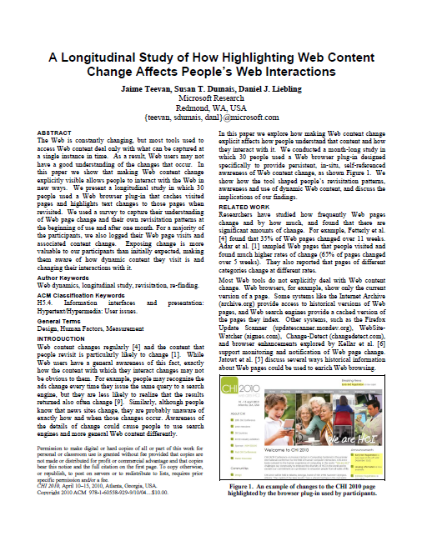
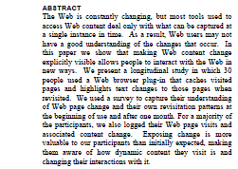
Components of a Paper
Title and abstract
Authors
Introduction
Related Work
Methodology
Findings
Conclusion
Notes:
Read a lot, familiarize yourself with what papers in your field look like

Slide 19
Title and Abstract
First impression of your paper
Used to decide to read or review it
Include terms for searching and scanning
Should be a clear, complete summary
Include motivation, findings
Could substitute for reading the paper
Avoid acronyms, citations, formatting
Notes:
Title
Make sure the reader knows roughly what the paper is about from the title alone
Include keywords related to the paper topic that people may search for
No acronyms or unique vocabulary
Be as unambiguous as possible
Abstract
Less than 250 words
Very direct and to the point
Should be able to function as a substitute for reading your paper, needs to include the key take-aways
Avoid acronyms, citations, specialized terminology

Slide 20
Authors
Be explicit and generous
Author ordering
By contribution or convention
Importance of position
Author responsibilities
Contributed to the work
Verified the work
Willing and able to present
Notes:
Be explicit up front about authorship and expectations
In addition to authorship, you can acknowledge people who help
As an author, you have responsibilities
You are responsible for ensuring that the work is correct and that there is no plagiarism
Author ordering varies by community
Contribution
Convention (alphabetical, student first and advisor last, …)
Know what the community does
First spot usually important, others less
First author typically the one to present the work

Slide 21
Successful Co-Authorship
Externalize thinking
Get your ideas onto paper
Share outlines and drafts
Be respectful of time
Create a schedule
Share it
Keep to it
Speak up

Slide 22
Introduction
Tell your story
Story ≠ what you did
Be concrete, provide examples
Do not include cute but unnecessary detail
Create “dead kittens” file
End with a description of paper structure
Notes:
Introduction
Begins with a catchy description of the problem area
Avoid being too abstract, this is a good place to give the reader a concrete way to understand the problem area
Nice to introduce an example that will carry through the problem
Nice to have a picture, screenshot, diagram, or something visual to grab onto
Give the big picture
Typically ends with a paragraph describing the rest of the paper
Get the story right
Provide a picture at the right level
Don’t go to low: You know all of the details and are the expert in the topic area, make sure you give the big picture for people who aren’t as into the details as you are
Your thesis covers more, your whole thesis story isn’t always needed for framing
Don’t tell what you did, the order you figured things out isn’t necessarily the best way to communicate them
Just because something was a lot of work, that doesn’t mean it was the important contribution
Don’t feel the need to include everything, it’s better to get your main points across clearly
Create a “dead kittens” file for ideas that are so cute you don’t want to kill them, but that don’t really belong in the paper
You’re not trying to build to a surprise, don’t hold anything out early on – be clear in the abstract and intro what you’re going to say, say it in the body, and then tell them what you said at the end

Slide 23
Related Work
Opportunity to highlight contribution
Describe existing research
Relate your research to it
Build from versus take down
Reviewers drawn from related authors
Avoid being defensive
Writing the Related Work section
Be concise, focus on key papers
Do not refer to papers as numbers [2]
Notes:
Related Work
Don’t be defensive
There is no need for related work to be deficient for your work to be new and valuable
Better to say how you build on related work than to focus on what is done wrong
The people you cite will be your reviewers, write your related work as if you were telling them why they should care about your work
Don’t cite papers as numbers (e.g., instead of “In [2] a model is proposed,” say, “Smith et al. propose a model..”)
Don’t freak out when you come across related work that seems to cover the same thing as you – chances are your work makes a contribution, you just need to let readers know how
End with a paragraph summarizing why the work your presenting is a valuable contribution
Don’t belabor the Introduction and Related work – in a 10 page paper, it is good to be onto the meat of the paper by the start of the third page

Slide 24
Methodology
Goal: Allow an informed expert to reproduce your research
Describe the exact approach taken
Acknowledge limitations
Explain why they exist
Frame them as positive when possible
Notes:
Methods
Goal: For the reader to be able to reproduce your work
Acknowledge limitations, frame them as positive when possible

Slide 25
Findings
Clearly explain what you observed
Pull content out of text when possible
Avoid paragraphs of numbers
Tables and figures should stand alone
Describe figures, tables, quotations
Do not assume reader is looking at them while reading the text
Help the reader interpret the findings
Notes:
Results
Put as many numbers into tables/figures so you don’t have to have them in the text
Don’t assume the reader is looking at your tables/figures when they read the text – tell them how to interpret the them. (Similarly, don’t assume they read quotations.)

Slide 26
Components of a Paper
Title and abstract
Authors
Introduction
Related Work
Methodology
Findings
Conclusion
Notes:
Conclusion: Summarize findings. Should be able to stand alone, may be read on its own. Should end strong and positive, telling the reviewer why they would want to cite this work.
Length
Typically 8 to 10 pages
Some conferences are page-limitless
Some do not include supplemental material (references, appendices, data)
Some conferences also have a 4 page short-paper option
Writing quality matters
Make it easy for readers to see your contributions
Find a proofreader or use an online service
Place figures well, make sure they print in black-and-white
Avoid orphans

Slide 27
Submitting Your Paper
Create a finished paper
Ensure proper layout
Copyedit
Anonymize appropriately
Submit on time
Usually can submit early and modify
Read the CFP carefully
Ask the PC Chair if you have questions

Slide 28
Author Responsibilities
Do NOT plagiarize
Obtain permission for use of material
Cite and acknowledge work
Be explicit about reuse of previous work
No dual submissions
Support the reviewing process
Submit work you are proud of
Respond to the reviews you receive
Provide thoughtful reviews

Slide 29
Dealing with Reviews
Separate out the emotional response
Write a rebuttal or make edits later
Understand the reviews
Identify important issues
Get to the root cause of complaints
Issues you already address were unclear
Respond to the reviews
Reviewers will see the paper again
Notes:
You can have an emotional response even when a paper is accepted
Reviews may still sting
Don’t read too much into reviews
Writing rebuttal – important, no additional experiments, be brief and to the point, don’t hide things
Understand reviews
Go through paper and tag issues with the comments, highlight reviews, …
Important issues tend to be:
- Raised by more than one reviewer
Raised by meta-reviewer
Get at the root cause of a complaint: Focus on a methodological issue may be that you weren’t clear about the focus, concern about the
How to handle reviews:
Papers don’t have to get in the first time you submit them
Built into the journal process, with conferences revise and re-submit expected
Take the time to respond to reviews positively, not just defensively (reviewers want to help you make the paper stronger)
Address reviewer comments, as reviewers are likely to see the paper again when you resubmit (or when it is published – at this point they can’t reject the paper again if you don’t address their suggestions, but they will know who you are and be annoyed)
Even when paper was accepted deal with responses
Long term game, long term management of reputation
You want to be know for doing good work and taking responses seriously

Slide 30
Dealing with Rejection
Great papers sometimes get rejected
There is variation and error in process
New or bridge topics particularly at risk
Keep trying
Good target: Three submissions
Consider a venue change
Match content to the best audience
Address reviewer comments
Notes:
Give an example of paper that was rejected, revised, venue changed

Slide 31
Publishing Your Research
Prepare the camera-ready version
Goal is a strong paper, not just an accepted paper
Address reviewer comments
Share the paper with others
Link to it, blog about it, Tweet about it
Present the work
Leave the details in the paper

Slide 32
Resources
Paper writing advice
First EuroSys Authoring workshop
Presentations: http://cs.kuleuven.ac.be/conference/EuroSys2006/workshop.html
An Evaluation of the Ninth SOSP Submissions or How (and How Not) to Write a Good Systems Paper (Levin & Redell)
http://john.regehr.org/reading_list/levin_sosp.html
Writing Technical Articles (Columbia CS Department)
http://www.cs.columbia.edu/~hgs/etc/writing-style.html
The Elements of Style (Strunk & White)
ACM Policy
Plagiarism
http://www.acm.org/publications/policies/plagiarism_policy
Note in particular the definition of “self-plagiarism”
Making your paper public
ACM Author-izer service (with interesting FAQ)
http://www.acm.org/publications/acm-author-izer-service

Slide 33
Share Your Feedback
holly.rushmeier@yale.edu
Find me at the Yale booth!
teevan@microsoft.com Find me at the Microsoft booth!
http://alturl.com/z4gp9
Notes:
Take advice thoughtfully.
Talk to your advisor.
Be aware of your community standards.

