Slide 1
Design of Large Scale Log Analysis Studies
A short tutorial…
Susan Dumais, Robin Jeffries, Daniel M. Russell, Diane Tang, Jaime Teevan
HCIC Feb, 2010

Slide 2
What can we (HCI) learn from logs analysis?
Logs are the traces of human behavior
  … seen through the lenses of whatever sensors we have
Actual behaviors
  As opposed to recalled behavior
  As opposed to subjective impressions of behavior

Slide 3
Benefits
Portrait of real behavior… warts & all
  … and therefore, a more complete, accurate picture of ALL behaviors, including the ones people don’t want to talk about
Large sample size / liberation from the tyranny of small N
  Coverage (long tail) & Diversity
Simple framework for comparative experiments
Can see behaviors at a resolution / precision that was previously impossible
➔ Can inform more focused experiment design
Notes:
Influence of learnings from large data set analysis… can help design studies

Slide 4
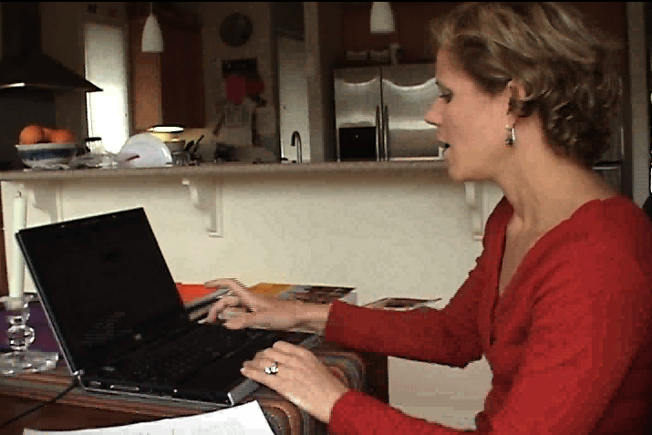
Drawbacks
Not annotated
Not controlled
No demographics
Doesn’t tell us the why
Privacy concerns
    AOL / Netflix / Enron / Facebook public
    Medical data / other kinds of personally identifiable data
00:32 …now I know…
00:35 … you get a lot of weird things..hold on…
00:38 “Are Filipinos ready for gay flicks?”
00:40 How does that have to do with what
I just….did...?
00:43 Ummm…
00:44 So that’s where you can get surprised…
you’re like, where is this… how does
this relate…umm…

Slide 5
What are logs for this discussion?
User behavior events over time
  User activity primarily on web
    Edit history
    Clickstream
    Queries
    Annotation / Tagging
    PageViews
    … all other instrumentable events (mousetracks, menu events….)
  Web crawls (e.g., content changes)
    E.g., programmatic changes of content

Slide 6
Other kinds of large log data sets
Mechanical Turk (may / may not be truly log-like)
Medical data sets
Temporal records of many kinds…

Slide 7
Overview
Perspectives on log analysis
  Understanding User Behavior (Teevan)
  Design and Analysis of Experiments (Jeffries)
  Discussion on appropriate log study design (all)
Practical Considerations for log analysis
  Collection & storage (Dumais)
  Data Cleaning (Russell)
  Discussion of log analysis & HCI community (all)

Slide 8
Section 2:
Understanding User Behavior
Jaime Teevan & Susan Dumais
Microsoft Research

Slide 9
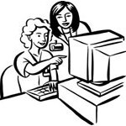

Kinds of User Data
User Studies Controlled interpretation of behavior with detailed instrumentation
User Groups In the wild, real-world tasks, probe for detail
Log Analysis No explicit feedback but lots of implicit feedback

Slide 10
Kinds of User Data
 | Observational
User Studies Controlled interpretation of behavior with detailed instrumentation | In-lab behavior observations
User Groups In the wild, real-world tasks, probe for detail | Ethnography, field studies, case reports
Log Analysis No explicit feedback but lots of implicit feedback | Behavioral log analysis
Goal: Build an abstract picture of behavior

Slide 11
Kinds of User Data
 | Observational | Experimental
User Studies Controlled interpretation of behavior with detailed instrumentation | In-lab behavior observations | Controlled tasks, controlled systems, laboratory studies
User Groups In the wild, real-world tasks, probe for detail | Ethnography, field studies, case reports | Diary studies, critical incident surveys
Log Analysis No explicit feedback but lots of implicit feedback | Behavioral log analysis | A/B testing, interleaved results
Goal: Build an abstract picture of behavior
Goal: Decide if one approach is better than another

Slide 12
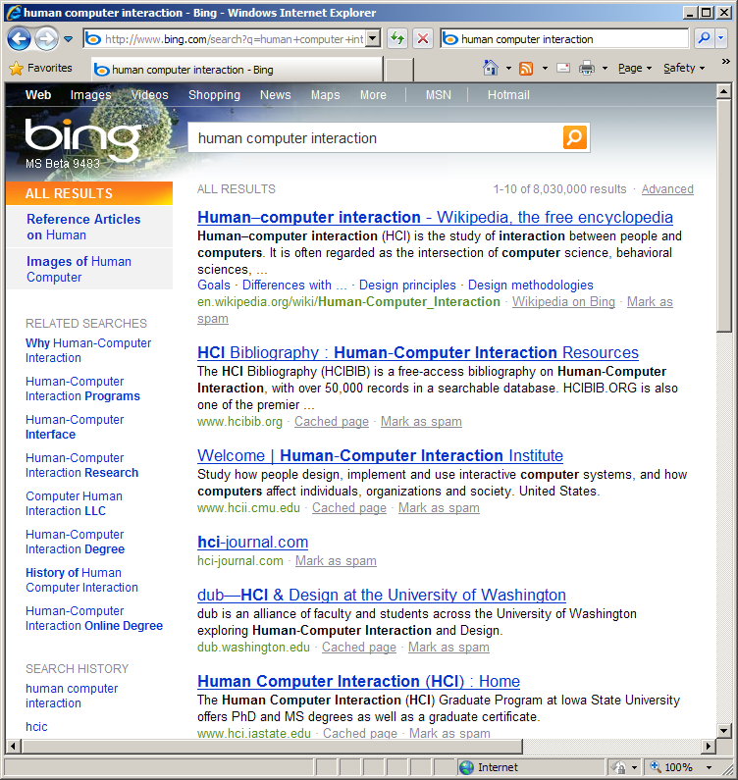
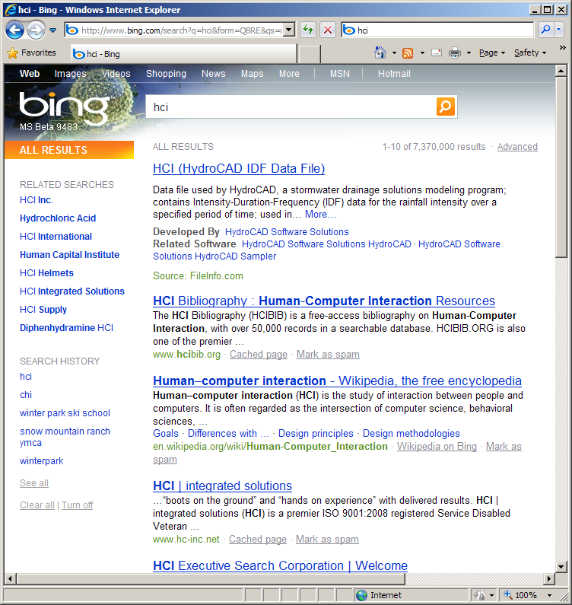
Web Service Logs
Example sources
  Search engine
  Commerce site
Types of information
  Queries, clicks, edits
  Results, ads, products
Example analysis
  Click entropy
  Teevan, Dumais and Liebling. To Personalize or Not to Personalize: Modeling Queries with Variation in User Intent. SIGIR 2008
Data file
Academic field
Company

Slide 13
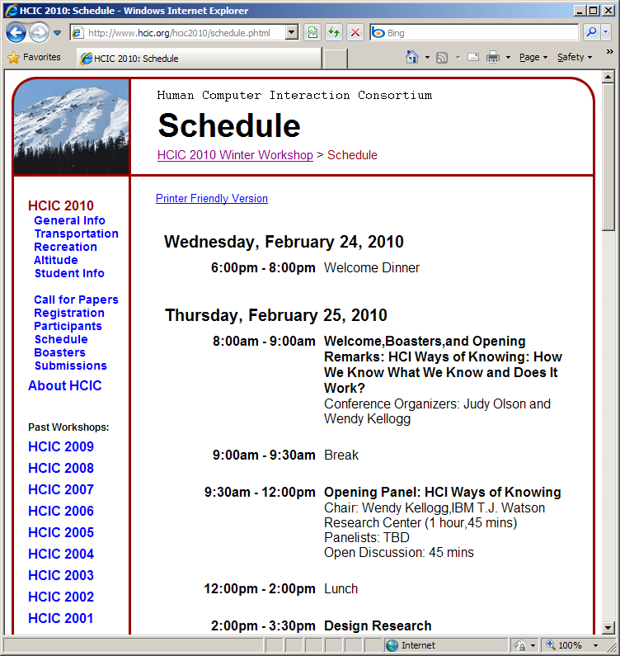
Web Browser Logs
Example sources
  Proxy
  Logging tool
Types of information
  URL visits, paths followed
  Content shown, settings
Example analysis
  Revisitation
  Adar, Teevan and Dumais. Large Scale Analysis of Web Revisitation Patterns. CHI 2008 a
Notes:
Can do a lot with just URL visits.

Slide 14
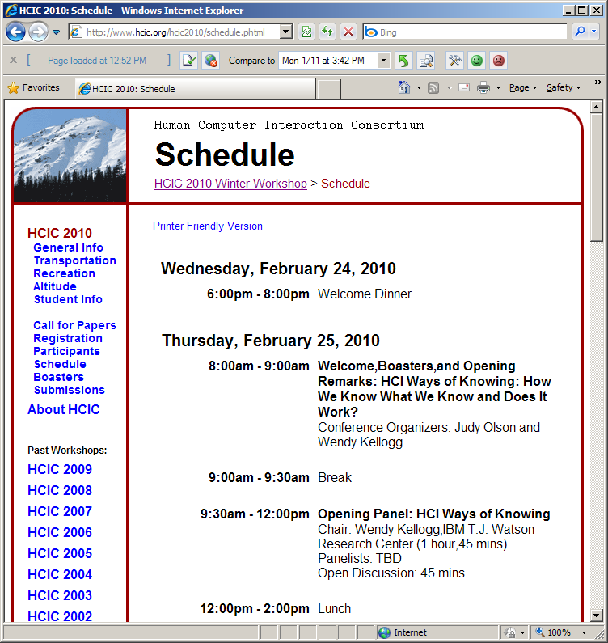
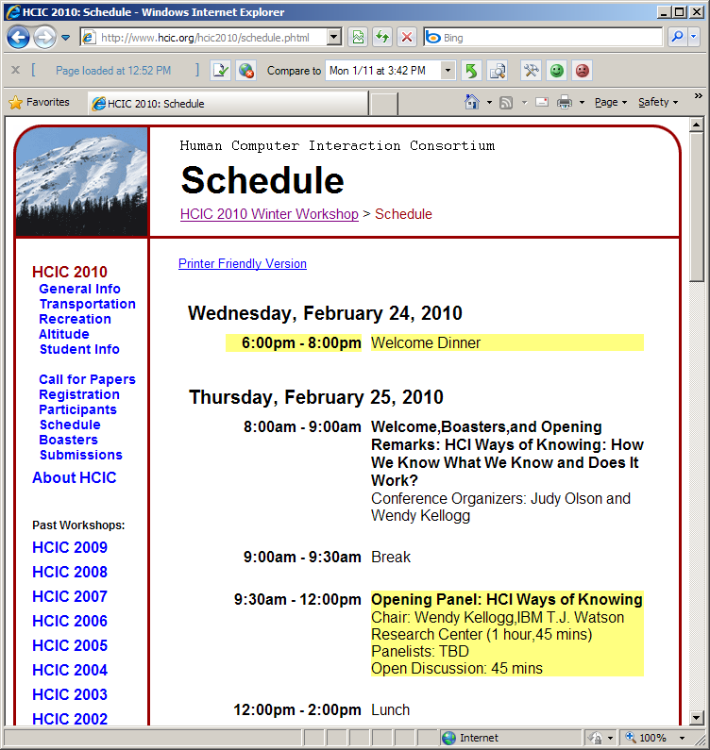
Web Browser Logs
Example sources
  Proxy
  Logging tool
Types of information
  URL visits, paths followed
  Content shown, settings
Example analysis
  DiffIE
  Teevan, Dumais and Liebling. A Longitudinal Study of How Highlighting Web Content Change Affects People’s Web Interactions. CHI 2010
Toolbar
Notes:
If additional information is captured, can look at how content displayed affects interactions. FIX ANIMATION

Slide 15
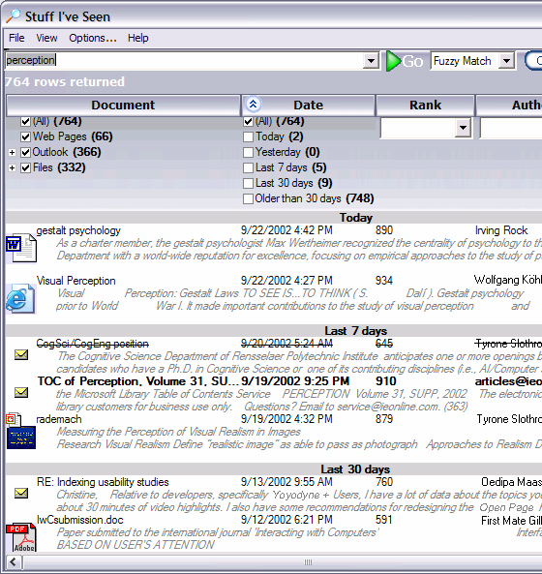
Rich Client-Side Logs
Example sources
  Client application
  Operating system
Types of information
  Web client interactions
  Other client interactions
Example analysis
  Stuff I’ve Seen
  Dumais et al. Stuff I've Seen: A system for personal information retrieval and re-use. SIGIR 2003

Slide 16
Logs Can Be Rich and Varied
Sources of log data
Types of information logged
Web service
  Search engine
  Commerce site
Web Browser
  Proxy
  Toolbar
  Browser plug-in
Client application
Interactions
  Queries, clicks
  URL visits
  System interactions
Context
  Results
  Ads
  Web pages shown

Slide 17
Using Log Data
What can we learn from log analysis?
What can’t we learn from log analysis?
How can we supplement the logs?

Slide 18
Using Log Data
What can we learn from log analysis?
  Now: Observations
  Later: Experiments
What can’t we learn from log analysis?
How can we supplement the logs?
Notes:
Talk about observational vs. experimental

Slide 19



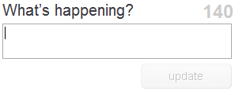

Generalizing About Behavior
Buttons clicks
Structured answers
Information use
Information needs
What people think
Feature
use
Human behavior
Notes:
What do you learn from your logs?
How people turn a feature on and off is about that system.
Query may be more about what people want.
But not entirely – for example, length may be about the system, type may be about corpus.
Twitter queries and Web queries are different in some ways, but similar in other ways.

Slide 20
Generalizing Across Systems
Bing version 2.0
Bing use
Web search engine use
Search engine use
Information seeking
Build new features
Logs from a particular run
Logs from a Web search engine
From many Web search engines
From many search verticals
From browsers, search, email…
Build better systems
Build new tools

Slide 21
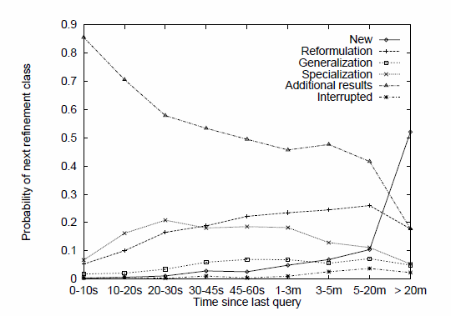

What We Can Learn from Query Logs
Summary measures
  Query frequency
  Query length
Analysis of query intent
  Query types and topics
Temporal features
  Session length
  Common re-formulations
Click behavior
  Relevant results for query
  Queries that lead to clicks
Queries appear 3.97 times
[Silverstein et al. 1999]
2.35 terms
[Jansen et al. 1998]
Navigational, Informational, Transactional
[Broder 2002]
Sessions 2.20 queries long
[Silverstein et al. 1999]
[Lau and Horvitz, 1999]
[Joachims 2002]

Slide 22
Query | Time | User
hcic | 10:41am 2/18/10 | 142039
snow mountain ranch | 10:44am 2/18/10 | 142039
snow mountain directions | 10:56am 2/18/10 | 142039
hcic | 11:21am 2/18/10 | 659327
restaurants winter park | 11:59am 2/18/10 | 318222
winter park co restaurants | 12:01pm 2/18/10 | 318222
chi conference | 12:17pm 2/18/10 | 318222
hcic | 12:18pm 2/18/10 | 142039
cross country skiing | 1:30pm 2/18/10 | 554320
chi 2010 | 1:30pm 2/18/10 | 659327
hcic schedule | 1:48pm 2/18/10 | 142039
hcic.org | 2:32pm 2/18/10 | 435451
mark ackerman | 2:42pm 2/18/10 | 435451
snow mountain directions | 4:56pm 2/18/10 | 142039
hcic | 5:02pm 2/18/10 | 142039

Slide 23
Query | Time | User
hcic | 10:41am 2/18/10 | 142039
snow mountain ranch | 10:44am 2/18/10 | 142039
snow mountain directions | 10:56am 2/18/10 | 142039
hcic | 11:21am 2/18/10 | 659327
restaurants winter park | 11:59am 2/18/10 | 318222
winter park co restaurants | 12:01pm 2/18/10 | 318222
chi conference | 12:17pm 2/18/10 | 318222
hcic | 12:18pm 2/18/10 | 142039
cross country skiing | 1:30pm 2/18/10 | 554320
chi 2010 | 1:30pm 2/18/10 | 659327
hcic schedule | 1:48pm 2/18/10 | 142039
hcic.org | 2:32pm 2/18/10 | 435451
mark ackerman | 2:42pm 2/18/10 | 435451
snow mountain directions | 4:56pm 2/18/10 | 142039
hcic | 5:02pm 2/18/10 | 142039
*
*
Query typology
*
*
*
*
*

Slide 24
Query | Time | User
hcic | 10:41am 2/18/10 | 142039
snow mountain ranch | 10:44am 2/18/10 | 142039
snow mountain directions | 10:56am 2/18/10 | 142039
hcic | 11:21am 2/18/10 | 659327
restaurants winter park | 11:59am 2/18/10 | 318222
winter park co restaurants | 12:01pm 2/18/10 | 318222
chi conference | 12:17pm 2/18/10 | 318222
hcic | 12:18pm 2/18/10 | 142039
cross country skiing | 1:30pm 2/18/10 | 554320
chi 2010 | 1:30pm 2/18/10 | 659327
hcic schedule | 1:48pm 2/18/10 | 142039
hcic.org | 2:32pm 2/18/10 | 435451
mark ackerman | 2:42pm 2/18/10 | 435451
snow mountain directions | 4:56pm 2/18/10 | 142039
hcic | 5:02pm 2/18/10 | 142039
*
*
Query typology
*
Query behavior
*

Slide 25
Query | Time | User
hcic | 10:41am 2/18/10 | 142039
snow mountain ranch | 10:44am 2/18/10 | 142039
snow mountain directions | 10:56am 2/18/10 | 142039
hcic | 11:21am 2/18/10 | 659327
restaurants winter park | 11:59am 2/18/10 | 318222
winter park co restaurants | 12:01pm 2/18/10 | 318222
chi conference | 12:17pm 2/18/10 | 318222
hcic | 12:18pm 2/18/10 | 142039
cross country skiing | 1:30pm 2/18/10 | 554320
chi 2010 | 1:30pm 2/18/10 | 659327
hcic schedule | 1:48pm 2/18/10 | 142039
hcic.org | 2:32pm 2/18/10 | 435451
mark ackerman | 2:42pm 2/18/10 | 435451
snow mountain directions | 4:56pm 2/18/10 | 142039
hcic | 5:02pm 2/18/10 | 142039
Uses of Analysis
Ranking
  E.g., precision
System design
  E.g., caching
User interface
  E.g., history
Test set development
Complementary research
*
Query typology
Query behavior
Long term trends
*

Slide 26
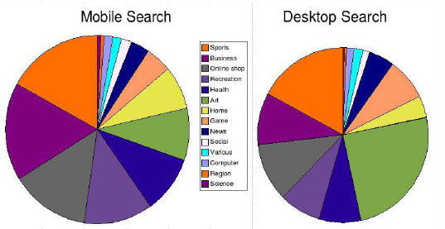
Partitioning the Data
Language
Location
Time
User activity
Individual
Entry point
Device
System variant
[Baeza Yates et al. 2007]

Slide 27
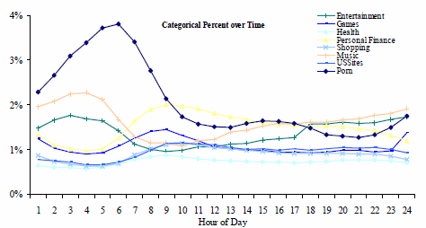
Partition by Time
Periodicities
Spikes
Real-time data
  New behavior
  Immediate feedback
Individual
  Within session
  Across sessions
[Beitzel et al. 2004]

Slide 28
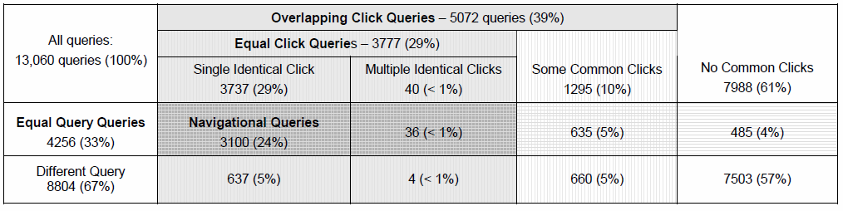
Partition by User
[Teevan et al. 2007]
Identification: Temporary ID, user account
Considerations: Coverage v. accuracy, privacy, etc.
Notes:
Enlarge the diagram for people in the back row!!

Slide 29
What Logs Cannot Tell Us
People’s intent
People’s success
People’s experience
People’s attention
People’s beliefs of what’s happening
Limited to existing interactions
Behavior can mean many things
Notes:
Limited to what’s available:
People may want to use facets, but you can’t see it (cheap, highly rated, recent)
People can’t search for old information on Twitter
See what people want with the tools they have available.
Don’t know when people are confused. E.g., people think they’re in Web search and searching on image search

Slide 30
Example: Click Entropy
Question: How ambiguous is a query?
Answer: Look at variation in clicks.
[Teevan et al. 2008]
Click entropy
  Low if no variation
    human computer interaction
  High if lots of variation
    hci
Data file
Academic field
Academic field
Company

Slide 31
Which Has Lower Click Entropy?
www.usajobs.gov v. federal government jobs
find phone number v. msn live search
singapore pools v. singaporepools.com
Results change
Click entropy = 1.5
Click entropy = 2.0
Result entropy = 5.7
Result entropy = 10.7
Notes:
Correlation of click entropy and result entropy: 0.53
Query Click Ent. Result Ent. Clicks/User Click Position
singaporepools.com 1.97489 10.65681 1.130435 1.965517
singapore pools 1.515033 5.668388 1.195122 1.69863
nytimes 2.46967 3.845487 1 2.615385
connecticut newspapers 0.978016 3.368705 1.1 1.588235
hockey equipment 2.198278 0.936667 2.181818 2.433333
soccer rules 1.66918 1.529389 1.1 3.230769
www.usajobs.gov 0.756619 1.986004 1.068966 1.407407
federal government jobs 1.817741 0.845351 1.227273 1.925926
msn live search 1.186278 1.288438 1 1.6875
find phone number 1.713079 0.684038 1.4 1.882353
tiffany's 0.413817 0 1 1.083333
tiffany 2.131177 2.240085 1.055556 1.904762
campbells soup recipes 0.371232 0.391244 1 1.142857
vegetable soup recipe 0.921928 0.721928 1 1.3

Slide 32
Which Has Lower Click Entropy?
www.usajobs.gov v. federal government jobs
find phone number v. msn live search
singapore pools v. singaporepools.com
tiffany v. tiffany’s
nytimes v. connecticut newspapers
Results change
Result quality varies
Click entropy = 2.5
Click entropy = 1.0
Click position = 2.6
Click position = 1.6
Notes:
Correlation of click entropy and click position: 0.73

Slide 33
Which Has Lower Click Entropy?
www.usajobs.gov v. federal government jobs
find phone number v. msn live search
singapore pools v. singaporepools.com
tiffany v. tiffany’s
nytimes v. connecticut newspapers
campbells soup recipes v. vegetable soup recipe
soccer rules v. hockey equipment
Results change
Result quality varies
Task affects # of clicks
Click entropy = 1.7
Click entropy = 2.2
Click /user = 1.1
Clicks/user = 2.1
Notes:
Correlation of click entropy and clicks/user: 0.73

Slide 34
Dealing with Log Limitations
Look at data
Clean data
Supplement the data
  Enhance log data
    Collect associated information (e.g., what’s shown)
    Instrumented panels (critical incident, by individual)
  Converging methods
    Usability studies, eye tracking, field studies, diary studies, surveys

Slide 35
Example: Click Entropy
Clicks proxy for relevance
  Collect explicit judgments
  Measure variation
Compare queries with
  Explicit judgments and
  Implicit judgments
Significantly correlated:
  Correlation coefficient = 0.77 (p<.01)

Slide 36
Example: Re-Finding Intent
Large-scale log analysis of re-finding
[Tyler and Teevan 2010]
  Do people know they are re-finding?
  Do they mean to re-find the result they do?
  Why are they returning to the result?
Small-scale critical incident user study
  Browser plug-in that logs queries and clicks
  Pop up survey on repeat clicks and 1/8 new clicks
Insight into intent + Rich, real-world picture
  Re-finding often targeted towards a particular URL
  Not targeted when query changes or in same session
Notes:
Re-finding often targeted at a particular URL
But sometimes accidental, particularly when:
Query changes
Within same session

Slide 37
Section 3: Design and Analysis of Experiments
Robin Jeffries & Diane Tang

Slide 38
Running Experiments
  Make a change, compare it to some baseline
    make a visible change to the page. Which performs better - the old or the new?
    change the algorithms behind the scenes. Is the new one better?
    compare a dozen variants and compute "optimal values" for the variables in play (find a local/global maximum for a treatment value, given a metric to maximize.)

Slide 39
Experiment design questions
  What is your population
  How to select your treatments and control
  What to measure
  What log-style data is not good for

Slide 40
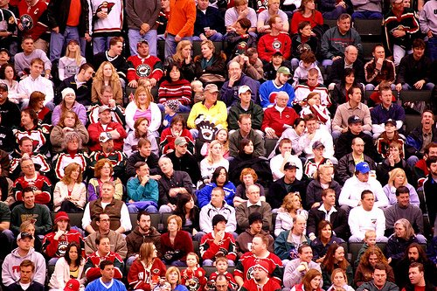
Selecting a population
  a population is a set of people
    in particular location(s)
    using particular language(s)
    during a particular time period
    doing specific activities of interest
  Important to consider how those choices might impact your results
    Chinese users vs. US users during Golden Week
    sports related change during Super Bowl week in US vs. UK
    users in English speaking countries vs. users of English UI vs. users in US

Slide 41
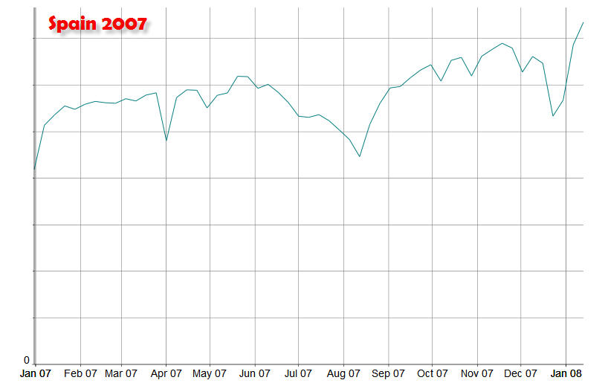
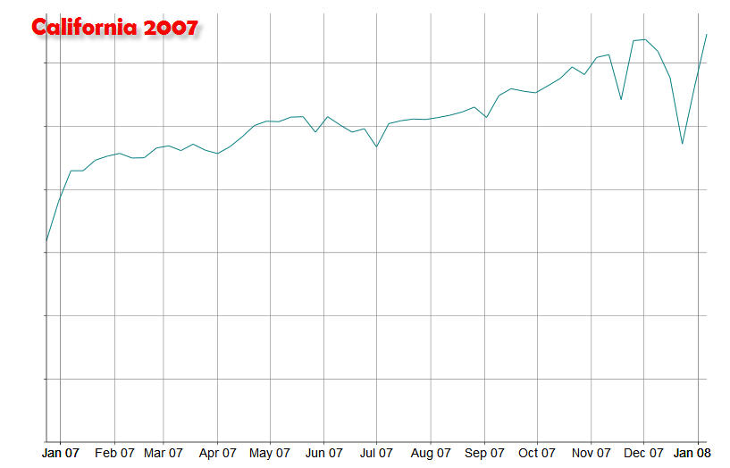

Slide 42
Sampling from your population
  A sample is a segment of your population
    e.g., the subset that gets the experimental treatment vs. the control subset
    important that samples be randomly selected
      with large datasets, useful to determine that samples are not biased in particular ways (e.g., pre-periods)
    within-user sampling (all users get all treatments) is very powerful (e.g., studies reordering search results)
  How big a sample do you need?
    depends on the size of effect you want to detect -- we refer to this as power
    in logs studies, you can trade off number of users vs. time

Slide 43
Power
  power is 1- prob(Type II) error
    probability that when there really is a difference, you will statistically detect it
    most hypothesis testing is all about Type I error
  power depends on
    size of difference you want to be able to detect
    standard error of the measurement
    number of observations
  power can (and should be) pre-calculated
    too many studies where there isn't enough power to detect the effect of interest
    there are standard formulas, e.g., en.wikipedia.org/wiki/Statistical_power

Slide 44
Power example: variability matters
effect size
(% change from control)
standard error
events required
(for 90% power at 95% conf. interval)
Metric A
1%
4.4
1,500,000
Metric B
1%
7.0
4,000,000
Notes:
I like this. Worth making look nice!

Slide 45
Treatments
  treatments: explicit changes you make to the user experience (directly or indirectly user visible)
  may be compared to other treatments or to the control
    if multiple aspects change, need multiple comparisons to tease out the different effects
      you can make sweeping changes, but you often cannot interpret them.
      a multifactorial experiment is sometimes the answer
    example: google video universal
      change in what people see: playable thumbnail of video for video results (left vs. right)
      change in when they see it: algorithm for which video results show the thumbnail

Slide 46
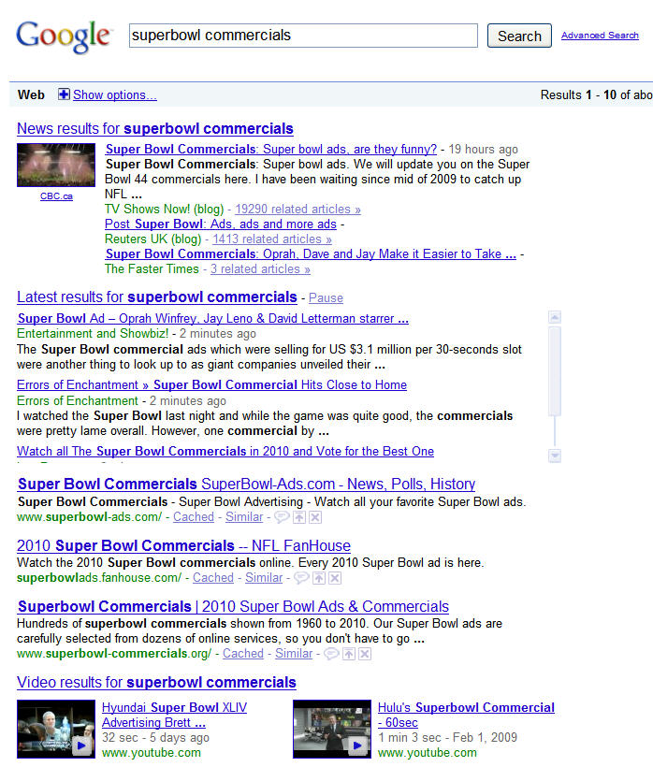

Slide 47
Example: Video universal
  show a playable thumbnail of a video in web results for highly ranked video results
  explore different visual treatments for thumbnails and different levels of triggering the thumbnail
  treatments
    thumbnail on right and conservative triggering
    thumbnail on right and aggressive triggering
    thumbnail on left and conservative triggering
    thumbnail on left and aggressive triggering
    control (never show thumbnail; never trigger)
→ note that this is not a complete factorial experiment
(should have 9 conditions)

Slide 48
Controls
  a control is the standard user experience that you are comparing a change to
  What is the right control?
    gold standard:
      equivalent sample from same population
      doing similar tasks
      using either
        The existing user experience
        A baseline “minimal” “boring” user experience

Slide 49
How controls go wrong
treatment is opt-in
treatment or control limited to subset (e.g., treatment only for English, control world-wide)
treatment and control at different times
control is all the data, treatment is limited to events that showed something novel

Slide 50
Counter-factuals
  controls are not just who/what you count,
  but what you log
    you need to identify the events where users would have experienced the treatment (since it is rarely all events)
      > referred to as counter-factual
    video universal example: log in the control when either conservative or aggressive triggering would have happened
      control shows no video universal results
      log that this page would have shown a video universal instance under (e.g.,) aggressive triggering
      enables you to compare equivalent subsets of the data in the two samples

Slide 51
Logging counter-factuals
  needs to be done at expt time
    often very hard to reverse-engineer later
    gives a true apples-to-apples comparison
    not always possible (e.g., if decisions being made "on the fly")

Slide 52
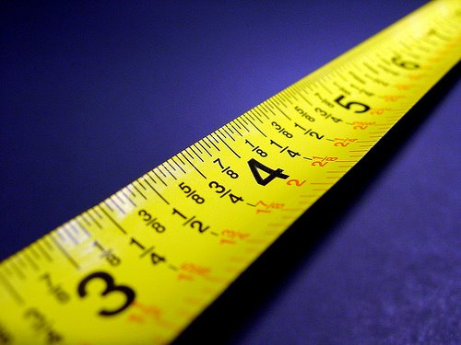
What should you measure?
  often have dozens or hundreds of
  possible effects
    clickthrough rate,
    ave. no. of ads shown,
    next page rate,
    some matter almost all the time
      in search: CTR
    some matter to your hypothesis
      if you put a new widget on the page, do people use it?
      if you have a task flow, do people complete the task?
    some are collaterally interesting
      increased nextpage rate to measure "didn't find it"
    sometimes finding the "right" metrics is hard
      “good abandonment”
Notes:
Should note that we do NOT determine all the variables a priori, but iterate over time.
Also note that it's smarter to gather LOTS of variables, then sort out later what's going on.
If you don't collect it, you can never interpret it (and you can't always repeat the experiment)

Slide 53
Remember: log data is NOT good for…
  Figuring out why people do things
    need more direct user input
  Tracking a user over time
    without special tracking software, the best you can do on the web is a cookie
      a cookie is not a user [Sue to discuss more later]
  Measuring satisfaction/feelings directly
    there are some indirect measures (e.g., how often they return)

Slide 54
Experiment Analysis
Common assumptions you can’t count on
Confidence intervals
Managing experiment-wide error
Real world challenges
Simpson’s Paradox
Not losing track of the big picture

Slide 55
Experiment Analysis for large data sets
  Different from Fisherian hypothesis testing
    Too many dependent variables
      > t-test, F-test often don't make sense
    don't have factorial designs
    Type II error is as important as Type I
True difference exists
True difference does not exist
    Many assumptions don't hold:
      > independence of observations
      > normal distributions
      > homoscedasticity
Difference observed in expt
Correct positive result
False Alarm (Type I error)
Difference not observed in expt
Miss
(Type II error)
Correct negative result

Slide 56
Invalid assumptions: independent observations
  if I clicked on a "show more" link before, I'm more likely to do it again
  if I queried for a topic before, I'm more likely to query for that topic again
  if I search a lot today, I'm more likely to search a lot tomorrow

Slide 57
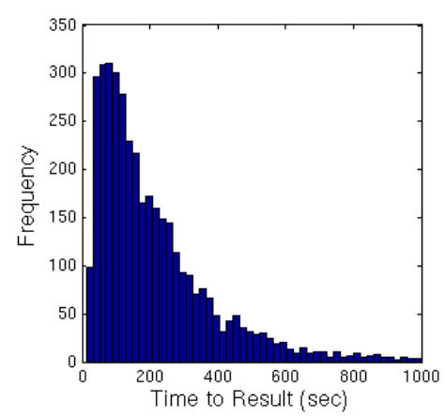
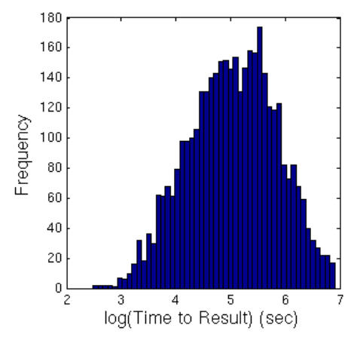
Invalid assumptions: Data is Gaussian
  Doesn't the law of large numbers apply?
    Apparently not
  What to do: transform the data if you can
  Most common for time-based measures (e.g., time to result)
    log transform can be useful
    geo-metric mean (multiplicative mean) is an alternative transformation
Notes:
But we don't do log transforms of time data

Slide 58
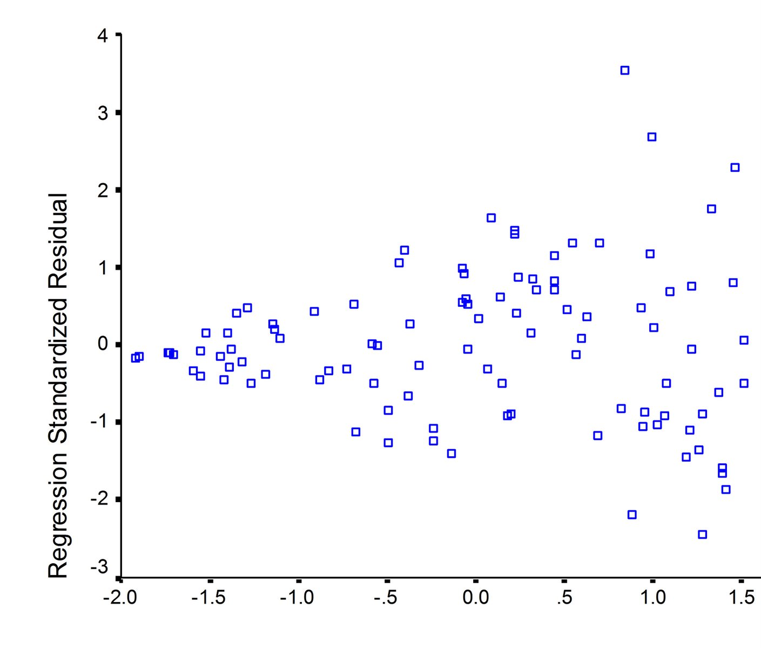
Invalid assumptions: Homoscedasticity
Variability (deviation from line of fit) is not uniform

Slide 59
Confidence intervals
  confidence interval (C.I.): interval around the treatment mean that contains the true value of the mean x% (typically 95%) of the time
  C.I.s that do not contain the control mean are statistically significant
  this is an independent test for each metric
    thus, you will get 1 in 20 results (for 95% C.I.s) that are spurious -- you just don't know which ones
  C.I.s are not necessarily straightforward to compute.

Slide 60
Managing experiment wide error
  Experiment wide error: overall probability of Type I error.
    Each individual result has a 5% chance of being spuriously significant (Type I error)
    Close to 1.0 that at least one item is spuriously significant.
  If you have a set of a priori metrics of interest, you can modify the confidence interval size to take into account the number of metrics
  Instead, you may have many metrics, and not know all of the interesting ones until after you do the analysis.
  Many of your metrics may be correlated
    Lack of a correlation when you expect one is a clue

Slide 61
Managing real world challenges
  Data from all around the world
    eg: collecting data for a given day (start/end times differ), collecting "daytime" data
  One-of-a-kind events
    death of Michael Jackson/Anna Nicole Smith
    problems with data collection server
    data schema changes
  Multiple languages
    practical issues in processing many orthographies
      ex: dividing into words to compare query overlap
    restricting language:
      language ≠ country
      query language ≠ UI language

Slide 62
Analysis challenges
  Simpson's paradox: simultaneous mix and metric changes
    changes in mix (denominators) make combined metrics (ratios) inconsistent with yearly metrics
Batting averages
1995
1996
Combined
Derek Jeter
12/48
.250
183/582
.314
195/630
.310
David Justice
104/411
.253
45/140
.321
149/551
.270
Notes:
Give the table a title of Batting Averages

Slide 63
More on Simpson's paradox
  neither the individual data (the yearly metrics) or the combined data is inherently more correct
    it depends, of course, on what you want to do
  once you have mix changes (changes to the denominators across subgroups), all metrics (changes to the ratios) are suspect
    always compare your denominators across samples
    if you wanted to produce a mix change, that's fine
    can you restrict analysis to the data not impacted by the mix change (the subset that didn't change)?
    minimally, be up front about this in any writeup

Slide 64
Detailed analyses ➔ Big picture
  not all effects will point the same direction
    take a closer look at the items going in the "wrong" direction
      - can you interpret them?
        > e.g., people are doing fewer next pages because they are finding their answer on the first page
      - could they be artifactual?
      - what if they are real?
        > what should be the impact on your conclusions? on your decision?
  significance and impact are not the same thing
    Couching things in terms of % change vs. absolute change helps
    A substantial effect size depends on what you want to do with the data

Slide 65
Summing up
  Experiment design is not easy, but it will save you a lot of time later
    population/sample selection
    power calculation
    counter-factuals
    controlling incidental differences
  Analysis has its own pitfalls
    Type I (false alarms) and Type II (misses) errors
    Simpson's paradox
    real world challenges
  Don't lose the big picture in the details

Slide 66
Section 4: Discussion
All

Slide 67
Our story to this point…
Perspectives on log analysis
  Understanding user behavior Jamie
    What you can / cannot learn from logs
    Observations vs. experiments
    Different kinds of logs
  How to design / analyze large logs Robin
    Selecting populations
    Statistical Power
    Treatments
    Controls
    Experimental error

Slide 68
Discussion
How might you use log analysis in your research?
What other things might you use large data set analysis to learn?
  Time-based data vs. non-time data
Large vs. small data sets?
How do HCI researchers review log analysis papers?
  Isn’t this just “large data set” analysis skills?
    (A la medical data sets)
    Other kinds of data sets:
      Large survey data
      Medical logs
      Library logs

Slide 69
Section 5: Practical Considerations for Log Analysis

Slide 70
Overview
Data collection and storage [Susan Dumais]
  How to log the data
  How to store the data
  How to use the data responsibly
Data analysis [Dan Russell]
  How to clean the data
Discussion: Log analysis and the HCI community

Slide 71
Section 6:
Data Collection, Storage and Use
Susan Dumais and Jaime Teevan
Microsoft Research

Slide 72
Overview
How to log the data?
How to store the data?
How to use the data responsibly?
Building large-scale systems out-of-scope

Slide 73
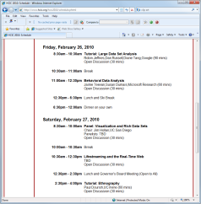
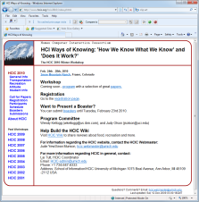
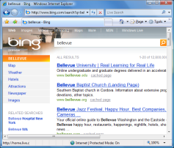
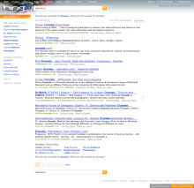
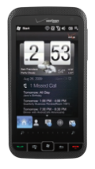
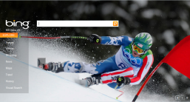
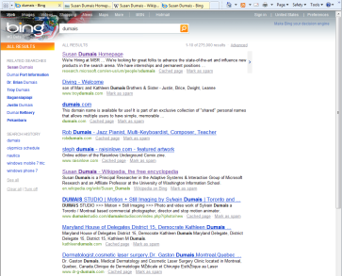


A Simple Example
hcic
hcic
Web Service
hcic
hcic
Web Service
“SERP”
Logging search Queries and Clicked Results
Logging Queries
  Basic data: <query, userID, time> – time_{C1}, time_{S1}, time_{S2} time_{C2}
  Additional contextual data:
    Where did the query come from? [entry points; refer]
    What results were returned?
    What algorithm or presentation was used?
    Other metadata about the state of the system
Web Service
Notes:
Anecdotes:
Office Help (10 years ago all on client, so no idea what queries people were asking or whether they were satisfied)
Broder’s informational/navigational/transactional @ TREC

Slide 74
A Simple Example (cont’d)
hcic
hcic
Web Service
hcic
hcic
Web Service
“SERP”
Web Service
Logging Clicked Results (on the SERP)
  How can a Web service know which links are clicked?
    Proxy re-direct [adds complexity & latency; may influence user interaction]
    Script (e.g., CSJS) [dom and cross-browser challenges]
  What happened after the result was clicked?
    Going beyond the SERP is difficult
  Was the result opened in another browser window or tab?
    Browser actions (back, caching, new tab) difficult to capture
    Matters for interpreting user actions [next slide]
  Need richer client instrumentation to interpret search behavior
hcic
Notes:
??? Examples of proxy redirect and script ???

Slide 75
Browsers, Tabs and Time
Interpreting what happens on the SERP
Scenario 1:
  7:12 SERP shown
  7:13 click R1
  <“back” to SERP>
  7:14 click R5
  <“back” to SERP>
  7:15 click RS1
  <“back” to SERP>
  7:16 go to new search engine
Scenario 2
  7:12 SERP shown
  7:13 click R1
    <“open in new tab”>
  7:14 click R5
    <“open in new tab”>
  7:15 click RS1
    <“open in new tab”>
  7:16 read R1
  10:21 read R5
  13:26 copies links to doc
Both look the same, if all you capture is clicks on result links
Important in interpreting user behavior
  Tabbed browsing accounted for 10.5% of clicks in 2006 study
  81% of observed search sequences are ambiguous
Notes:
Scenario 1 – linear
Scenario 2 – parallel
Ref:
Weinreich et al., Off the beaten tracks: Exploring three aspects of Web navigation, WWW 2006.
Viermetz et al., Relevance and impact of tabbed browsing on Web usage mining.

Slide 76
Richer Client Instrumentation
Toolbar (or other client code)
  Richer logging (e.g., browser events, mouse/keyboard events, screen capture, eye-tracking, etc.)
  Several HCI studies of this type [e.g., Keller et al., Cutrell et al., …]
  Importance of robust software, and data agreements
Instrumented panel
  A group of people who use client code regularly; may also involve subsequent follow-up
  Nice mix of in situ use (the what) and support for further probing (the why)
  E.g., Curious Browser [next slide]
Data recorded on the client
  But still needs to get logged centrally on a server
  Consolidation on client possible

Slide 77
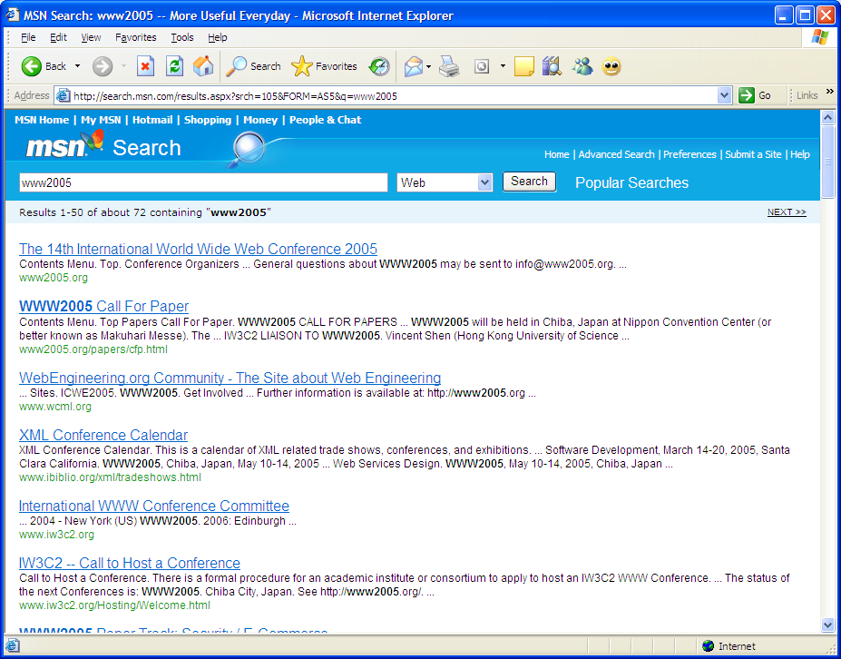
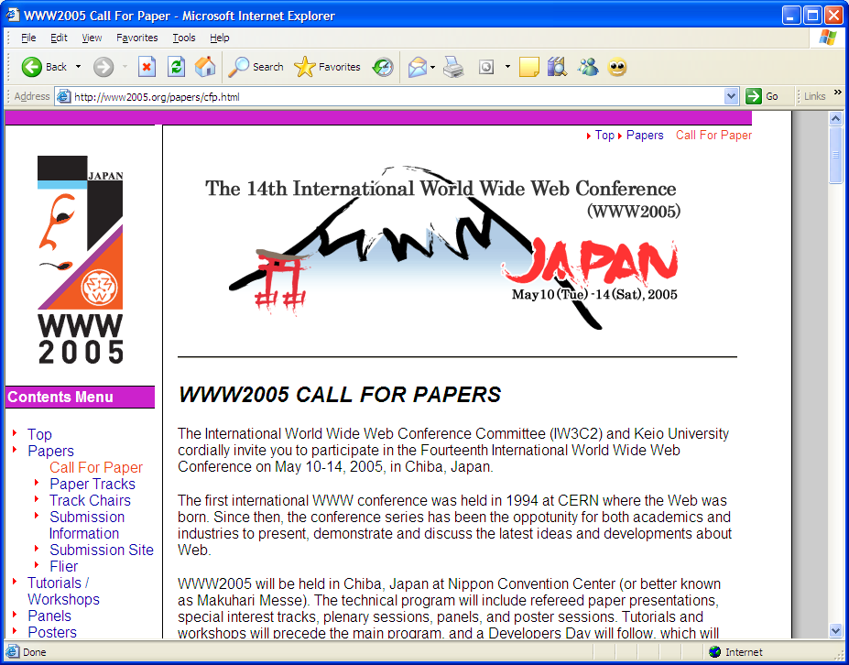
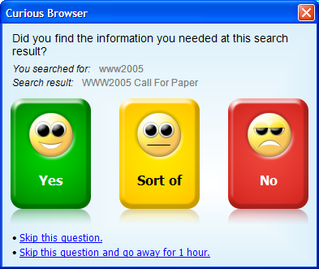
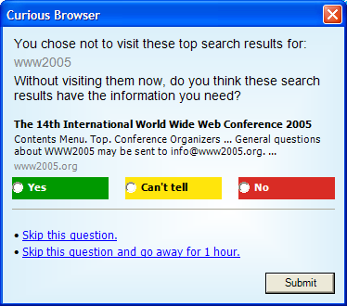
Example: Curious Browser
Plug-in to examine relationship between explicit and implicit behavior
  Capture lots of implicit actions (e.g., click, click position, dwell time, scroll)
  Probe for explicit user judgments of relevance of a page to the Query
Deployed to ~4k people in US and Japan
Learned models to predict explicit judgments from implicit indicators
  45% accuracy w/ just click; 75% accuracy w/ click + dwell + session
Used to learn identify important features, and run model in online evaluation
Notes:
Impt: People’s own information needs (and judgments) in standard work settings
Outcomes: Guidance about what variables matter
Can apply learned models in open loop ….
Ref:
Fox et al. Evaluating implicit measures to improve Web search. ACM:TOIS, 23(2), 2005, 147-168.
Other examples:
Weinreich et al., Off the beaten tracks: Exploring three aspects of Web navigation, WWW 2006.
Catledge & Pitkow
Tauscher & Greenberg
Cockburn & McKenzie

Slide 78
Setting Up Server-side Logging
What to log?
  Log as much as possible
  But … make reasonable choices
    Richly instrumented client experiments can provide some guidance
    Pragmatics about amount of data, storage required will also guide
What to do with the data?
  The data is a large collection of events, often keyed w/ time
    E.g., <time, userID, action, value, context>
  Keep as much raw data as possible (and allowable)
  Post-process data to put into a more usable form
    Integrating across servers to organize the data by time, userID, etc.
    Normalizing time, URLs, etc.
    Richer data cleaning [Dan, next section]

Slide 79
Three Important Practical Issues
Scale
  Storage requirements
    E.g., 1k bytes/record x 10 records/query x 10 mil queries/day = 100 Gb/day
  Network bandwidth
    Client to server
    Data center to data center
Time
  Client time is closer to the user, but can be wrong or reset
  Server time includes network latencies, but controllable
  In both cases, need to synchronize time across multiple machines
  Data integration: Ensure that joins of data are all using the same basis (e.g., UTC vs. local time)
  Importance: Accurate timing data is critical for understanding sequence of activities, daily temporal patterns, etc.
What is a user?
Notes:
Possible lossiness
Synchronization: Enron example

Slide 80
What is a User?
Http cookies, IP address, temporary ID
  Provides broad coverage and easy to use, but …
  Multiple people use same machine
  Same person uses multiple machines (and browsers)
    How many cookies did you use today?
  Lots of churn in these IDs
    Jupiter Res (39% delete cookies monthly); Comscore (2.5x inflation)
Login, or Download of client code (e.g., browser plug-in)
  Better correspondence to people, but …
  Requires sign-in or download
  Results in a smaller and biased sample of people or data (who remember to login, decided to download, etc.)
Either way, loss of data

Slide 81
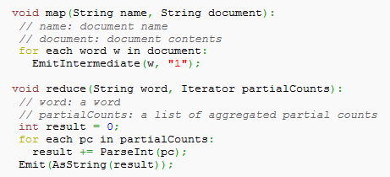
How To Do Log Analysis at Scale?
MapReduce, Hadoop, Pig … oh my!
What are they?
  MapReduce is a programming model for expressing distributed computations while hiding details of parallelization, data distribution, load balancing, fault tolerance, etc.
    Key idea: partition problem into pieces which can be done in parallel
    Map (input_key, input_value) -> list (output_key, intermediate_value)
    Reduce (output_key, intermediate_value) -> list (output_key, output_value)
  Hadoop open-source implementation of MapReduce
  Pig execution engine on top of Hadoop
Why would you want to use them?
  Efficient for ad-hoc operations on large-scale data
  E.g., Count number words in a large collection of documents
How can you use them?
  Many universities have compute clusters
  Also, Amazon EC3, Microsoft-NSF, and others
Notes:
http://code.google.com/edu/parallel/mapreduce-tutorial.html
http://lucene.apache.org/hadoop/
Jeffrey Dean and Sanjay Ghemawat. (2004) MapReduce: Simplified Data Processing on Large Clusters. Proceedings of the 6th Symposium on Operating System Design and Implementation (OSDI 2004), pages 137-150.

Slide 82
Using the Data Responsibly
What data is collected and how it can be used
  User agreements (terms of service)
  Emerging industry standards and best practices
Trade-offs
  More data: more intrusive and potential privacy concerns, but also more useful for analysis and system improvement
  Less data: less intrusive, but less useful
Risk, benefit, trust

Slide 83
Using the Data Responsibly
Control access to the data
  Internally: access control; data retention policy
  Externally: risky (e.g., AOL, Netflix, Enron, FB public)
Protect user privacy
  Directly identifiable information
    Social security, credit card, driver’s license numbers
  Indirectly identifiable information
    Names, locations, phone numbers … you’re so vain (e.g., AOL)
    Putting together multiple sources indirectly (e.g., Netflix, hospital records)
      Linking public and private data
      k-anonymity
Transparency and user control
  Publicly available privacy policy
  Giving users control to delete, opt-out, etc.
Notes:
1) AOL data, released to academic community Aug 2006 (at SIGIR)
<AnonID, Query, Qtime, ItemRank, ClickedURL>
Two days later NYT story [Michael Barbaro & Tom Zeller Jr., “A Face Is Exposed for AOL Searcher No. 4417749,” New York Times, August 9, 2006] <ID 4417749 was found to be Thelma Arnold, a 62 year old woman living in GA.>
Direct: social security numbers, drive license numbers, and credit card numbers
Indirect:
- Ms. Arnold narrowed down her location by making multiple queries for businesses and services in Lilburn, GA. (Lilburn has 11k people)
- Ms. Arnold further helped the NYT by making a number of queries for a Jarrett Arnold (and other members of the Arnold clan).
From here, the NYT could contact all citizens of Lilburn with the last name Arnold (of which there are only 14).
When contacted, she acknowledged that these were her queries
2) Netflix – <UserID, ItemID, Rating, Time?>
http://www.cs.utexas.edu/~shmat/shmat_netflix-prelim.pdf
Direct: nothing …
Indirect: linked private (Netflix ratings) w/ public (IMDB reviews) -- using infrequently rated movies and time
[UMN Movie Lens research too, at SIGIR 2006] Dan Frankowski, Dan Cosley, Shilad Sen, Loren Terveen, John Riedl. You are what you say: privacy risks of public mentions.
3) L. Sweeney (1997) – Showed how to de-anonymize Massachusetts hospital discharge database by joining it with a public voter database.
k-Anonymity: Any algorithm or process that anonymizes data by insuring each entity in the data is indistinguishable from at least a specific number of other such entities in the data.

Slide 84
Data cleaning for large logs
Dan Russell

Slide 85
Why clean logs data?
The big false assumption: Isn’t logs data intrinsically clean?
  A: Nope.

Slide 86
Typical log format
210.116.18.93 - - [23/Jan/2005:13:37:12 -0800]
“GET /modules.php?name=News&file=friend&op=FriendSend&sid=8225 HTTP/1.1" 200 2705
"http://www.olloo.mn/modules.php?name=News&file=article&catid=25&sid=8225" "Mozilla/4.0
(compatible; MSIE 6.0; Windows NT 5.1; SV1)“ …
– Client IP - 210.126.19.93
– Date - 23/Jan/2005
– Accessed time - 13:37:12
– Method - GET (to request page ), POST, HEAD (send to server)
– Protocol - HTTP/1.1
– Status code - 200 (Success), 401,301,500 (error)
– Size of file - 2705
– Agent type - Mozilla/4.0
– Operating system - Windows NT
http://www.olloo.mn/modules.php?name=News&file=article&catid=25&sid=8225 →
→ http://www.olloo.mn/modules.php?name=News&file=friend&op=FriendSend&sid=8225
What this really means… A visitor (210.126.19.93) viewing the news who sent it to friend.

Slide 87
Sources of noise
Non-completion due to caching (back button)
Also… tabs… invisible…
  Also – new browser instances.
C.html
D.html
E.html
B.html
F.html
Topological Structure
Path completion
Clicks
Reality
H.html
J.html
A.html
G.html
I.html
K.html
A,B,C,D,F
A,B,C,D,C,B,F
L.html
M.html
O.html
Q.html
N.html
P.html

Slide 88
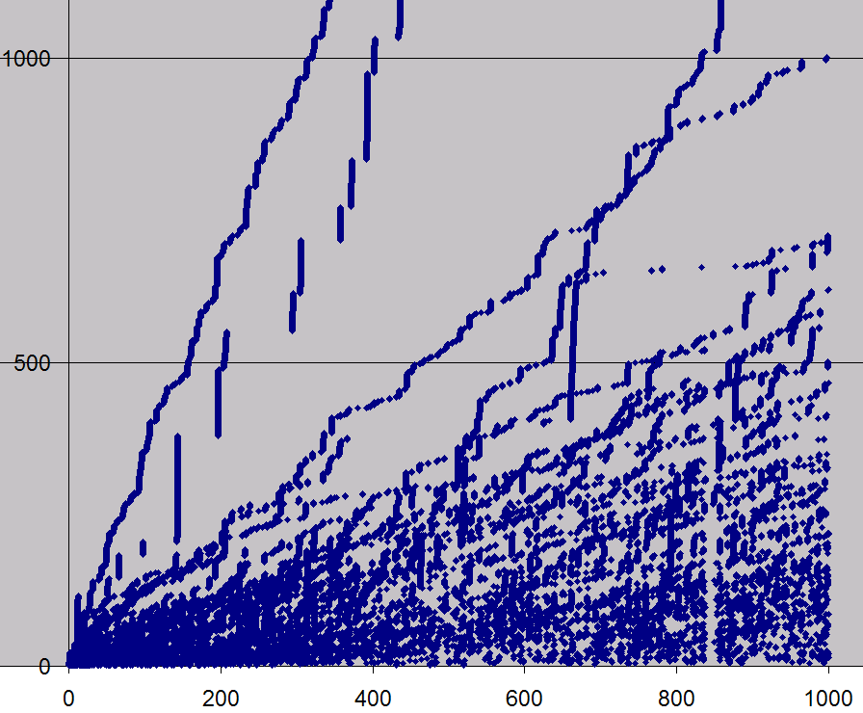
A real example
A previously unknown gap in the data
Sum number of
clicks against
time
Time (hours)
Notes:
Here, plotting 400 individual users; clicks over time. X axis shows when the clicks occurred; Y axis is the running sum of the number of clicks by that user.

Slide 89
What we’ll skip…
Often data cleaning includes
(a) input / value validation
(b) duplicate detection / removal
    We’ll assume you know how to do that
  (c) multiple clocks – syncing time across servers / clients
  But… note that valid data definitions often shift out from under you. (See schema change later)

Slide 90
When might you NOT need to clean data?
Examples:
  When the data is going to be presented in ranks.
    Example: counting most popular queries. Then outliers
    are either really obvious, or don’t matter
  When you need to understand overall behavior for system purposes
    Example: traffic modeling for queries—probably don’t want to remove outliers because the system needs to accommodate them as well!

Slide 91
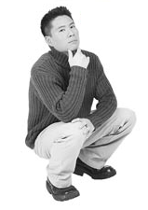
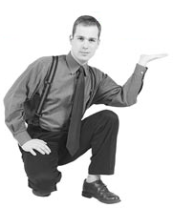
Before cleaning data
Consider the point of cleaning the data
  What analyses are you going to run over the data?
  Will the data you’re cleaning damage or improve the analysis?
How about we remove all the short click queries?
So…what DO I want to learn from this data?

Slide 92
Importance of data expertise
Data expertise is important for understanding the data, the problem and interpreting the results
  Often.. .background knowledge particular to the data or system:
    “That counter resets to 0 if the number of calls exceeds N”.
    “The missing values are represented by 0, but the default amount is 0 too.”
Insufficient DE is a common cause of poor data interpretation
DE should be documented with the data metadata

Slide 93
Outliers
Often indicative either of
  measurement error, or that the population has a heavy-tailed distribution.
  Beware of distributions with highly non-normal distributions
    Be cautious when using tool or intuitions that assume a normal distribution (or, when sub-tools or models make that assumption)
    a frequent cause of outliers is a mixture of two distributions, which may be two distinct sub-populations

Slide 94
Outliers: Common types from search
Quantity:
  10K searches from the same cookie in one day
  Suspicious whole numbers: exactly 10,000 searches from single cookie
Notes:
Note: the same search repeated idea is from Jamie and Sue.

Slide 95
Outliers: Common types from search
Quantity:
  10K searches from the same cookie in one day
  Suspicious whole numbers: exactly 10,000 searches from single cookie
Repeated:
  The same search repeated over-frequently
  The same search repeated at the same time (10:01AM)
  The same search repeated at a repeating interval (every 1000 seconds)
Time of day | Query
12:02:01 | [ google ]
13:02:01 | [ google ]
14:02:01 | [ google ]
15:02:01 | [ google ]
16:02:01 | [ google ]
17:02:01 | [ google ]
Notes:
Note: the same search repeated idea is from Jamie and Sue.

Slide 96
Treatment of outliers: Many methods
Remove outliers when you’re looking for average user behaviors
  Methods:
    Error bounds, tolerance limits – control charts
    Model based – regression depth, analysis of residuals
    Kernel estimation
    Distributional
    Time Series outliers
    Median and quantiles to measure / identify outliers
Sample reference:
Exploratory Data Mining and Data Quality, Dasu & Johnson (2004)

Slide 97

Identifying bots & spam
Adversarial environment
How to ID bots:
  Queries too fast to be humanoid-plausible
  High query volume for a single query
  Queries too specialized (and repeated) to be real
  Too many ad clicks by cookie

Slide 98
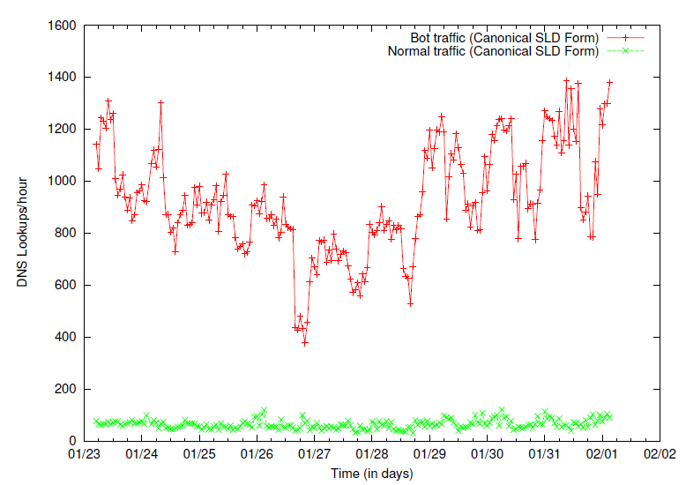
Bot traffic tends to have pathological behaviors
Botnet Detection and Response
The Network is the Infection
David Dagon, OARC Workshop 2005,
Such as abnormally high page-request or DNS lookup rates

Slide 99
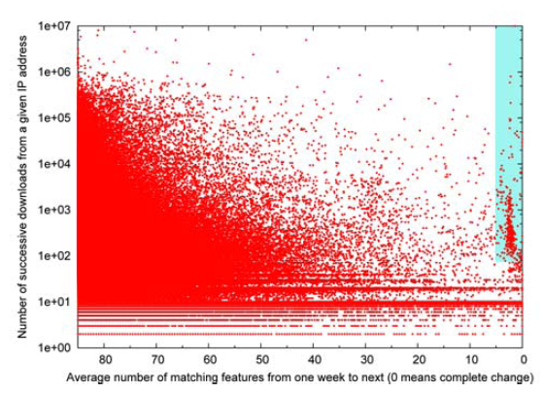
How to ID spam
Spam, Damn Spam, and Statistics: Using statistical analysis to locate spam web pages. D. Fetterly, M. Manasse and M. Najork. 7th Int’l Workshop on the Web and Databases, June 2004.
  Look for outliers along different kinds of features
    Example: click rapidity, interclick time variability,
Spammy sites often change many of their features (page titles, link anchor text, etc.) rapidly
week to week

Slide 100
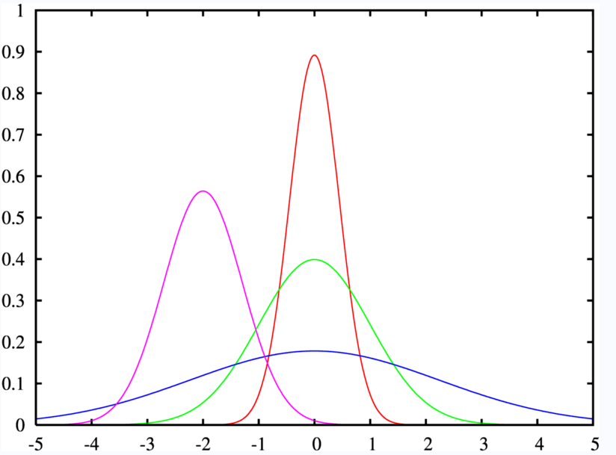
Bots / spam clicks look like mixtures
Although bots tend to be tightly packed and far from the large mass of data

Slide 101
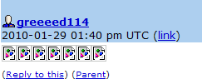
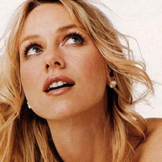
Story about spam…
98.3% of queries for [naomi watts] had no click
Checking the referers of these queries led us to a cluster of LiveJournal users
img src="http://www.google.ru/search?q=naomi+watts...
What??
Comment spam by greeed114. No friends, no entries. Apparently trying to boost Naomi Watts on IMDB, Google, and MySpace.

Slide 102
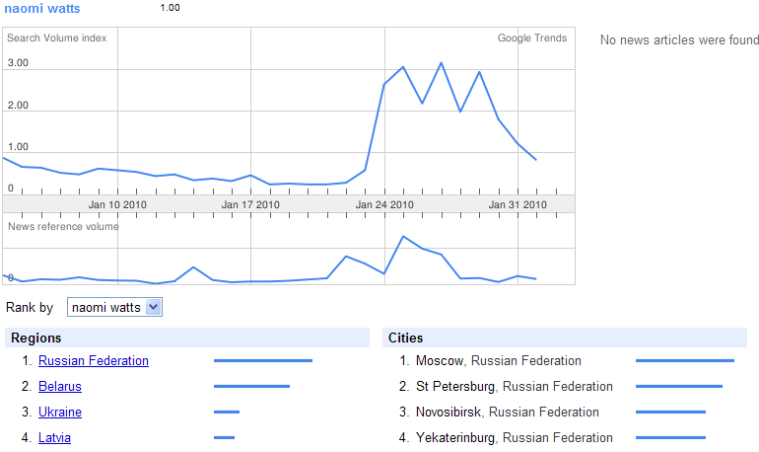
Did it work?

Slide 103
Cleaning heuristics:
Be sure to account for known errors
Examples:
  Known data drops
    e.g., when a server went down during data collection period – need to account for missing data
  Known edge cases
    e.g., when errors occur at boundaries, such as timing cutoffs for behaviors (when do you define a behavior such as a search session as “over”)

Slide 104
Simple ways to look for outliers
Simple queries are effective:
Select Field, count(*) as Cnt
from Table
Group by Field
Order by Cnt Desc
  Hidden NULL values at the head of the list, typos at the end of the list
Visualize your data
  Often can see data discrepancies that are difficult to note in statistics
  LOOK at a subsample… by hand. (Be willing to spend the time)

Slide 105
But ultimately…
Nearly all data cleaning operations are special purpose, one-off kinds of operations

Slide 106
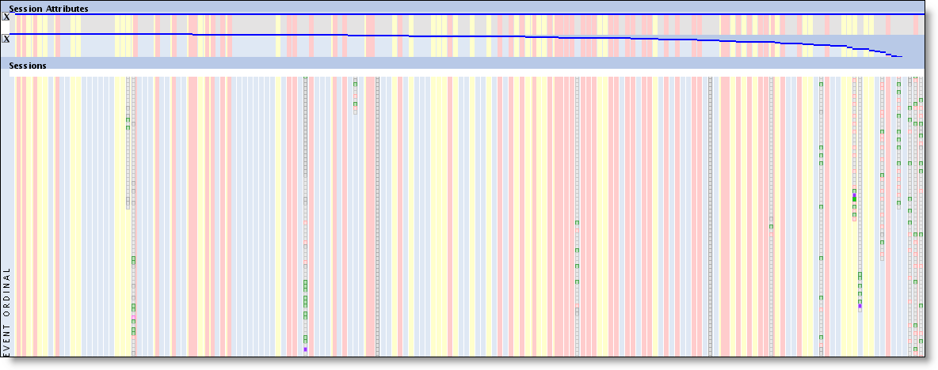
But ultimately…
Big hint: Visual representations of the data ROCK!
Why? Easy to spot all kinds of variations on the data quality that you might not anticipate a priori.
Notes:
Pink vertical stripes indicate the presence of duplicated sessions. Easy to spot in the data.

Slide 107
Careful about skew, not just outliers
For example, if an NBA-related query is coming from Wisconsin, search queries are biased by local preferences. Google Trends and Google Insights data shows pretty strong indications of this (look at the Cities entries in either product):
http://www.google.com/trends?q=Milwaukee+bucks&ctab=0&geo=all&date=all&sort=0
http://www.google.com/trends?q=lakers&ctab=0&geo=all&date=all&sort=0
http://www.google.com/trends?q=celtics&ctab=0&geo=all&date=all&sort=0
http://www.google.com/trends?q=manchester+united&ctab=0&geo=all&date=all
http://www.google.com/trends?q=chelsea&ctab=0&geo=all&date=all&sort=0
http://www.google.com/insights/search/#q=lakers%2C%20celtics%2Cmilwaukee%20bucks&cmpt=q
http://www.google.com/insights/search/#q=arsenal%2Cmanchester%20united%2Cchelsea&cmpt=q
Using this data will generate some interesting correlations. For example, Ghana has a higher interest in Chelsea (because one of the Chelsea players is Ghanaian).
Similarly for temporal variations (see Robin’s query volume variation over the year)
Notes:
>> CHECK THIS!

Slide 108
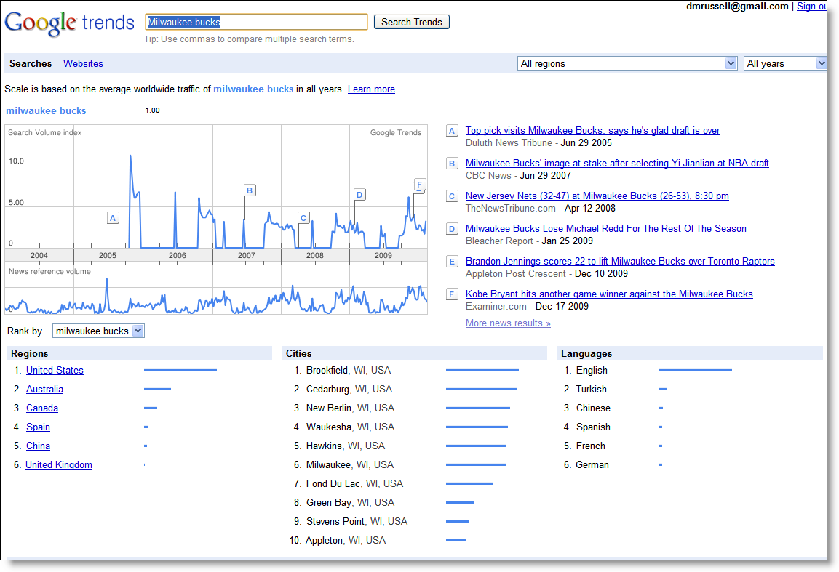

Slide 109
Pragmatics
Keep track of what data cleaning you do!
  Add lots of metadata to describe what operations you’ve run
  (It’s too easy to do the work, then forget which cleaning operations you’ve already run.)
    Example: data cleaning story from ClimateGate –only the cleaned data was available…
  Add even more metadata so you can interpret this (clean) data in the future.
    Sad story: I’ve lost lots of work because I couldn’t remember what this dataset was, how it was extracted, or what it meant… as little as 2 weeks in the past!!

Slide 110
Pragmatics
BEWARE of truncated data sets!
  All too common: you think you’re pulling data from Jan 1, 20?? – Dec 31, 20??, but you only get Jan 1 – Nov 17
BEWARE of censored / preprocessed data!
  Example: Has this data stream been cleaned-for-safe-search before you get it?
    Story: Looking at queries that have a particular UI treatment. (Image univeral triggering) We noticed the porn rate was phenomenally low. Why? Turns out that this UI treatment has a porn-filter BEFORE the UI treatment is applied, therefore, the data from the logs behavior was already implicitly run through a porn filter.

Slide 111
Pragmatics
BEWARE of capped values
  Does your measuring instrument go all the way to 11?
  Real problem: time on task (for certain experiments) is measured only out to X seconds. All instances that are > X seconds are either recorded as X, or dropped. (Both are bad, but you need to know which data treatment your system follows.)
    This seems especially true for very long user session behaviors, time-on-task measurements, click duration, etc.
  Metadata should capture this
  Note: big spikes in the data often indicate this kind of problem

Slide 112
Pragmatics
Do sanity checks constantly
  Don’t underestimate their value.
  Right number of files? Roughly the right size? Expected number of records?
  Does this data trend look roughly like previous trends?
  Check sampling frequency (Are you using downsampled logs, or do you have the complete set?)

Slide 113
Data integration
Be sure that joins of data are all using the same basis
  e.g., time values that are measured consistently – UTC vs. local timezone
Time | Event
18:01:19 | Query A
18:01:20 | Query A
18:05:30 | Query B
18:25:30 | Query B
19:53:01 | Query B
19:53:02 | Query C
PST
Time | Event
18:01:29 | Query A
18:05:30 | Query B
19:53:02 | Query C
Zulu
Time | Event
18:01:19 | Query A
18:25:30 | Query B
19:53:01 | Query B

Slide 114
Data Cleaning Summary
CAUTION: Many, many potholes to fall into
Know what the purpose of your data cleaning is for
Maintain metadata
Beware of domain expertise failure
Ensure that the underlying data schema is what you think it is

Slide 115
Section 8: Log Analysis and the HCI Community
All

Slide 116
Discussion: Log Analysis and HCI
Is log analysis relevant to HCI?
How to present/review log analysis research
  Observational
  Experimental
How to generate logs
Sources of log data

Slide 117
Is Log Analysis Relevant to HCI?
“Know thy user”
  In situ large-scale log provide unique insights
  Real behavior
What kinds of things can we learn?
  Patterns of behavior (e.g., info seeking goals)
  Use of systems (e.g., how successful are people in using the currrent vs. new system)
  Experimental comparison of alternatives

Slide 118
How to Present/Review Log Analysis
Examples of successful log analysis papers
  Several published logs analysis of observational type
  But fewer published reports of the experimental type
Determining if conclusions are valid
  Significance unlikely to be a problem
  Data cleanliness important
  Only draw supported claims (careful with intent)

Slide 119
How to Generate Logs
Use existing logged data
  Explore sources in your community (e.g., proxy logs)
  Work with a company (e.g., intern, visiting researcher)
  Construct targeted questions
Generate your own logs
  Focuses on questions of unique interest to you
Construct community resources
  Shared software and tools
    Client side logger (e.g., VIBE logger)
  Shared data sets
  Shared experimental platform to deploy experiments (and to attract visitors)
  Other ideas?

Slide 120
Interesting Sources of Log Data
Anyone who runs a Web services
Proxy (or library) logs at your institution
Publically available social resources
  Wikipedia (content, edit history)
  Twitter
  Delicious, Flickr
  Facebook public data?
Others?
  GPS
  Virtual worlds
  Cell call logs

