Slide 1
Using Large Scale Log Analysis to Understand Human Behavior
UNC 2015
Jaime Teevan, Microsoft Reseach
Notes:
Behavioral log analysis is really a study of how people use information.

Slide 2
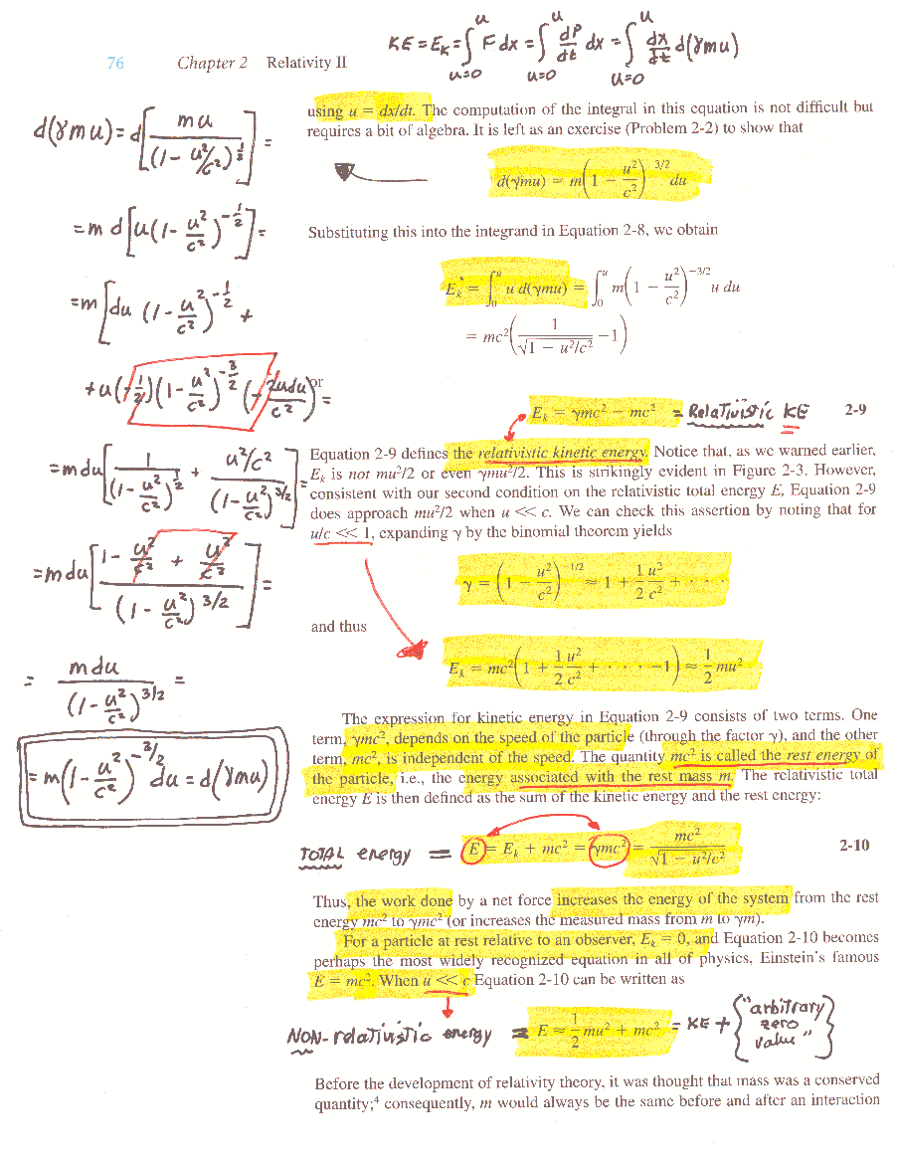
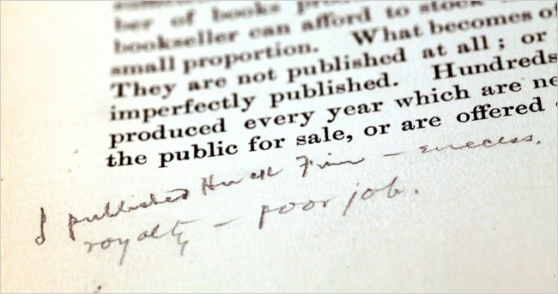

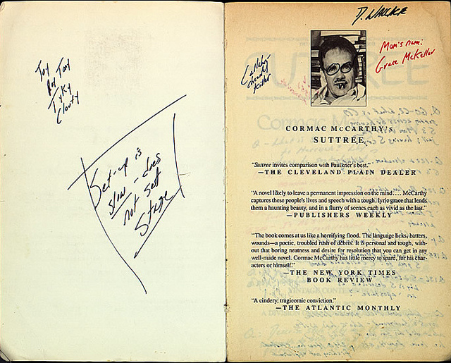

Students prefer used textbooks that are annotated. [Marshall 1998]
Mark Twain
Cowards die many times
before their deaths.
Annotated by Nelson Mandela
David Foster Wallace
I have discovered a truly marvelous proof ...
which this margin is too narrow to contain.
Pierre de Fermat (1637)
Notes:
Researchers have been interested in how people use information for many years.
Rare and old books often valuable not just for their content, but their context.
And this is because you can tell a lot about a book and the people who have read it by looking at it.
Poll: Do you dogear your books? Underline? Highlight? Write notes in the margins?
Even without deliberate markings, books show signs of use.
My favorite books have broken bindings, open to my favorite pages, etc.
We can study these physical signs of how physical objects are used. For example:
The University of Texas has a collection of books from the late David Foster Wallace (author) with a lot of marginalia.
They are considered a real treasure trove for researchers.
http://theenglishmuse.blogspot.com/2010/11/do-you-write-in-margins.html
Note from Mark Twain about Huckleberry Finn in the margin of a book The Pen and the Book by Walter Besant.
http://www.nytimes.com/2011/02/21/books/21margin.html?_r=1
When Nelson Mandela was imprisoned in South Africa in 1977, a copy of Shakespeare was circulated among the inmates. Mandela wrote his name next to the passage from “Julius Caesar” that reads, “Cowards die many times before their deaths.”
Other examples of marginalia in prison: Voltaire wrote books in book margins while in prison, and Sir Walter Raleigh wrote a personal statement in margins just before his execution.
Probably the most famous marginalia (from 1637) is Fermat’s last Theorem.
http://en.wikipedia.org/wiki/Fermat%27s_Last_Theorem
Students prefer used textbooks that have annotations.
They are taking advantage of knowledge of how others used the information to use the information better themselves.
Marshall, Catherine C. (1998). The Future of Annotation in a Digital (Paper) World. Paper Presented at the 35th Annual GSLIS Clinic: Successes and Failures of Digital Libraries, University of Illinois at Urbana-Champaign, March 24, 1998.
Marginalia (Billy Collins)
Sometimes the notes are ferocious,
skirmishes against the author
raging along the borders of every page
in tiny black script.
If I could just get my hands on you,
Kierkegaard, or Conor Cruise O'Brien,
they seem to say,
I would bolt the door and beat some logic into your head.
Other comments are more offhand, dismissive -
"Nonsense." "Please!" "HA!!" -
that kind of thing.
I remember once looking up from my reading,
my thumb as a bookmark,
trying to imagine what the person must look like
why wrote "Don't be a ninny"
alongside a paragraph in The Life of Emily Dickinson.
Students are more modest
needing to leave only their splayed footprints
along the shore of the page.
One scrawls "Metaphor" next to a stanza of Eliot's.
Another notes the presence of "Irony"
fifty times outside the paragraphs of A Modest Proposal.
Or they are fans who cheer from the empty bleachers,
Hands cupped around their mouths.
"Absolutely," they shout
to Duns Scotus and James Baldwin.
"Yes." "Bull's-eye." "My man!"
Check marks, asterisks, and exclamation points
rain down along the sidelines.
And if you have managed to graduate from college
without ever having written "Man vs. Nature"
in a margin, perhaps now
is the time to take one step forward.
We have all seized the white perimeter as our own
and reached for a pen if only to show
we did not just laze in an armchair turning pages;
we pressed a thought into the wayside,
planted an impression along the verge.
Even Irish monks in their cold scriptoria
jotted along the borders of the Gospels
brief asides about the pains of copying,
a bird signing near their window,
or the sunlight that illuminated their page-
anonymous men catching a ride into the future
on a vessel more lasting than themselves.
And you have not read Joshua Reynolds,
they say, until you have read him
enwreathed with Blake's furious scribbling.
Yet the one I think of most often,
the one that dangles from me like a locket,
was written in the copy of Catcher in the Rye
I borrowed from the local library
one slow, hot summer.
I was just beginning high school then,
reading books on a davenport in my parents' living room,
and I cannot tell you
how vastly my loneliness was deepened,
how poignant and amplified the world before me seemed,
when I found on one page
A few greasy looking smears
and next to them, written in soft pencil-
by a beautiful girl, I could tell,
whom I would never meet-
"Pardon the egg salad stains, but I'm in love

Slide 3
Digital Marginalia
Do we lose marginalia with digital documents?
Internet exposes information experiences
  Meta-data, annotations, relationships
  Large-scale information usage data
  Change in focus
    With marginalia, interest is in the individual
    Now we can look at experiences in the aggregate
Notes:
A concern of people who study marginalia is that we’ll use this valuable context with digital documents.
On the surface we do: PDFs don’t get messy as you use read them. You can’t dogear a document.
Although people have ported these affordances to digital documents.
However, even in the absence of such affordances,
I argue that digital information actually increases the amount of context we have about documents.
In large part this is thanks to the Internet.
Most analogous to marginalia: annotations.
We also link items.
Relationships can tell a lot about the item.
E.g.: On Facebook our social network is valuable in good part because it uniquely identifies us.
I’m particularly interested in large-scale information usage data.
What we understand about people
How we build and test systems
Enables a change in focus.
With Mark Twain we cared about the notes he made because he is Mark Twain.
If the notes had been some 6th grader’s comments in the margin of Huck Finn, that wouldn’t have been interesting.
But when we can look at all 6th graders’ comments, and they all read the book, that becomes interesting.

Slide 4
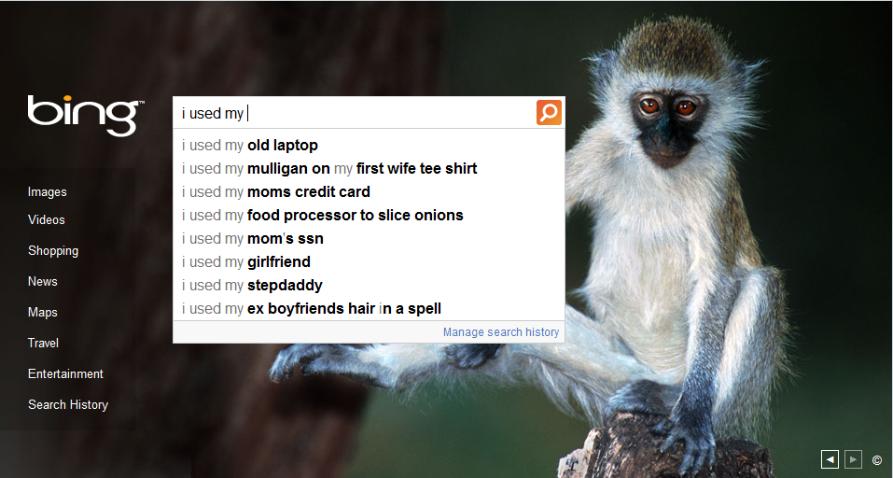
Notes:
We can see evidence of how people use information all over the Web.

Slide 5
Defining Behavioral Log Data
Behavioral log data are:
  Traces of natural behavior, seen through a sensor
    Examples: Links clicked, queries issued, tweets posted
  Real-world, large-scale, real-time
Behavioral log data are not:
  Non-behavioral sources of large-scale data
  Collected data (e.g., poll data, surveys, census data)
    Not recalled behavior or subjective impression
Notes:
The talk will focus on the use of log data to understand people and build better systems.
But before we dive in, let’s define what we mean by behavioral log data.
Example of a non-behavioral source: Large-scale astronomy data.

Slide 6
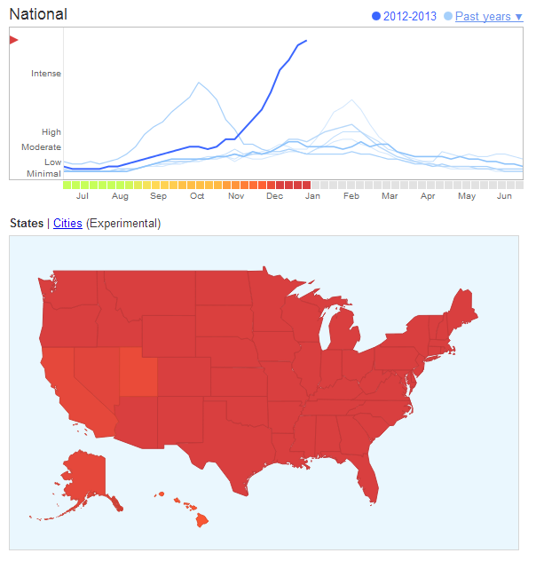
Real-World, Large-Scale, Real-Time
Private behavior is exposed
  Example: Porn queries, medical queries
Rare behavior is common
  Example: Observe 500 million queries a day
    Interested in behavior that occurs 0.002% of the time
    Still observe the behavior 10 thousand times a day!
New behavior appears immediately
  Example: Google Flu Trends

Slide 7
Overview
How behavioral log data can be used
Sources of behavioral log data
  Challenges with privacy and data sharing
Example: Query log analysis
  To understand people’s information needs
  To experiment with different systems
What behavioral logs cannot reveal
  How to address limitations

Slide 8
Practical Uses for Behavioral Data
Behavioral data to improve Web search
  Observational log analysis
    Example: Re-finding common, so add history support
  Log-based experiments
    Example: Interleave different rankings to find best algorithm
  Log-based functionality
    Example: Boost clicked results in a search result list
Behavioral data on the desktop
  Goal: Allocate editorial resources to create Help docs
  How to do so without knowing what people search for?
Notes:
Web search an example of successful use of log data.
On the desktop, it’s much harder to understand use and build better tools!

Slide 9
Value of Observing Behavior
Focus of observational log analysis
  Description: What do people currently do?
  Prediction: What will people do in similar situations?
Study real behavior in natural settings
Understand how people search
Identify real problems to study
Improve ranking algorithms
Influence system design
Create realistic simulations and evaluations
Build a picture of human interest

Slide 10
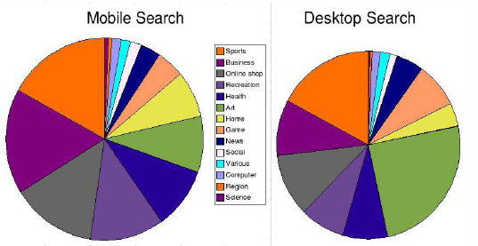
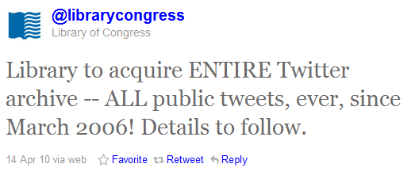
Societal Uses of Behavioral Data
Understand people’s information needs
Understand what people talk about
Impact public policy? (E.g., DonorsChoose.org)
[Baeza Yates et al. 2007]
Notes:
DonorsChoose.org running a contest to analyze educational donation data
In a way that positively impacts educational policy in the US.
http://developer.donorschoose.org/the-data

Slide 11
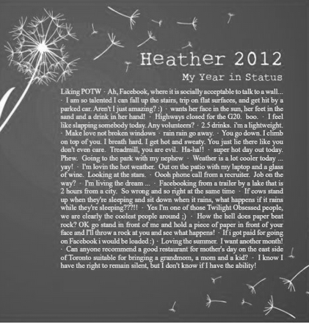
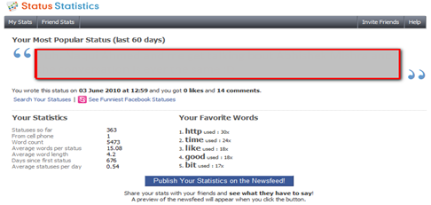
Personal Use of Behavioral Data
Individuals now have a lot of behavioral data
Introspection of personal data popular
  My Year in Status
  Status Statistics
Expect to see more
  As compared to others
  For a purpose

Slide 12
Overview
Behavioral logs give practical, societal, personal insight
Sources of behavioral log data
  Challenges with privacy and data sharing
Example: Query log analysis
  To understand people’s information needs
  To experiment with different systems
What behavioral cannot reveal
  How to address limitations

Slide 13
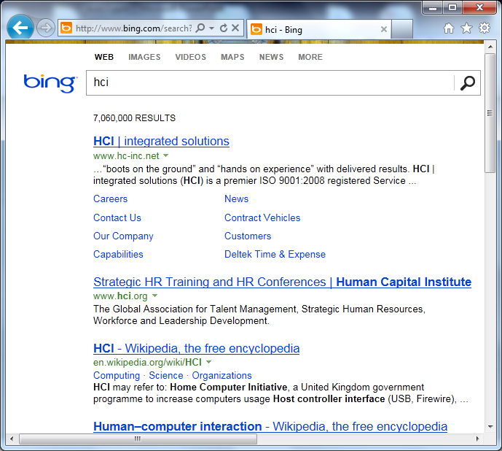
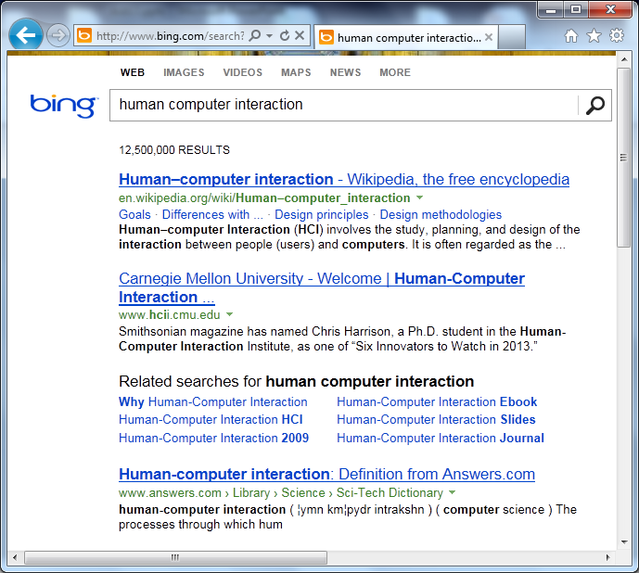
Web Service Logs
Example sources
  Search engines
  Commercial websites
Types of information
  Behavior: Queries, clicks
  Content: Results, products
Example analysis
  Query ambiguity
  Teevan, Dumais & Liebling. To Personalize or Not to Personalize: Modeling Queries with Variation in User Intent. SIGIR 2008
Companies
Wikipedia disambiguation
HCI

Slide 14
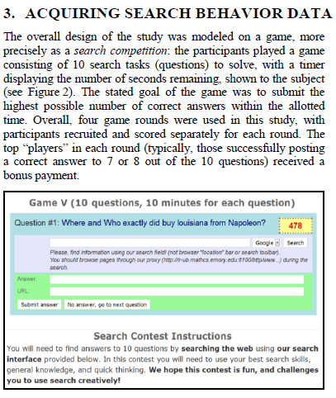
Controlled Web Service Logs
Example sources
  Mechanical Turk
  Games with a purpose
Types of information
  Logged behavior
  Active feedback
Example analysis
  Search success
  Ageev, Guo, Lagun & Agichtein. Find It If You Can: A Game for Modeling … Web Search Success Using Interaction Data. SIGIR 2011j

Slide 15
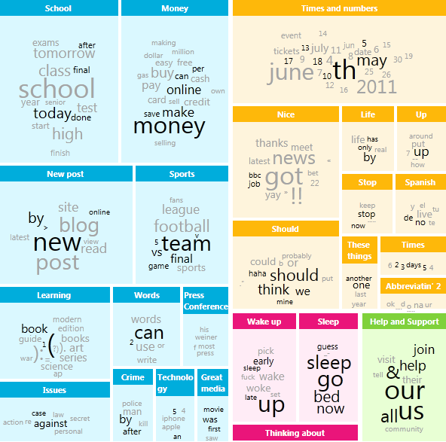
Public Web Service Content
Example sources
  Social network sites
  Wiki change logs
Types of information
  Public content
  Dependent on service
Example analysis
  Twitter topic models
  Ramage, Dumais & Liebling. Characterizing microblogging using latent topic models. ICWSM 2010 j
http://twahpic.cloudapp.net
Notes:
Sometimes Web services expose data from their logs.

Slide 16
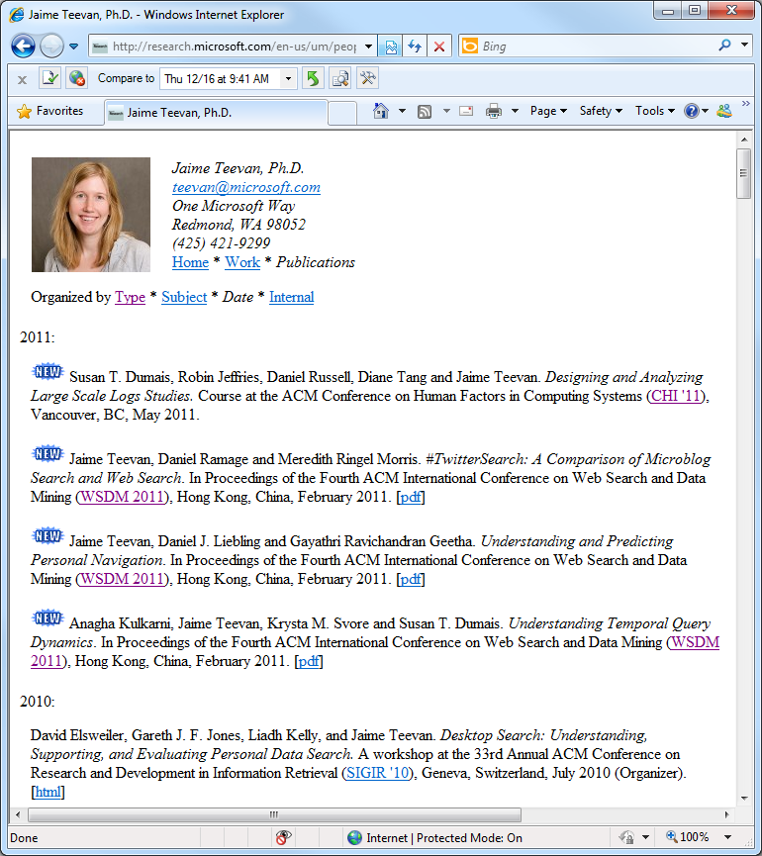
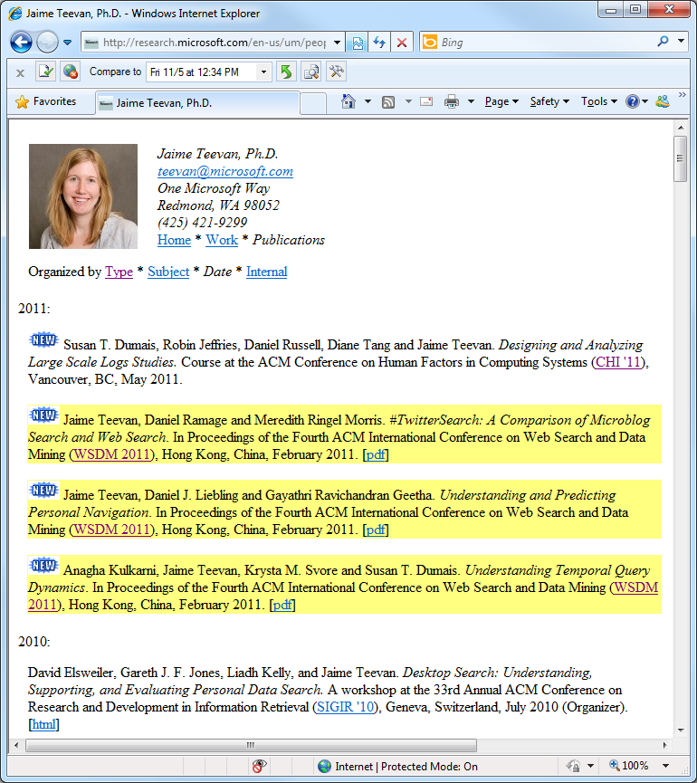
Web Browser Logs
Example sources
  Proxies
  Toolbar
Types of information
  Behavior: URL visit
  Content: Settings, pages
Example analysis
  Diff-IE
  Teevan, Dumais & Liebling. A Longitudinal Study of How Highlighting Web Content Change Affects .. Interactions. CHI 2010

Slide 17
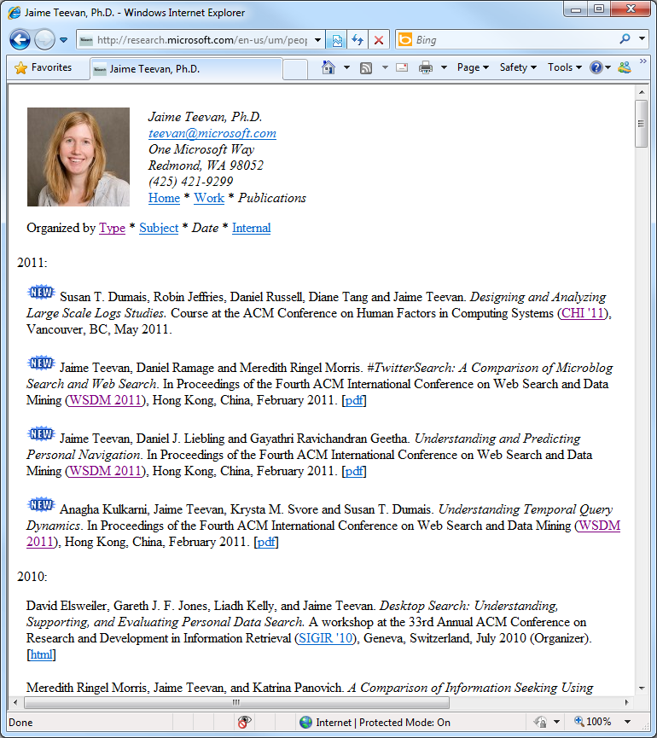
Web Browser Logs
Example sources
  Proxies
  Toolbar
Types of information
  Behavior: URL visit
  Content: Settings, pages
Example analysis
  Webpage revisitation
  Adar, Teevan & Dumais. Large Scale Analysis of Web Revisitation Patterns. CHI 2008
Notes:
As with Web services,
sometimes you can get access to this type of data
But don’t have control of the specifics of the data being collected.
We will talk later about how to supplement the data to build a richer understanding.

Slide 18
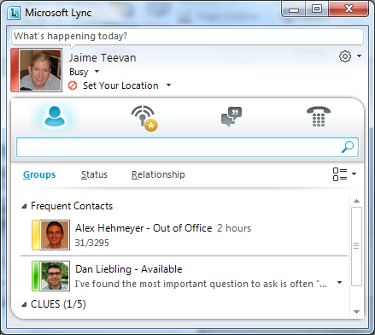
Client-Side Logs
Example sources
  Client application
  Operating system
Types of information
  Web client interactions
  Other interactions – rich!
Example analysis
  Lync availability
  Teevan & Hehmeyer. Understanding How the Projection of Availability State Impacts the Reception... CSCW 2013

Slide 19
Types of Logs Rich and Varied
Sources of Log Data
Types of Information Logged
Web services
  Search engines
  Commerce sites
Public Web services
  Social network sites
  Wiki change logs
Web Browsers
  Proxies
  Toolbars or plug-ins
Client applications
Interactions
  Posts, edits
  Queries, clicks
  URL visits
  System interactions
Context
  Results
  Ads
  Web pages shown
Notes:
Trade-offs:
Number of users
Control over the system
Amount of information you can collect

Slide 20
Public Sources of Behavioral Logs
Public Web service content
  Twitter, Facebook, Pinterest, Wikipedia
Research efforts to create logs
  Lemur Community Query Log Project
    http://lemurstudy.cs.umass.edu/
    1 year of data collection = 6 seconds of Google logs
Publicly released private logs
  DonorsChoose.org
    http://developer.donorschoose.org/the-data
  Enron corpus, AOL search logs, Netflix ratings
Notes:
Enron corpus, purchased by Andrew McCallum at UMass Amherst for $10k
Abdur Chowdhury released AOL logs to support information retrieval community right before SIGIR

Slide 21
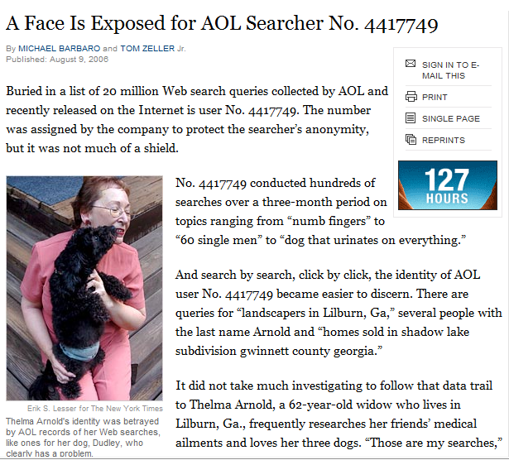
Example: AOL Search Dataset
August 4, 2006: Logs released to academic community
  3 months, 650 thousand users, 20 million queries
  Logs contain anonymized User IDs
August 7, 2006: AOL pulled the files, but already mirrored
August 9, 2006: New York Times identified Thelma Arnold
  “A Face Is Exposed for AOL Searcher No. 4417749”
  Queries for businesses, services in Lilburn, GA (pop. 11k)
  Queries for Jarrett Arnold (and others of the Arnold clan)
  NYT contacted all 14 people in Lilburn with Arnold surname
  When contacted, Thelma Arnold acknowledged her queries
August 21, 2006: 2 AOL employees fired, CTO resigned
September, 2006: Class action lawsuit filed against AOL
  AnonID Query QueryTime ItemRank ClickURL
  ---------- --------- --------------- ------------- ------------
  1234567 uw cse 2006-04-04 18:18:18 1 http://www.cs.washington.edu/
  1234567 uw admissions process 2006-04-04 18:18:18 3 http://admit.washington.edu/admission
  1234567 computer science hci 2006-04-24 09:19:32
  1234567 computer science hci 2006-04-24 09:20:04 2 http://www.hcii.cmu.edu
  1234567 seattle restaurants 2006-04-24 09:25:50 2 http://seattletimes.nwsource.com/rests
  1234567 perlman montreal 2006-04-24 10:15:14 4 http://oldwww.acm.org/perlman/guide.html
  1234567 uw admissions notification 2006-05-20 13:13:13
  …
Notes:
Released at SIGIR 2006
Thelma Arnold, a 62 year old woman from Lilburn, GA
Lawsuit asking for $5000/user
http://en.wikipedia.org/wiki/AOL_search_data_scandal
http://www.nytimes.com/2006/08/09/technology/09aol.html?_r=1
Basic Collection Statistics
Dates: 01 March, 2006 - 31 May, 2006
Normalized queries:
36,389,567 lines of data
21,011,340 instances of new queries (w/ or w/o click-through)
7,887,022 requests for "next page" of results
19,442,629 user click-through events
16,946,938 queries w/o user click-through
10,154,742 unique (normalized) queries
657,426 unique user ID's
Please reference the following publication when using this collection:
G. Pass, A. Chowdhury, C. Torgeson. A Picture of Search. The First International Conference on Scalable Information Systems, Hong Kong, June 2006.

Slide 22
Example: AOL Search Dataset
Other well known AOL users
  User 711391 i love alaska
    http://www.minimovies.org/documentaires/view/ilovealaska
  User 17556639 how to kill your wife
  User 927
Anonymous IDs do not make logs anonymous
  Contain directly identifiable information
    Names, phone numbers, credit cards, social security numbers
  Contain indirectly identifiable information
    Example: Thelma’s queries
    Birthdate, gender, zip code identifies 87% of Americans
Notes:
User 927:
Inspired theatrical production by Katharine Clark Gray
User 711391:
Middle-aged woman, has an affair, ends it, tries to save her marriage.

Slide 23
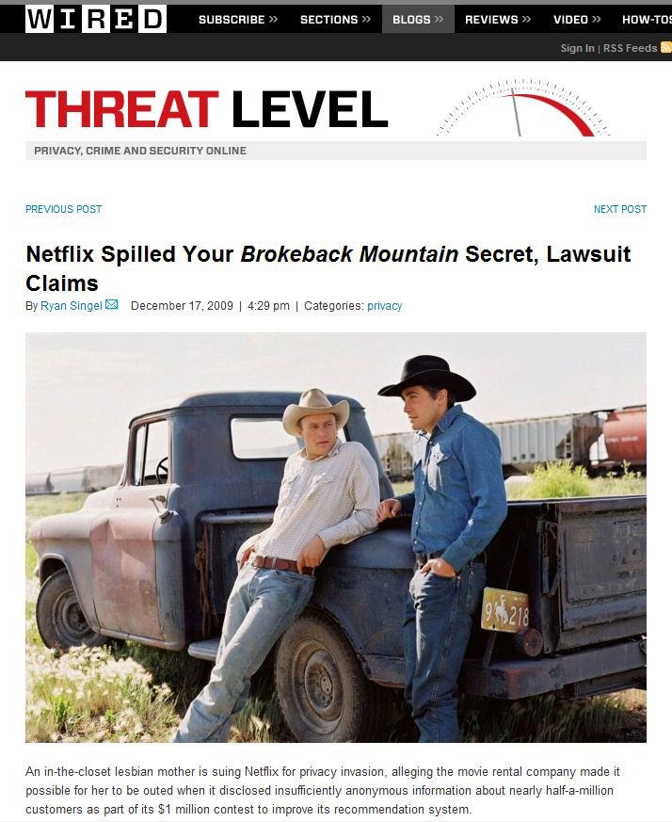
Example: Netflix Challenge
October 2, 2006: Netflix announces contest
  Predict people’s ratings for a $1 million dollar prize
  100 million ratings, 480k users, 17k movies
  Very careful with anonymity post-AOL
May 18, 2008: Data de-anonymized
  Paper published by Narayanan & Shmatikov
  Uses background knowledge from IMDB
  Robust to perturbations in data
December 17, 2009: Doe v. Netflix
March 12, 2010: Netflix cancels second competition
  Ratings
  1: [Movie 1 of 17770]
  12, 3, 2006-04-18 [CustomerID, Rating, Date]
  1234, 5 , 2003-07-08 [CustomerID, Rating, Date]
  2468, 1, 2005-11-12 [CustomerID, Rating, Date]
  …
  Movie Titles
  …
  10120, 1982, “Bladerunner”
  17690, 2007, “The Queen”
  …
    All customer identifying information has been removed; all that remains are ratings and dates. This follows our privacy policy. . . Even if, for example, you knew all your own ratings and their dates you probably couldn’t identify them reliably in the data because only a small sample was included (less than one tenth of our complete dataset) and that data was subject to perturbation.
Notes:
http://en.wikipedia.org/wiki/Netflix_Prize
http://www.netflixprize.com/
http://bits.blogs.nytimes.com/2009/09/21/netflix-awards-1-million-prize-and-starts-a-new-contest/?8au&emc=au
http://tech.fortune.cnn.com/2009/09/21/box-office-boffo-for-brainiacs-the-netflix-prize/
Netflix offered $1,000,000 prize for a 10% improvement in its recommendation system.
Netflix has also released a training dataset for the competing developers to train their systems.
While releasing this dataset they had provided a disclaimer:
To protect customer privacy, all personal information identifying individual customers has been removed and all customer ids have been replaced by randomly-assigned ids.
Netflix FAQ:
“No, all customer identifying information has been removed; all that remains are ratings and dates. This follows our privacy policy [. . . ] Even if, for example, you knew all your own ratings and their dates you probably couldn’t identify them reliably in the data because only
a small sample was included (less than one tenth of our complete dataset) and that data was subject to perturbation. Of course, since you know all your own ratings that really isn’t a privacy problem is it?”
An AT&T Research Team called BellKor combined with commendo's team BigChaos and others to win the 2009 grand prize.
The winning team algorithm called Pragmatic Chaos.
Used machine learning techniques to find:
The rating system people use of older movies is very different than for a movie they just saw
The mood of the day made a difference also. E.g.: Friday ratings different than Monday morning ratings.
Netflix is not the only available movie rating portal on the web.
Imdb also individuals can register and rate movies,
moreover they have the option of not keeping their details anonymous.
Narayanan and Shmatikov linked the Netflix database with the Imdb database (using the date of rating by a user)
to partly de-anonymize the Netflix training database.
http://www.cs.utexas.edu/~shmat/shmat_oak08netflix.pdf
Arvind Narayanan, Vitaly Shmatikov. Robust De-anonymization of Large Sparse Datasets. In IEEE Symposium on Security and Privacy 2008, p. 111–125.
In 2010, Netflix canceled a running contest to improve the company's recommendation algorithm due to privacy concerns.
Netflix was sued by KamberLaw L.L.C. and ended the contest after reaching a deal with the FTC.
Direct: nothing …
Indirect: linked private (Netflix ratings) w/ public (IMDB reviews) -- using infrequently rated movies and time
Also:
UMN Movie Lens research, SIGIR 2006
Dan Frankowski, Dan Cosley, Shilad Sen, Loren Terveen, John Riedl. You are what you say: privacy risks of public mentions.
Latanya Sweeney, CMU, 1997
Showed how to de-anonymize Massachusetts hospital discharge database by joining it with a public voter database.
Linked the anonymized GIC database (which retained the birthdate, sex, and zip code of each patient)
With voter registration records
to identify the medical record of the governor of Massachusetts.
k-Anonymity: Any algorithm or process that anonymizes data by insuring each entity in the data is indistinguishable from at least a specific number of other such entities in the data.
Differential Privacy: Dwork

Slide 24
Use Log Data Responsibly
Protect user privacy
  Directly identifiable information
    Social security, credit card, driver’s license numbers
  Indirectly identifiable information
    Names, locations, phone numbers … we’re all so vain! (e.g., AOL)
    Putting together multiple sources (e.g., Netflix, hospital records)
Control access to the data
  Internally: Access control, data retention policy
  Externally: Beware! (AOL, Netflix, Enron, Facebook public)
Transparency and user control
  Publicly available privacy policy
  Give users control to delete, opt-out, etc.

Slide 25
Overview
Behavioral logs give practical, societal, personal insight
Sources include Web services, browsers, client apps
  Public sources limited due to privacy concerns
Example: Query log analysis
  To understand people’s information needs
  To experiment with different systems
What behavioral logs cannot reveal
  How to address limitations

Slide 26
Query | Time | User
weather channel | 10:41 am Jan 15 | 142039
new york times | 10:44 am Jan 15 | 142039
snow storm prediction | 10:56 am Jan 15 | 142039
weather channel | 11:21 am Jan 15 | 659327
banana republic | 11:59 am Jan 15 | 318222
restaurants seattle | 12:01 pm Jan 15 | 318222
pikes market restaurants | 12:17 pm Jan 15 | 318222
james fogarty | 12:18 pm Jan 15 | 142039
daytrips in paris | 1:30 pm Jan 15 | 554320
weather channel | 1:30 pm Jan 15 | 659327
chi program | 2:32 pm Jan 15 | 435451
weather.com | 2:42 pm Jan 15 | 435451
snowstorm prediction | 4:56 pm Jan 15 | 142039
weather channel | 5:02 pm Jan 15 | 312055
xxx clubs in seattle | 10:14 pm Jan 15 | 142039
sex videos | 1:49 am Jan 15 | 142039
Notes:
A fun thought experiment for thinking about how comfortable people are about sharing their query logs:
Ask if anyone recognizes themselves here.
Expose some sex-related queries.
[Obviously, this is a fake query log – but it can feel scary regardless.]

Slide 27
Query | Time | User
weather channel | 10:41 am Jan 15 | 142039
new york times | 10:44 am Jan 15 | 142039
hot sex | 10:56 am Jan 15 | 142039
weather channel | 11:21 am Jan 15 | 659327
banana republic | 11:59 am Jan 15 | 318222
restaurants seattle | 12:01 pm Jan 15 | 318222
pikes market restaurants | 12:17 pm Jan 15 | 318222
james fogarty | 12:18 pm Jan 15 | 142039
daytrips in paris | 1:30 pm Jan 15 | 554320
porn videos | 1:30 pm Jan 15 | 659327
chi program | 2:32 pm Jan 15 | 435451
weather.com | 2:42 pm Jan 15 | 435451
snowstorm prediction | 4:56 pm Jan 15 | 142039
weather channel | 5:02 pm Jan 15 | 312055
xxx clubs in seattle | 10:14 pm Jan 15 | 142039
sex videos | 1:49 am Jan 15 | 142039
Data cleaning
pragmatics
Significant part of data analysis
Ensure cleaning is appropriate
Keep track of the cleaning process
Keep the original data around
  Example: ClimateGate
Language
社会科学
11:59 am Jan 37
12:01 pm Jan 37
System errors
cheap digital camera | 12:17 pm Jan 15 | 554320
cheap digital camera | 12:18 pm Jan 15 | 554320
cheap digital camera | 12:19 pm Jan 15 | 554320
Spam
Porn

Slide 28
Query | Time | User
weather channel | 10:41 am Jan 15 | 142039
new york times | 10:44 am Jan 15 | 142039
snow storm prediction | 10:56 am Jan 15 | 142039
weather channel | 11:21 am Jan 15 | 659327
banana republic | 11:59 am Jan 15 | 318222
restaurants seattle | 12:01 pm Jan 15 | 318222
pikes market restaurants | 12:17 pm Jan 15 | 318222
james fogarty | 12:18 pm Jan 15 | 142039
daytrips in paris | 1:30 pm Jan 15 | 554320
weather channel | 1:30 pm Jan 15 | 659327
chi program | 2:32 pm Jan 15 | 435451
weather.com | 2:42 pm Jan 15 | 435451
snowstorm prediction | 4:56 pm Jan 15 | 142039
weather channel | 5:02 pm Jan 15 | 312055
macaroons paris | 10:14 pm Jan 15 | 142039
ubiquitous sensing | 1:49 am Jan 15 | 142039

Slide 29
Query | Time | User
weather channel | 10:41 am Jan 15 | 142039
new york times | 10:44 am Jan 15 | 142039
snow storm prediction | 10:56 am Jan 15 | 142039
weather channel | 11:21 am Jan 15 | 659327
banana republic | 11:59 am Jan 15 | 318222
restaurants seattle | 12:01 pm Jan 15 | 318222
pikes market restaurants | 12:17 pm Jan 15 | 318222
james fogarty | 12:18 pm Jan 15 | 142039
daytrips in paris | 1:30 pm Jan 15 | 554320
weather channel | 1:30 pm Jan 15 | 659327
chi program | 2:32 pm Jan 15 | 435451
weather.com | 2:42 pm Jan 15 | 435451
snowstorm prediction | 4:56 pm Jan 15 | 142039
weather channel | 5:02 pm Jan 15 | 312055
macaroons paris | 10:14 pm Jan 15 | 142039
ubiquitous sensing | 1:49 am Jan 15 | 142039
Query typology

Slide 30
Query | Time | User
weather channel | 10:41 am Jan 15 | 142039
new york times | 10:44 am Jan 15 | 142039
snow storm prediction | 10:56 am Jan 15 | 142039
weather channel | 11:21 am Jan 15 | 659327
banana republic | 11:59 am Jan 15 | 318222
restaurants seattle | 12:01 pm Jan 15 | 318222
pikes market restaurants | 12:17 pm Jan 15 | 318222
james fogarty | 12:18 pm Jan 15 | 142039
daytrips in paris | 1:30 pm Jan 15 | 554320
weather channel | 1:30 pm Jan 15 | 659327
chi program | 2:32 pm Jan 15 | 435451
weather.com | 2:42 pm Jan 15 | 435451
snowstorm prediction | 4:56 pm Jan 15 | 142039
weather channel | 5:02 pm Jan 15 | 312055
macaroons paris | 10:14 pm Jan 15 | 142039
ubiquitous sensing | 1:49 am Jan 15 | 142039
Query typology
Query behavior

Slide 31
Query | Time | User
weather channel | 10:41 am Jan 15 | 142039
new york times | 10:44 am Jan 15 | 142039
snow storm prediction | 10:56 am Jan 15 | 142039
weather channel | 11:21 am Jan 15 | 659327
banana republic | 11:59 am Jan 15 | 318222
restaurants seattle | 12:01 pm Jan 15 | 318222
pikes market restaurants | 12:17 pm Jan 15 | 318222
james fogarty | 12:18 pm Jan 15 | 142039
daytrips in paris | 1:30 pm Jan 15 | 554320
weather channel | 1:30 pm Jan 15 | 659327
chi program | 2:32 pm Jan 15 | 435451
weather.com | 2:42 pm Jan 15 | 435451
snowstorm prediction | 4:56 pm Jan 15 | 142039
weather channel | 5:02 pm Jan 15 | 312055
macaroons paris | 10:14 pm Jan 15 | 142039
ubiquitous sensing | 1:49 am Jan 15 | 142039
Uses of Analysis
Ranking
  E.g., precision
System design
  E.g., caching
User interface
  E.g., history
Test set development
Complementary research
Query typology
Query behavior
Long term trends

Slide 32
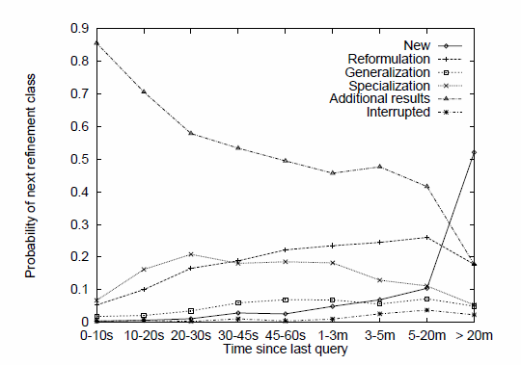

Things Observed in Query Logs
Summary measures
  Query frequency
  Query length
Analysis of query intent
  Query types and topics
Temporal features
  Session length
  Common re-formulations
Click behavior
  Relevant results for query
  Queries that lead to clicks
Queries appear 3.97 times
[Silverstein et al. 1999]
2.35 terms
[Jansen et al. 1998]
Navigational, Informational, Transactional
[Broder 2002]
Sessions 2.20 queries long
[Silverstein et al. 1999]
[Lau and Horvitz, 1999]
[Joachims 2002]
Notes:
Important to start analysis with summary of data
Especially on new datasets
Because sometimes this can be surprising, and indicate new issues

Slide 33
Surprises About Query Log Data
From early log analysis
  Examples: Jansen et al. 2000, Broder 1998
Queries are not 7 or 8 words long
Advanced operators not used or “misused”
Nobody used relevance feedback
Lots of people search for sex
Navigation behavior common
Prior experience was with library search
Notes:
Over the past 10 to 15 years, we’ve developed a pretty good picture of what Web search looks like
But when we first started looking at Web search, we didn’t really know much about what to expect.
It’s interesting to go back and read early Web search papers, and see what surprised people that we now take for granted.
(If for nothing else than for scale. A term was common if it occurred more than 100 times!)

Slide 34
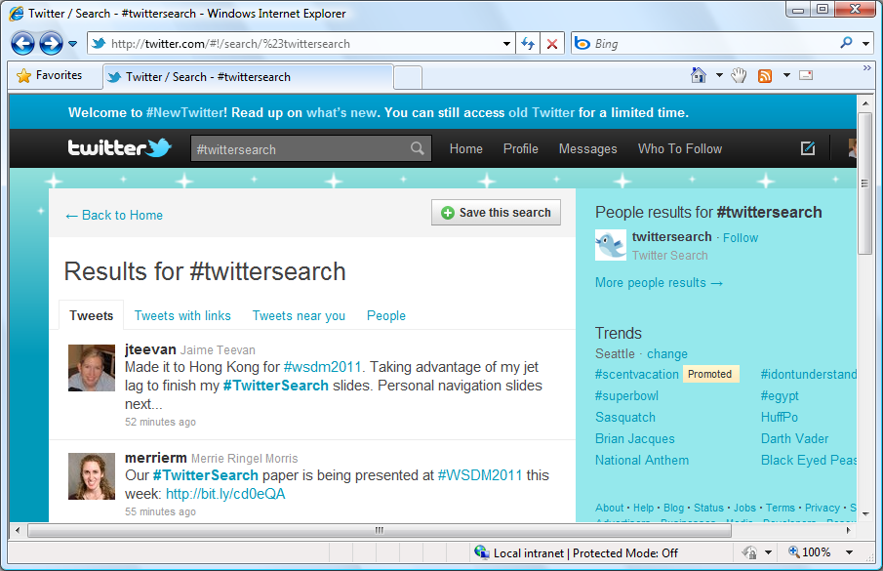
Surprises About Microblog Search?
Notes:
Same thing happens when we look at microblog search,
where we carry over our Web search experience

Slide 35
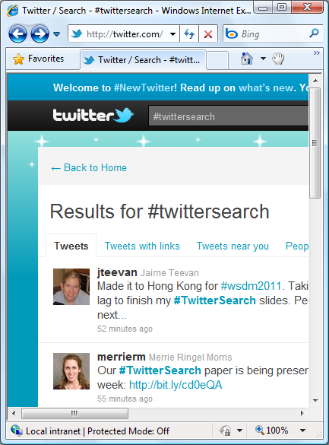
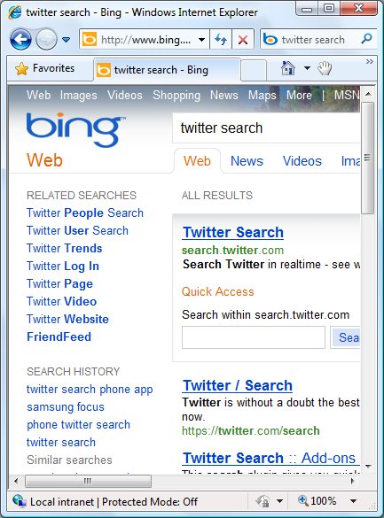
Surprises About Microblog Search?
Ordered
by time
Ordered by relevance
8 new tweets

Slide 36
Surprises About Microblog Search?
Time important
People important
Specialized syntax
Queries common
Repeated a lot
Change very little
Often navigational
Time and people less important
No syntax use
Queries longer
Queries develop
Ordered
by time
Ordered by relevance
8 new tweets

Slide 37
Partitioning the Data
Corpus
Language
Location
Device
Time
User
System variant
[Baeza Yates et al. 2007]
Notes:
Make sure partitions are balanced and fair

Slide 38
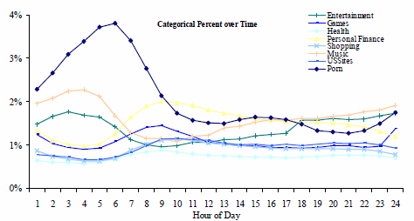
Partition by Time
Periodicities
Spikes
Real-time data
  New behavior
  Immediate feedback
Individual
  Within session
  Across sessions
[Beitzel et al. 2004]

Slide 39
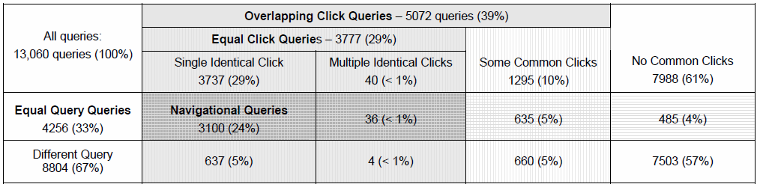
Partition by User
Temporary ID (e.g., cookie, IP address)
  High coverage but high churn
  Does not necessarily map directly to users
User account
  Only a subset of users
[Teevan et al. 2007]

Slide 40
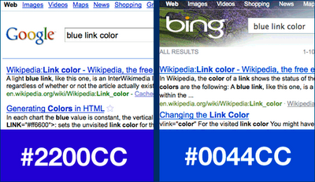
Partition by System Variant
Also known as controlled experiments
Some people see one variant, others another
Example: What color for search result links?
  Bing tested 40 colors
  Identified #0044CC
  Value: $80 million

Slide 41
Everything is Significant
Everything is significant, but not always meaningful
  Choose the metrics you care about first
  Look for converging evidence
Choose comparison group carefully
  From the same time period
  Log a lot because it can be hard to recreate state
  Confirm with metrics that should be the same
High variance, calculate empirically
Look at the data

Slide 42
Overview
Behavioral logs give practical, societal, personal insight
Sources include Web services, browsers, client apps
  Public sources limited due to privacy concerns
Partition query logs to view interesting slices
  By corpus, time, individual
  By system variant = experiment
What behavioral logs cannot reveal
  How to address limitations

Slide 43
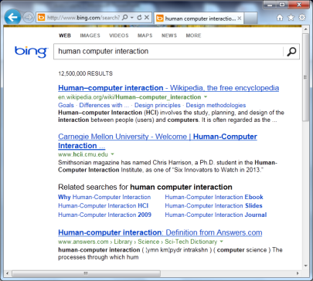
What Logs Cannot Tell Us
People’s intent
People’s success
People’s experience
People’s attention
People’s beliefs of what happens
Behavior can mean many things
  81% of search sequences ambiguous
  [Viermetz et al. 2006]
7:12 – Query
7:14 – Click Result 1
7:15 – Click Result 3
<Back to results>
<Back to results>
7:16 – Try new engine
<Open in new tab>
<Open in new tab>
7:16 – Read Result 1
7:20 – Read Result 3
7:27 –Save links locally
Notes:
Limited to what’s available:
People may want to use facets, but you can’t see it (cheap, highly rated, recent)
People can’t search for old information on Twitter
You only see what people want with the tools they have available.
Don’t know when people are confused. E.g., people think they’re in Web search and searching on image search

Slide 44
Example: Click Entropy
Question: How ambiguous is a query?
Approach: Look at variation in clicks
[Teevan et al. 2008]
Measure: Click entropy
  Low if no variation
    human computer …
  High if lots of variation
    hci
Companies
Wikipedia disambiguation
HCI
HCI

Slide 45
Which Has Less Variation in Clicks?
www.usajobs.gov v. federal government jobs
find phone number v. msn live search
singapore pools v. singaporepools.com
tiffany v. tiffany’s
nytimes v. connecticut newspapers
campbells soup recipes v. vegetable soup recipe
soccer rules v. hockey equipment
?
Results change
Result entropy = 5.7 Result entropy = 10.7
?
Result quality varies
Click position = 2.6 Click position = 1.6
?
Tasks impacts # of clicks
Clicks/user = 1.1 Clicks/user = 2.1
Notes:
Correlation of click entropy and result entropy: 0.53
Correlation of click entropy and click position: 0.73
Correlation of click entropy and clicks/user: 0.73

Slide 46
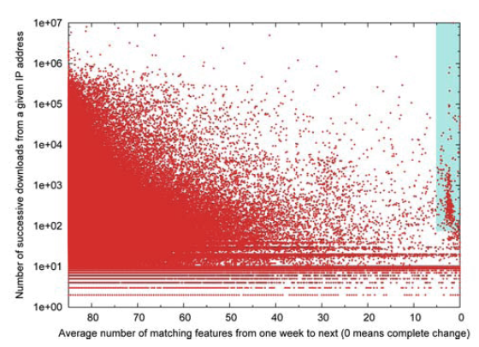
Beware of Adversaries
Robots try to take advantage your service
  Queries too fast or common to be a human
  Queries too specialized (and repeated) to be real
Spammers try to influence your interpretation
  Click-fraud, link farms, misleading content
Never-ending arms race
  Look for unusual clusters of behavior
Adversarial use of log data
[Fetterly et al. 2004]
Notes:
Spam, Damn Spam, and Statistics: Using statistical analysis to locate spam web pages. D. Fetterly, M. Manasse and M. Najork. 7th Int’l Workshop on the Web and Databases, June 2004.

Slide 47
Beware of Tyranny of the Data
Can provide insight into behavior
  Example: What is search for, how needs are expressed
Can be used to test hypotheses
  Example: Compare ranking variants or link color
Can only reveal what can be observed
Cannot tell you what you cannot observe
  Example: Nobody uses Twitter to re-find

Slide 48

Supplementing Log Data
Enhance log data
  Collect associated information
    Example: For browser logs, crawl visited webpages
  Instrumented panels
Converging methods
  Usability studies
  Eye tracking
  Surveys
  Field studies
  Diary studies

Slide 49
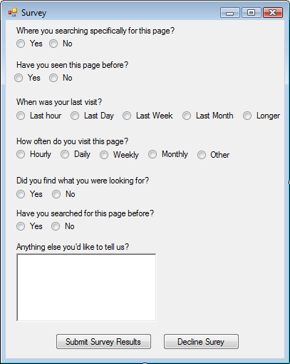
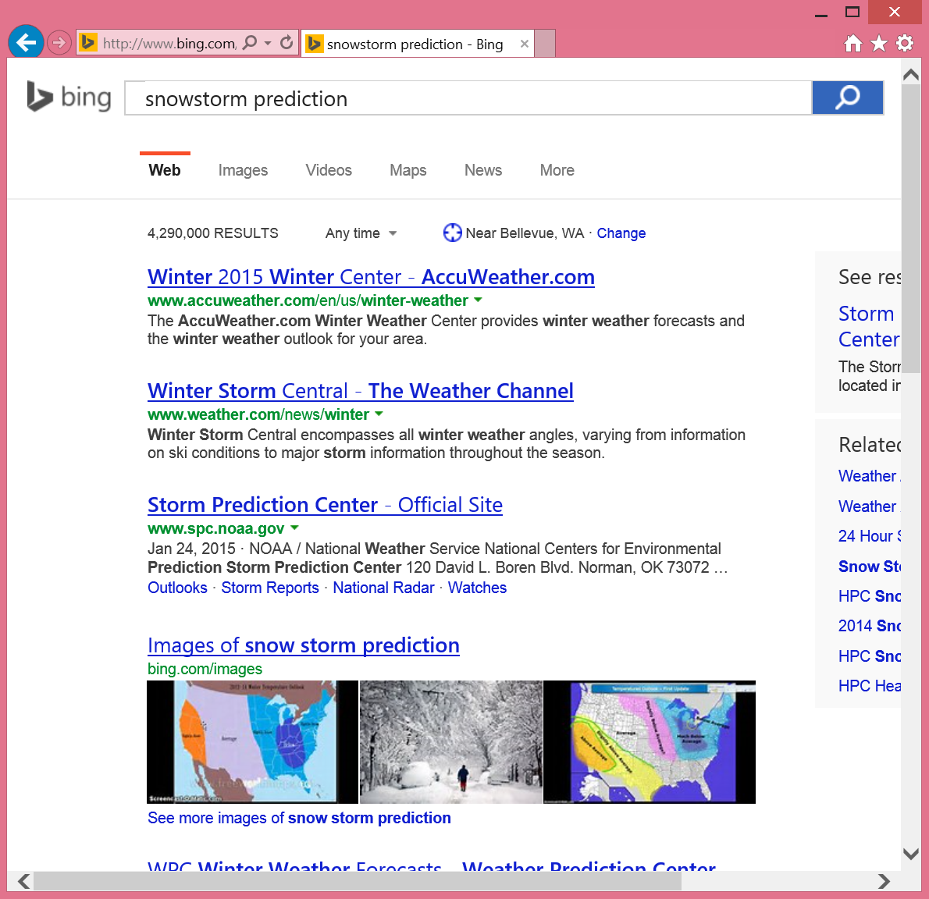
Example: Re-Finding Intent
Large-scale log analysis of re-finding
[Tyler and Teevan 2010]
  Do people know they are re-finding?
  Do they mean to re-find the result they do?
  Why are they returning to the result?
Small-scale critical incident user study
  Browser plug-in that logs queries and clicks
  Pop up survey on repeat clicks and 1/8 new clicks
Insight into intent + Rich, real-world picture
  Re-finding often targeted towards a particular URL
  Not targeted when query changes or in same session
Notes:
Re-finding often targeted at a particular URL
But sometimes accidental, particularly when:
Query changes
Within same session

Slide 50
Summary
Behavioral logs give practical, societal, personal insight
Sources include Web services, browsers, client apps
  Public sources limited due to privacy concerns
Partition query logs to view interesting slices
  By corpus, time, individual
  By system variant = experiment
Behavioral logs are powerful but not complete picture
  Can expose small differences and tail behavior
  Cannot expose motivation, which is often adversarial
  Look at the logs and supplement with complementary data

Slide 51
Questions?
Jaime Teevan
teevan@microsoft.com

Slide 52
References
Adar, E. , J. Teevan & S.T. Dumais. Large scale analysis of Web revisitation patterns. CHI 2008.
Baeza Yates, B., G. Dupret & J. Velasco. A study of mobile search queries in Japan. Query Log Analysis: Social and Technological Challenges. WWW 2007.
Beitzel, S.M., E.C. Jensen, A. Chowdhury, D. Grossman & O. Frieder. Hourly analysis of a very large topically categorized Web query log. SIGIR 2004.
Broder, A. A taxonomy of Web search. SIGIR Forum 2002.
Dumais, S.T., R. Jeffries, D.M. Russell, D. Tang & J. Teevan. Understanding user behavior through log data and analysis. Ways of Knowing 2014.
Fetterly, D., M. Manasse, & M. Najork. Spam, damn spam, and statistics: Using statistical analysis to locate spam Web pages. Workshop on the Web and Databases 2004.
Jansen, B.J., A. Spink, J. Bateman & T. Saracevic. Real life information retrieval: A study of user queries on the Web. SIGIR Forum 1998.
Joachims, T. Optimizing search engines using clickthrough data. KDD 2002.
Lau, T. & E. Horvitz. Patterns of search: Analyzing and modeling Web query refinement. User Modeling 1999.
Marshall, C.C. The future of annotation in a digital (paper) world. GSLIS Clinic 1998.
Narayanan, A. & V. Shmatikov. Robust de-anonymization of large sparse datasets. IEEE Symposium on Security and Privacy 2008.
Silverstein, C., Henzinger, M., Marais, H. & Moricz, M. Analysis of a very large Web search engine query log. SIGIR Forum 1999.
Teevan, J., E. Adar, R. Jones & M. Potts. Information re-retrieval: Repeat queries in Yahoo's logs. SIGIR 2007.
Teevan, J., S.T. Dumais & D.J. Liebling. To personalize or not to personalize: Modeling queries with variation in user intent. SIGIR 2008.
Teevan, J., S.T. Dumais & D.J. Liebling. A longitudinal study of how highlighting Web content change affects people's Web interactions. CHI 2010.
Teevan, J. & A. Hehmeyer. Understanding How the Projection of Availability State Impacts the Reception of Incoming Communication. CSCW 2013.
Teevan, J., D. Ramage & M. R. Morris. #TwitterSearch: A comparison of microblog search and Web search. WSDM 2011.
Tyler, S. K. & J. Teevan. Large scale query log analysis of re-finding. WSDM 2010.
Viermetz, M., C. Stolz, V. Gedov & M. Skubacz. Relevance and impact of tabbed browsing behavior on Web usage mining. Web Intelligence 2006.

