Slide 1
Finding and Re-Finding Personal Information
Jaime Teevan
Microsoft Research
Notes:
Lecture at INSC 598a (Spring 2008)
Topic: Finding and re-finding PIM
Length: 20 to 40 minutes
Location: MGH 253
Date: April 15 at 2pm

Slide 2
How YOU Find and Re-Find
Email
  What’s the last email you read? Did you file it?
  Have you gone back to an email you read before?
Web
  What’s the last Web page you (re-)visited?
  Have you looked for anything on the Web?
Files
  What’s the last file you accessed? How did you?
  Have you looked for a file?
Notes:
How many people have searched for email, Web, files?
Which of these items had you seen before?
Were you looking for a piece of information?
Did you use a keyword search engine in the process?

Slide 3
What is Different about Finding Personal Information?
Target is often clearly defined
A lot of re-finding
Know lots of meta-data
Know target exists
Searcher decided how information was kept

Slide 4
Study of How People Find PI
Teevan, J., C. Alvarado, M. S. Ackerman, and D. R. Karger (2004). The Perfect Search Engine is Not Enough: A Study of Orienteering Behavior in Directed Search. In Proceedings of CHI 2004, Vienna, Austria.

Slide 5
Study of How People Find PI
Modified diary study of finding behavior
Ten interviews each (2/day x 5 days)
Two question types
  Last email/file/Web page looked at
  Last email/file/Web page looked for
Supplemented with direct observation and an hour-long semi-structured interview
Subjects: 15 CS graduate students

Slide 6
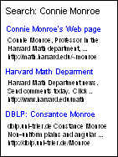
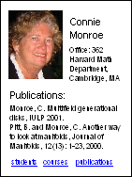
Directed Search: Expectation
Target: Connie Monroe’s office number
→ Type into a search engine:
“Connie Monroe, office number”

Slide 7
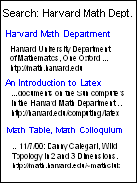

Directed Search: Observed
Interviewer: Have you looked for anything on the Web today?
Jim: I had to look for the office number of the Harvard professor.
I: So how did you go about doing that?
J: I went to the homepage of the Math department at Harvard

Slide 8
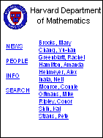
Directed Search: Observed
I: So you went to the Math department, and then what did you do over there?
J: It had a place where you can find people and I went to that page and they had a dropdown list of visiting faculty, and so I went to that link and I looked for her name and there it was.

Slide 9
Directed Search: Observed
J: I knew that she had a very small Web page saying, “I’m here at Harvard. Here’s my contact information.”

Slide 10

Strategies Looking for Information
Teleporting
Orienteering

Slide 11
Why Do People Orienteer?
Easier than saying what you want
You know where you are
You know what you find
Teleporting tools don’t work

Slide 12
Easier Than Saying What You Want
Habit
  “Whichever way I remember first.”
Describing the target is hard
  Can’t
  Prefer not to
Search for source
  E.g., Your last email search

Slide 13
Easier Than Saying What You Want
People know a lot of meta-data
Commonly used meta-data in PIM
  People
  Time
  Document type
Meta-data often conceptual
  Person v. email address
  Time v. last modified time

Slide 14
You Know Where You Are
Stay in known space
  URL manipulation
  Bookmarks
  History
Backtracking
  Following an information scent
  Never end up at a dead end

Slide 15
You Know What You Find
Context gives understanding of answer
“I was looking for a specific file. But even when I saw its name, I wouldn’t have known that that was the file I wanted until I saw all of the other names in the same directory…”
Understanding negative results
“I basically clicked on every single button until I was convinced… I don’t think that it exists…”

Slide 16
Individual Factors Affect Finding
Search expertise
Domain expertise
Learning style
Organizational style
Notes:
E.g., holistic learners (start with big picture) are more exploratory in their search behavior

Slide 17
Organization and Finding
Categorize based on email usage
People who pile information take small steps
People who file information take big steps
Filers
Pilers

Slide 18
How Individuals Search For Files
Filers
Big steps
Pilers
Small steps
Notes:
Irony: Those people who had their information well classified don’t take advantage of their classification to get to their information
While people who had their information all in a jumble wanted to sort through that jumble.
Similar on the Web.
Pilers were more likely to navigate to a specific site and do site search, an orienteering behavior
While filers used a general purpose search engine like Google more often.

Slide 19
Searching to Eliminate PIM
Organizing and finding behavior related
Future value of information hard to predict
  Post-valued recall
Will better search make PIM unnecessary?
  Keyword search engines alone won’t!
  Provide orienteering benefits (recognition, context)
  Support reminding
What value do we get from organizing?

Slide 20
Applying What We Learned
Multi-stepped finding
  You know where you are
  You know where you are
  You know what you find
Individual differences
  Step size varies
Target often well defined
  Make search process interactive
  Integrate different tools used for different steps
  Support exhaustive search
  Support different step sizes
  Highlight sources that contain target type

Slide 21
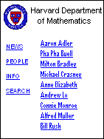
Re-Finding Involves Expectation
All must be the same to re-find the information!
.. But new information can be valuable.

Slide 22
Re-Finding Involves Expectation
Solution: Preserve what user expects
Supports orienteering for re-finding
Allows access to new information

Slide 23






“Pick a card, any card!”

Slide 24
Case 1 Case 2 Case 3 Case 4 Case 5 Case 6
Abracadabra!

Slide 25





Your Card is Gone!

Slide 26
People Forget a Lot

Slide 27
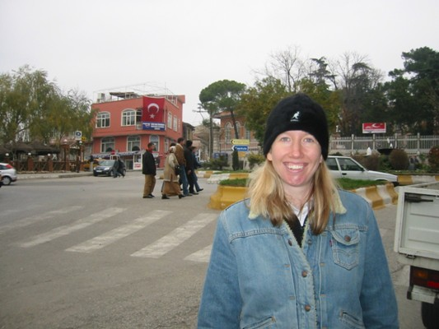
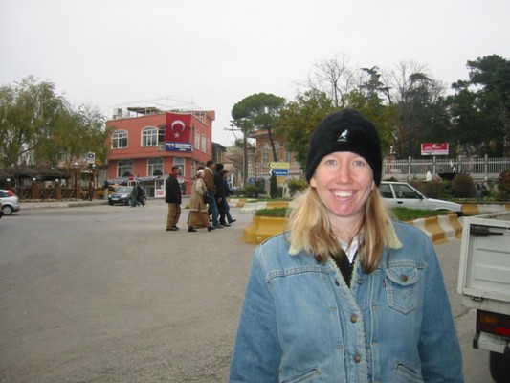
Change Blindness

Slide 28
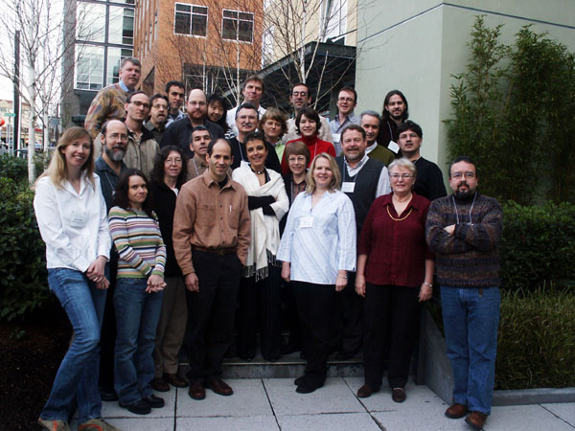
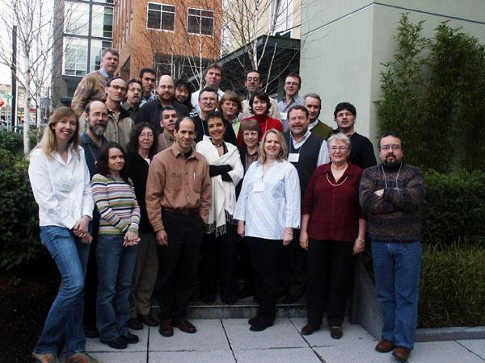
Change Blindness

Slide 29
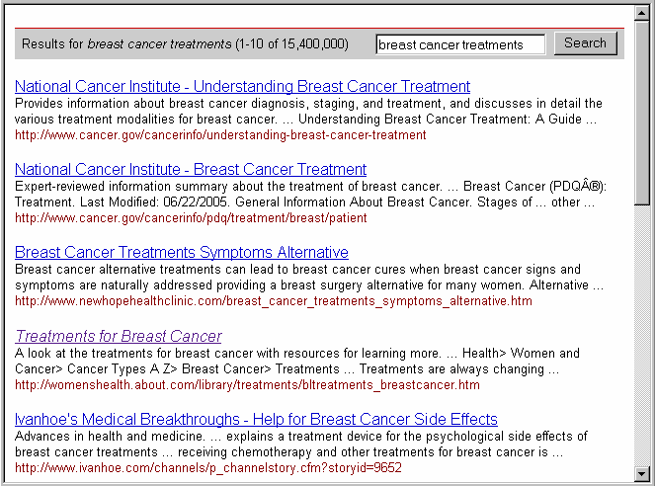
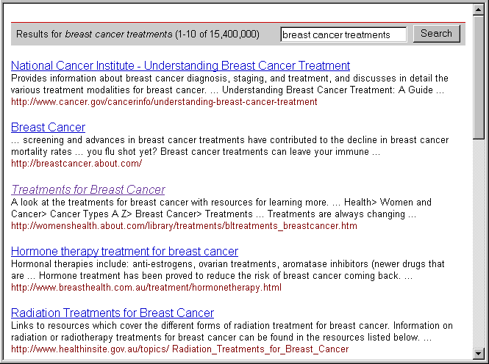

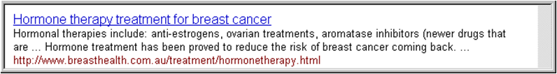
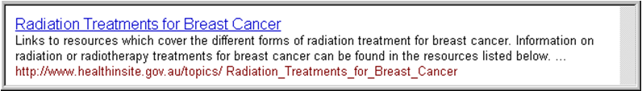

Slide 30
Preserve What User Remembers
E.g., example changed during presentation

Slide 31
Summary
Personal Information searches unique
  Lots of re-finding
  Lots of meta-data
  Lots of directed search
  Lots of orienteering
Individual differences matter
Finding and organizing related
Important to match people’s expectations

Slide 32
Thank you
Jaime Teevan, teevan@microsoft.com

